Slide 1
California Community College Technology Center Project Spam Filter

Slide 2
Weekly Update Oct 12, 2017

Slide 3
Post-Review Execution Strategy
Previous Proposal
New Proposal (Based on Tim’s Suggestion)
Transform
Use Rulesets to augment current Fraud Tagging
Complete ML Initial Model Development
Deploy
Work with colleges to do good tagging of new applications
Complete ML Phase 2 - Model Tuning/Refining
Transform
Complete ML Initial Model Development (Use Allan Hancock College)
Deployment Readiness
Work with colleges to do good tagging of new applications
Complete ML Phase 2 - Model Tuning/Refining
Deploy
New Proposal: Steps 1-3 will happen in Parallel with Step 4

Slide 4
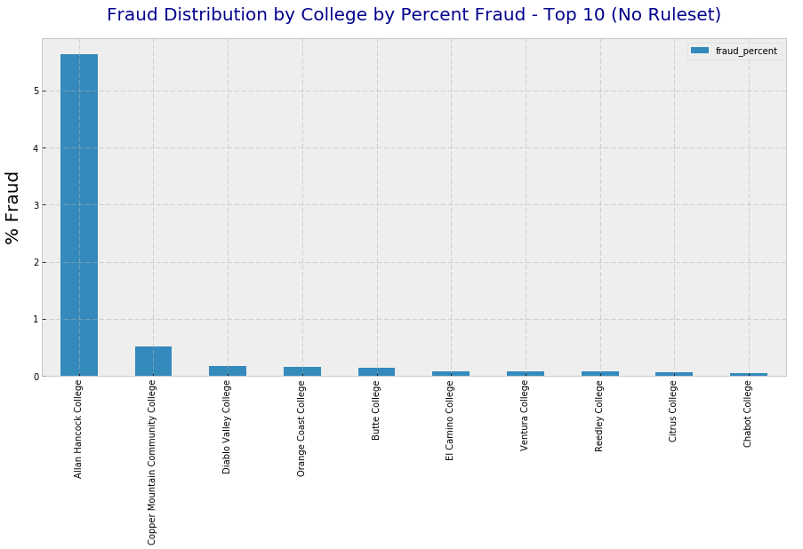
No Filters: % Fraud by College
Allan Hancock clearly dominant

Slide 5
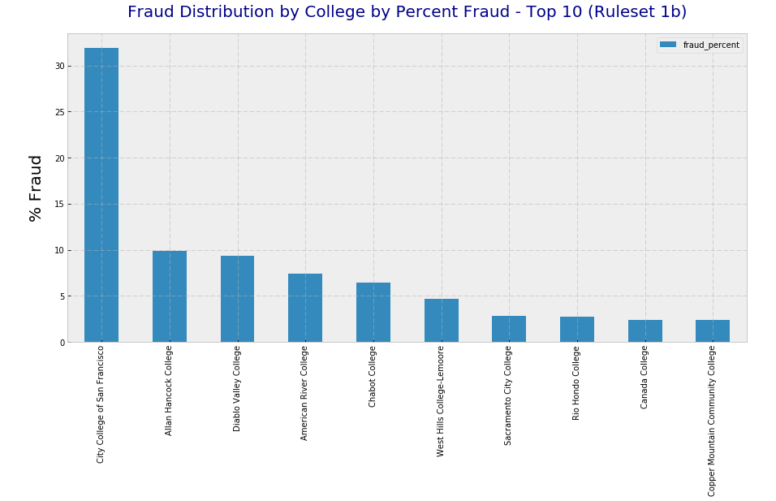
AppTime < 1 min: % Fraud by College
City College of San Francisco significantly higher

Slide 6
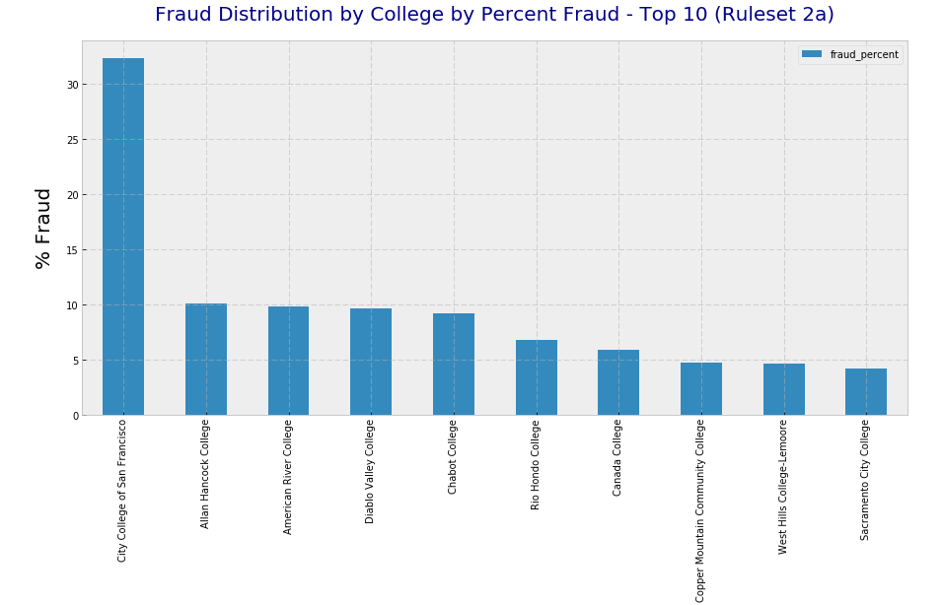
AppTime < 1 min + Email Domain Filter
Recommendation: Target Top 3-4 Colleges for Pilot

Slide 7
Weekly Update Sep 26, 2017

Slide 8
Activity
Infrastructure
Instance scaling to 32GB. (Will likely require larger footprint.)
Setting up third instance for additional team member
Phase 1 EDA Continuation
Added IP address, Email domain analysis
Performed in-depth analysis on application time
Generate detailed Phase 1 EDA document
Phase 2 EDA
ETL Complete: Merged all batches of data. Merged fraud classified data
EDA in progress
Transform
Did preparatory work for Label Encoding

Slide 9
Plans
Infrastructure
Potential Compute Scaling & Windows Instance (Placeholder).
Continue Exploratory Analysis on Phase 2 data [SeyVu]
Extrapolate Phase 1 analysis vectors in Phase 2
Explore college level breakdown analysis
Explore rule-set to tagged “potential” fraud
Would like to review this with CCCTC in meeting next week

Slide 10
Receivables
Phase 2 (Non-PII) Data [Jigish]
Email domain information for Phase 2 data

Slide 11
Weekly Update Sep 18, 2017

Slide 12
Activity
Infrastructure
Multiple instances Setup; File share enabled
Debugged instance performance issues. Upgraded to 8GB memory instances
Reviewed Project Milestones / Details
Revised SmartSheet Tasks; Added end goals for each project phase
Continued with Exploratory Analysis on Phase 1 data
Analyzed most application sections. Extracted key insights where relevant

Slide 13
Plans
Infrastructure
Scale to 16GB Memory footprint to support ML computational needs
Data Extraction, ETL
Extract Phase 2 (Non-PII only) data
Prepare data for EDA/ML work
Continue Exploratory Data Analysis on Phase 1 [SeyVu]
Study IP Address, Email domain distribution
Start Exploratory Analysis on Phase 2 data [SeyVu]
Evaluate need for Windows instances [SeyVu]
Excel based statistical analysis
Dependent on dataset size for Phase 2

Slide 14
Receivables
Phase 2 (Non-PII) Data [Jigish]
Close to complete. Expected by tomorrow (09/19/2017)
Fraud tagging already provided
Extract email domain information for Phase 1 & 2 data [Jigish]
Working with Jigish to get this data
Expected by sometime this week

Slide 15
Weekly Update Sep 11, 2017

Slide 16
Key Insights
Exploratory Data Analysis (EDA)
Few features looked at show very strong signals
Fraud techniques look basic
Assume it’ll evolve
Fields | Not Fraud | Fraud
Total Applications | 27162 (94%) | 1700 (6%)
Home State - CA | 25358 (93%) | 186 (11%)
High School Name Provided | 22825 (84%) | 37 (2%)
CA High School 3 Year = False | 10777 (40%) | 1677 (98.5%)

Slide 17
Activity
Infrastructure – One Instance setup, Tools installed, Access Issues resolved
Reviewed Project Milestones / Details
Reviewed Data Extract from CCCTC Database
Data extraction for Phase 1 completed [Jigish]
Fraud data separately provided by CCCTC
Initial ETL for Phase 1 complete
Cleaned up data source for Exploratory Analysis
Integrated Fraudulent applications into data set
Initial Exploration in Progress. Some promising observations made.

Slide 18
Plans
Install Multiple Machine Instances + EFS [Jigish]
Continue Exploratory Data Analysis [Harsha/Ananth]
Study input variables and relationship to fraud/non-fraud
Study general input variable distributions
Evaluate need for Windows instances [Harsha/Ananth]
Excel based statistical analysis
Dependent on dataset size for Phase 2

Slide 19
Receivables
Phase 2 Data (Target: 09/15/17?) [CCCTC]
All applicable colleges with Fraud Tagging
Including hashed PII data

Slide 20
Backup

