Slide 1
Fulfillment Configuration
Part II
Notes:
Good morning/afternoon. Welcome to this second session on Fulfillment Configuration.

Slide 2
HealthCheck Tool for Fulfillment
Policies, Terms of Use and Fulfillment Units
Testing and Troubleshooting Fulfillment with the Fulfillment Configuration Utility
Notes:
During this second session on Fulfillment Configuration, we’ll be exploring these areas in Alma:
HealthCheck Dashboard for Fulfillment
Policies, Terms of Use and Fulfillment Units
Testing and Troubleshooting Fulfillment with the Fulfillment Configuration Utility
Note that the PPT has many screen captures of the areas we will view in Alma.

Slide 3
HealthCheck Tool for Fulfillment
Notes:
HealthCheck Tool for Fulfillment

Slide 4
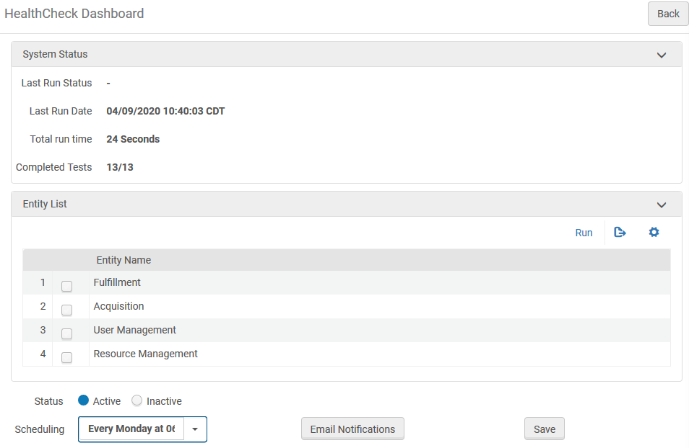
HealthCheck Tool
Notes:
The HealthCheck Tool is available to allow a General System Administrator to identify if there are potential configuration errors or other inconsistencies for Fulfillment, Acquisitions, User Management and Resource Management. For Fulfillment, thirteen specific tests are performed. You might run the HealthCheck Tool, if, for example, you are noticing what seems to be unexpected behaviour. Running the HealthCheck Tool may help you to identify configuration errors or other problems.
Go to the HealthCheck Tool via Admin > Advanced Tools > HealthCheck Dashboard.
The System Status section provides details of the last time this job was run. Institutions can choose to schedule the job to run according to available options or to run the job manually. How often you run the job at your institution is up to you, however, it is probably worthwhile to run the HealthCheck Tool twice per year to ensure that Alma is functioning as well as possible.

Slide 5
HealthCheck for Fulfillment
Notes:
We will run the HealthCheck for Fulfillment manually. Place a check in the box for Fulfillment and click on the Run button.

Slide 6
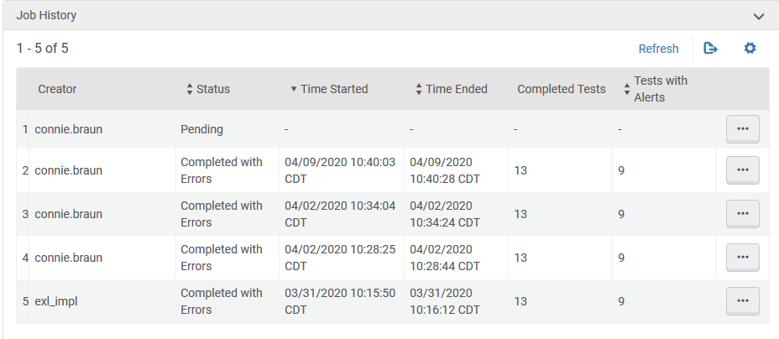
Job History
Notes:
As the job runs, the results appear within the Job History section. Select Refresh, as the job runs, to update the results.

Slide 7
View the Report
Notes:
When the job completes and you are ready to review the report, click on the More Actions button and select View Report. At the top of the report, we see the alert.
Click on the > to open the report details.

Slide 8
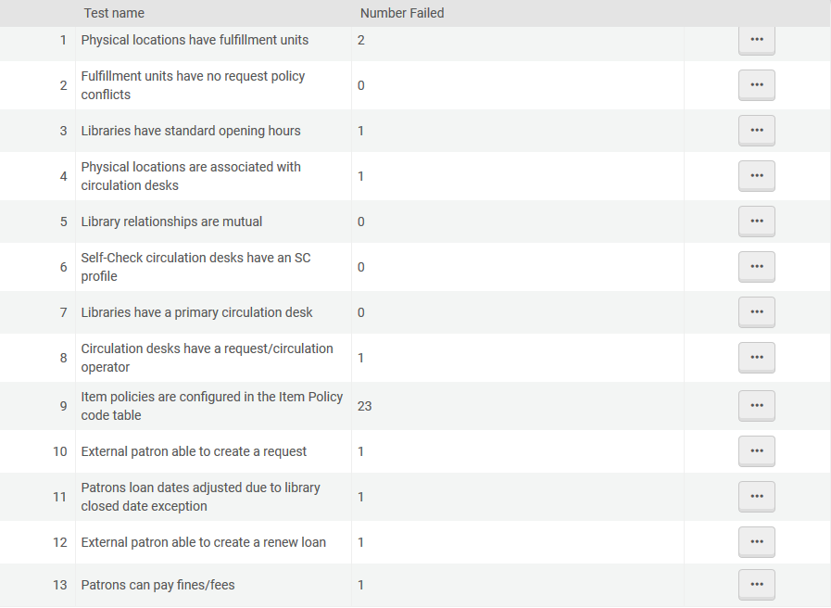
Report Details for Fulfillment
Notes:
For each of the 13 tests performed, we can see success and failure numbers. Wherever there is a number other than 0…

Slide 9
View Error Events
Notes:
…we can see additional information about the specific test results by viewing the Error Events. Looking at the first entry, Physical locations have fulfillment units, we see details telling us that there are two locations that do not have associated Fulfillment Units. With this information in hand, we can go to configuration to adjust the situation and correct the problem.

Slide 10
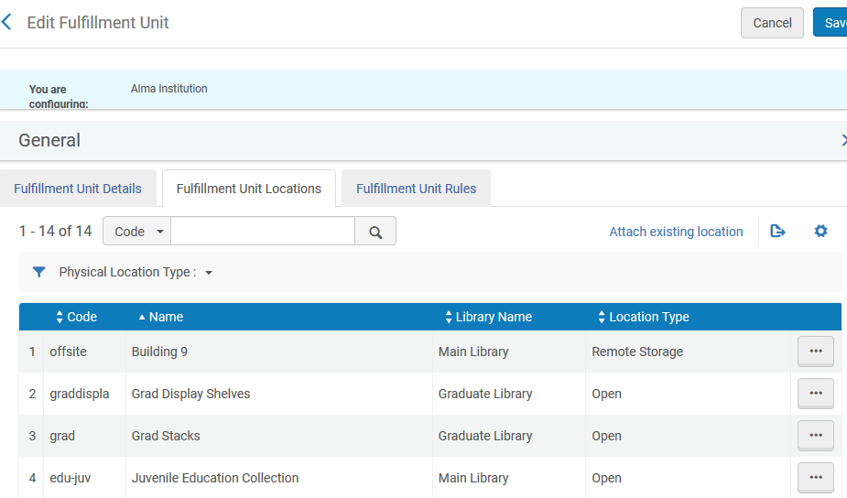
Making Corrections
Notes:
Go to Configuration > Fulfillment > Physical Fulfillment > Fulfillment Units and open the General Fulfillment Unit and go to the Fulfillment Unit Locations tab.
We can see that the location, Grad Foreign Language Collection, is not present. To correct the situation…

Slide 11
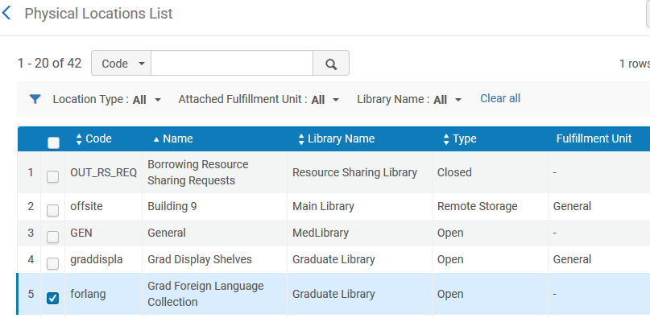
Making Corrections
Notes:
…attach the location to the Fulfillment Unit and we have resolved the problem. To confirm, you would simply need to run the HealthCheck for Fulfillment again.

Slide 12
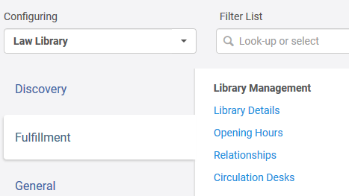
Making Corrections
Notes:
Let’s look at a second example, this time for Circulation desks have a request/circulation operator. In this case, there is no Circulation Desk Operator defined for Law Library ILL Circulation. To correct, we’ll navigate to the configuration for that Circulation Desk to add at least one operator.
Go to Configuration and select Law Library from the Configuring drop-down before clicking on the Fulfillment tab and clicking on Circulation Desks. Click on the More Actions button for Law Library ILL Circulation to open its configuration.

Slide 13
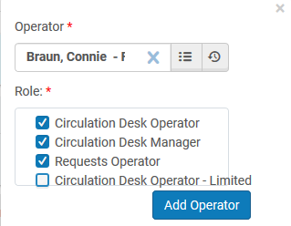
Making Corrections
Notes:
On the Operators tab, click on Add Operator to add at least one operator to the Law Library ILL Circulation Desk. Search for the user and associate the appropriate roles with the individual. If more than operator should be added, repeat the process.
General System Administrators at your institutions will want to review the results of each test and make the necessary corrections.

Slide 14
Policies, Terms of Use and Fulfillment Units
Notes:
Policies, Terms of Use and Fulfillment Units

Slide 15
Policies, Terms of Use and Fulfillment Units
Policies
Fulfillment
Terms of Use
Fulfillment Units
Notes:
As you will likely recall,
[CLICK] Policies are the smallest elements that contain all of the options for how fulfillment ultimately works at your institution.
[CLICK] Terms of Use consist of a grouping of similar policies (loan-related policies, request-related policies, booking policies, etc.).
[CLICK] Fulfillment Units comprise a grouping of locations that use similar Terms of Use.
[CLICK] It is these three components that are the framework for Fulfillment in Alma.

Slide 16
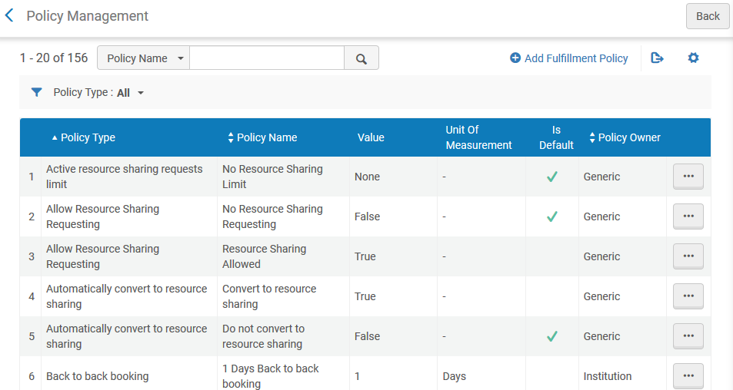
Policies
Notes:
Since Policies are the smallest elements in Fulfillment Configuration, let’s start by looking at them.
To configure Policies, you must have one of the following roles:
General System Administrator
Fulfillment Administrator
Fulfillment policies are provided out-of-the-box and can be used as is. When no changes are made, the Policy Owner remains Generic. Updating a policy at the institution level changes the policy owner to Institution; updating a policy at the library level changes the policy owner to Library. You will want to ensure that you are within the correct context, institution or library, when working in this area of configuration.

Slide 17
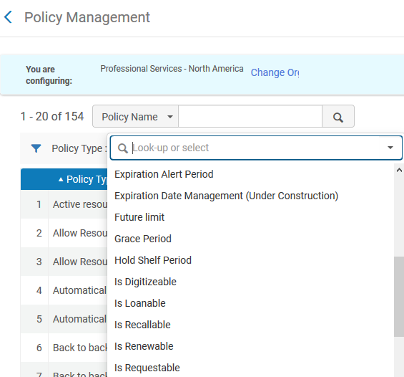
Policies
Notes:
Go to Configuration (make sure that you are configuring the Institution) > Fulfillment > Physical Fulfillment > Advanced Policy Configuration
As you can see, there are many different types of policies. Let’s focus on the type, Is Loanable. Select Is Loanable from the drop-down list of Policy Types.
Here we can see that the policy allowing loans has been customized for the Institution.
The Is Loanable policy indicates whether or not a patron can borrow the item. In this case, the options are:
Yes, the item can be loaned
No, the item cannot be loaned
Yes, the item can be loaned, however, only in the Reading Room.

Slide 18
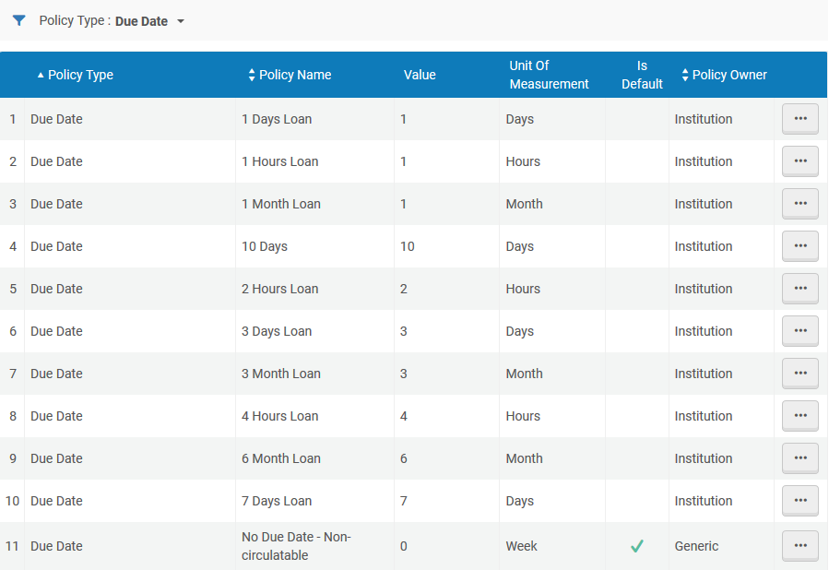
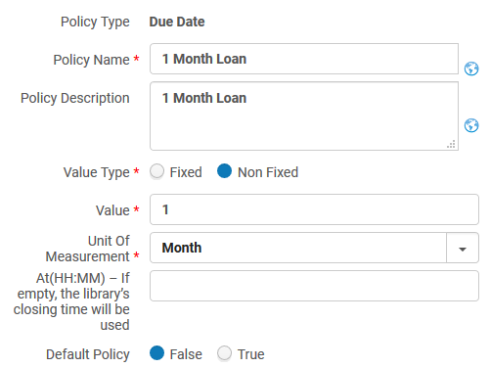
Policies
Notes:
Second, let’s look at the policy type, Due Date which sets the length of time an item may be borrowed. Select Due Date from the drop-down list of Policy Types.
The values are:
Fixed: Based on your institution’s calendar, this might be the end of the semester or term, or end of the year.
Non-Fixed: Based on the date the item was borrowed. If you set the Unit of Measurement field to Days, Month, or Week, you can also specify a specific time. If you don’t specify a time, the default is your institution’s closing time.
For any of these policies, the institution may add more policies to obtain greater granularity.
Note that the original date on which the item was borrowed is not included when determining the due date.
We could spend a lot of time looking at these policies. I recommend that you take time to review the policies at your institutions.

Slide 19
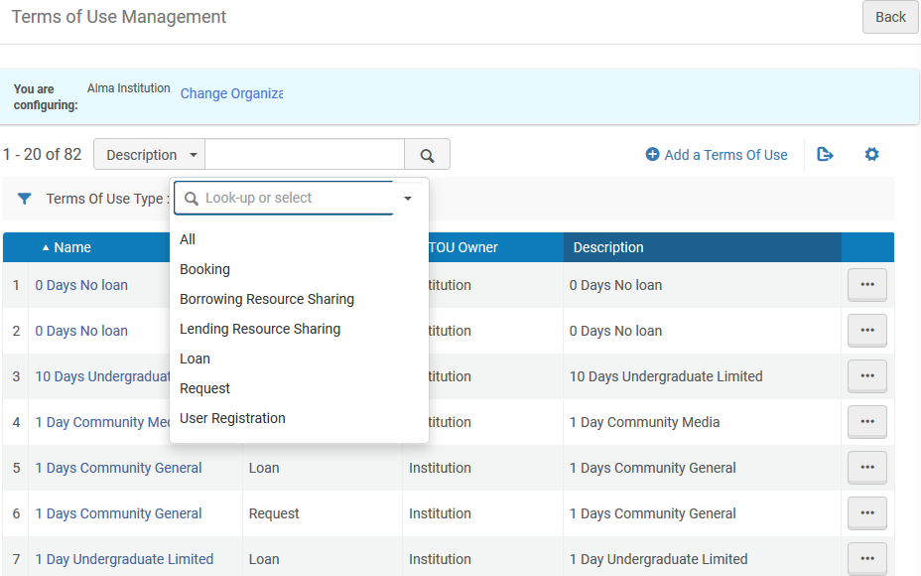
Terms of Use
Notes:
Terms of Use refers to a list of policies that define service to patrons. Terms of Use are associated with a specific type of fulfillment activity, such as a loan or a request. Based on the relationship configured, Fulfillment Unit Rules determine which Terms of Use to employ when delivering service to a patron.
To configure Terms of Use, you must have one of the following roles:
General System Administrator
Fulfillment Administrator
An item's Terms of Use is re-calculated each time an activity is performed on a loaned item (such as renewal). This means that changes made to a policy, fulfillment rule, patron information, or item information have an immediate effect on a loan's or request's Terms of Use.
Should the situation arise where an item belongs to a location that does not have Terms of Use, Alma determines which Terms of Use will apply based on the default policies.

Slide 20
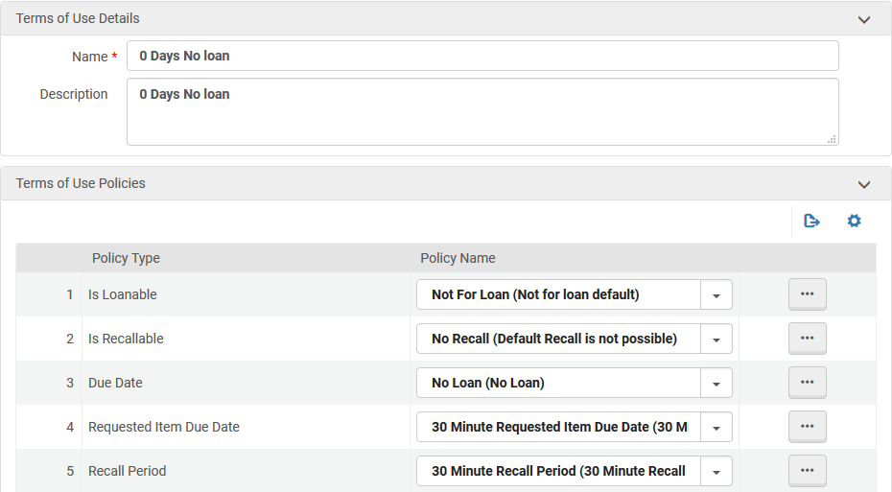
Terms of Use
Notes:
In Alma, go to Configuration > Fulfillment > Physical Fulfillment and select Terms of Use and Policies. Then, open the Loan > 0 Days No Loan Terms of Use. Explore the Policy options that apply to
Is Loanable
Due Date
Is Renewable
Overdue Fine

Slide 21
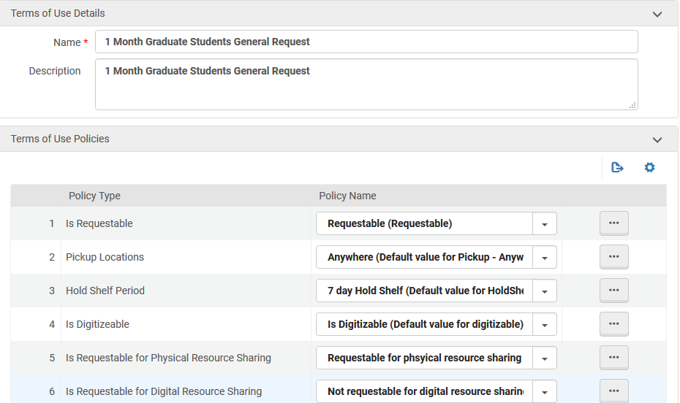
Terms of Use
Notes:
Review the example, Request > 1 Month Graduate Students General Request, and explore the Policy options that apply to
Is Requestable
Pickup Locations
Hold Shelf Period

Slide 22
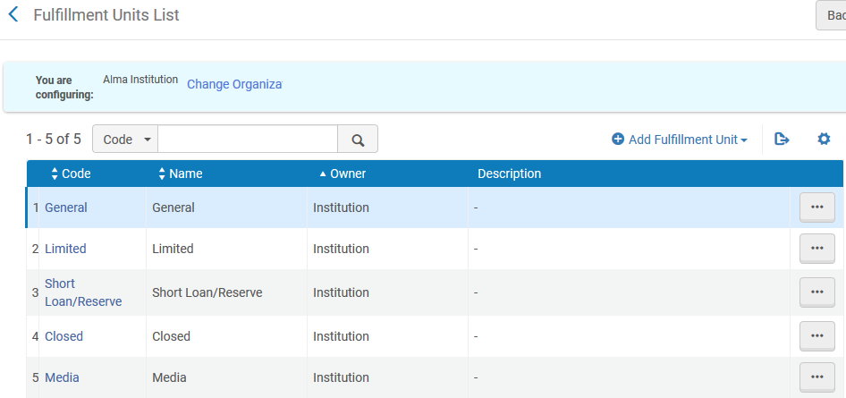
Fulfillment Units
Notes:
It’s at the Fulfillment Units, that everything comes together.
To configure fulfillment units, you must have one of the following roles:
General System Administrator
Fulfillment Administrator
While it is possible to configure Fulfillment Units for individual libraries, we strongly recommend that you configure Fulfillment Units at the institutional level. Fulfillment Units configured at the institutional-level may include locations found in any of the libraries within the institution whereas Fulfillment Units configured at the library-level includes only those locations found in the library for which the fulfillment unit is defined.

Slide 23
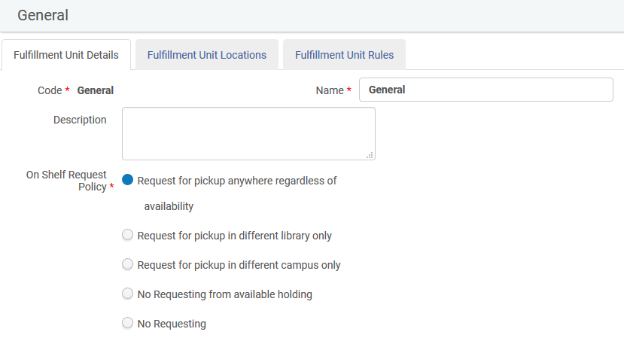
Fulfillment Unit – General
Notes:
Go to Configuration > Fulfillment > Physical Fulfillment > Fulfillment Units to have a look at the General Fulfillment Unit in Alma.
Beginning with the Fulfillment Unit Details tab, we see the option to configure the policy for on-shelf requesting. Whatever setting you choose here, will affect all locations associated with this Fulfillment Unit.
In a situation where your institution has one library only and you allow patrons to request items that are on the shelf, you will select the option, Request for pick anywhere regardless of availability. Should you institution have multiple libraries, you have more options to consider, including whether or not requested items can be requested at all, whether or not requested items will be delivered to another library or another campus, or, if a patron is expected to go to the owning library for the item to pick it up.
Over time, your institution and its libraries may decide to change the policy with regard to requesting items that are on the shelf. This is one configuration area that will likely require modification.

Slide 24
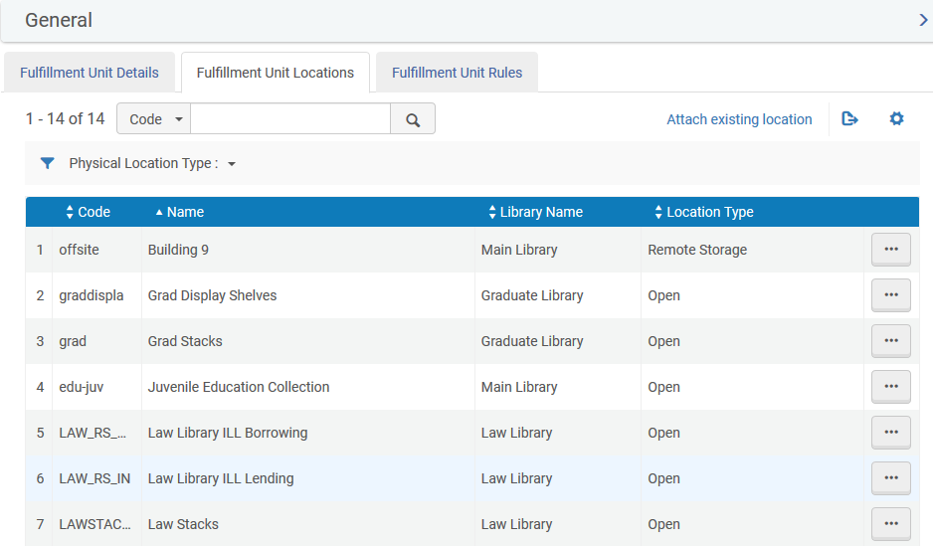
Fulfillment Unit – General
Notes:
Moving on to the Fulfillment Unit Locations tab. Here, we see the physical locations to which the Terms of Use/policies referenced by the Fulfillment Unit Rules are applied.
Some things that are noteworthy about Fulfillment Unit Locations.
A location may be associated with one Fulfillment Unit only.
Libraries can move a location from one Fulfillment Unit to another even if items from the location are currently on loan. A modification such as this may result in a change to the applicable Terms of Use. When this occurs, the new Terms of Use will be applied with the next action relating to the loan, such as a renewal or return
You may include up to 1000 locations in a Fulfillment Unit.

Slide 25
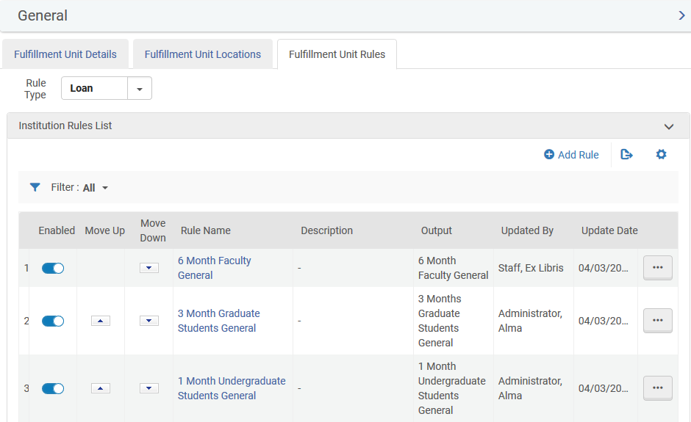
Fulfillment Unit – General
Notes:
Go to the Fulfillment Unit Rules tab. Fulfillment Unit Rules is where we apply Terms of Use to the Fulfillment Unit. There are three types of rules that may be managed here: Bookings, Loans and Requests. Terms of Use are already in place for us to associate with the Fulfillment Unit Rules.

Slide 26
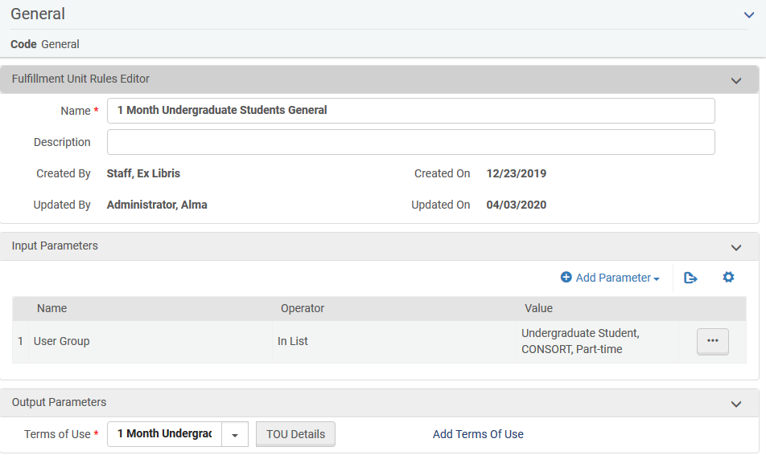
Fulfillment Unit – General
Notes:
Let’s take a look at the Fulfillment Unit Rule, 1 Month Undergraduate Students General as it relates to Loans. In addition to seeing the associated Terms of Use, we can also see the specific User Group to which this rule applies. Clicking on the TOU Details button allows us to see the details of this relationship.
At any time, institutions may modify the name of the rule, change the User Groups to which the Fulfillment Unit rule applies or choose a different Terms of Use.

Slide 27
Testing and Troubleshooting Fulfillment with the Fulfillment Configuration Utility
Notes:
Testing and Troubleshooting Fulfillment with the Fulfillment Configuration Utility

Slide 28
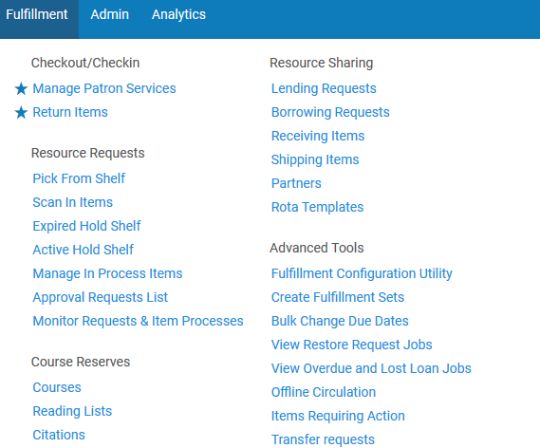
Fulfillment Configuration Utility
Notes:
The Fulfillment Configuration Utility is a very useful tool that allows operators to troubleshoot and test Fulfillment Configuration for a library’s physical items. Staff operators at a Circulation Desk may find that they will use this utility from time to time when needing to figure out why an attempted Circulation transaction works differently than expected or doesn’t work at all.

Slide 29
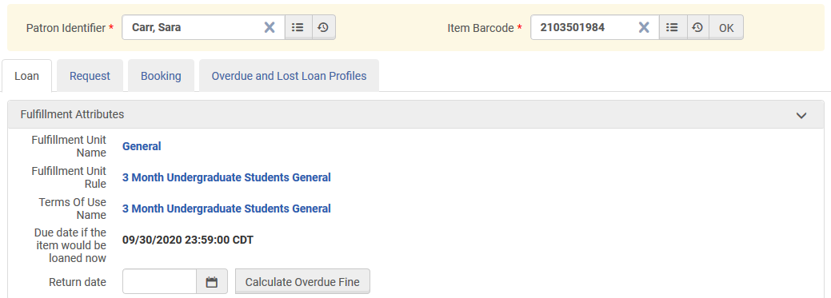
Fulfillment Configuration Utility – Loan
Notes:
When used, this tool displays the rules that would govern the loan if this item were loaned to a specific patron. The operator will be able to view the
Fulfillment Unit Name
Fulfillment Unit Rule
Terms of Use
associated with the item. The due date is calculated by the system as if the specified item would be loaned to the indicated patron. The overdue fine for an item returned after its due date.
Go to Fulfillment > Advanced Tools > Fulfillment Configuration Utility. Enter a Patron Identifier and Item Barcode before clicking on the OK button to view results. Based on the configuration of the Fulfillment Unit Rule and Terms of Use, the patron, Sara Carr, an undergraduate student, would be able to borrow the item Food and nutrition for three months with a due date on 30 September 2020. Scroll down on the page to view the policies associated with the Terms of Use.
Let’s look at some other examples:
Mitchel Bezalion – Faculty and Sara Carr – Undergraduate Student:
Food and nutrition – 2103501984
Mitchel Bezalion – Faculty: Atlas of cities – 2501322380 (item located in the Graduate Library Reference Collection; two-hour limited loan
Sara Carr – Undergraduate Student: The Sound of music (DVD) – 2530182601; a three-month loan period
Mitchel Bezalion – Faculty:
World without end – 2379499752; no terms of use associated with this location and, for this reason, the default terms of use that does not permit loans is used

Slide 30
Fulfillment Configuration Utility – Request
Notes:
In addition to Terms of Use for Loans, we can see the Terms of Use displayed for Requesting items…

Slide 31
Fulfillment Configuration Utility – Booking
Notes:
…as well as Booking. In this example, this item is not bookable based on the relationship for this Faculty borrower and this item.

Slide 32
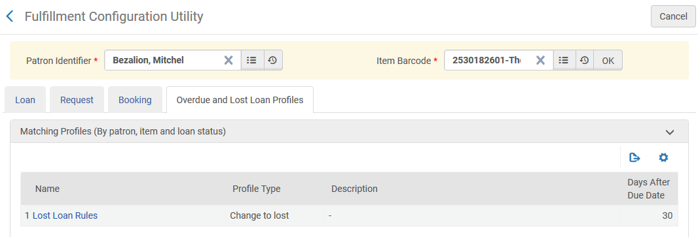
Fulfillment Configuration Utility – Overdue/Lost Loan
Notes:
Lastly, we can view the Overdue and Lost Loan Profile that would apply for a long overdue loan.

Slide 33
Additional Resources
Notes:
That’s all I have for you today. Please review these additional resources.

Slide 34
Additional Resources
HealthCheck Tool
Fulfillment Units, Terms of Use and Policies
Fulfillment Configuration Utility

Slide 35
Thank you!
Notes:
Thank you for joining me.

