Slide 1
Fulfillment Configuration
Part I
Notes:
Good morning/afternoon, all. Welcome to this first session on Fulfillment Configuration.

Slide 2
Library Circulation Desks
Blocks
Overdue Loan Profiles and Processes
Fulfillment Jobs Configuration and Scheduling
Notes:
During this first session on Fulfillment Configuration, we’ll be exploring these areas in Alma:
Library Circulation Desks
Blocks (both system- and operator-applied)
Overdue Loan Profiles and Processes
Fulfillment Jobs Configuration and Scheduling
Note that the PPT has many screen captures of things that we will look at in Alma.
If you have any questions throughout this presentation, please post them in the chat.

Slide 3
Library Circulation Desks
Notes:
Starting with Library Circulation Desks

Slide 4
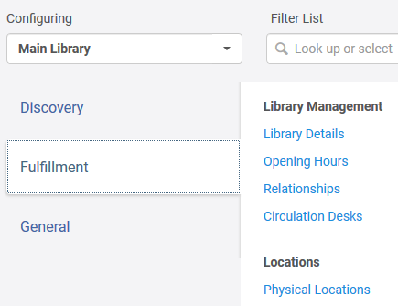
Circulation Desks
Notes:
Configuration for Circulation Desks always occurs at the Library level. From the drop-down list, select Main Library.

Slide 5
Circulation Desks
Notes:
In this institution, the Main Library has three Circulation Desks associated with it. We will focus on the primary Circulation Desk.
Click on the More Actions button for DEFAULT_CIRC_DESK/Main Library Circulation to open its configuration.

Slide 6
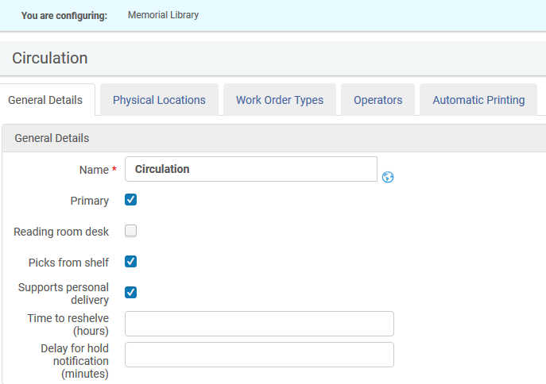
General Details
Notes:
On the General Details tab, in the General Details section, we can see immediately that the name for the Circulation Desk can be edited. Some libraries have named Circulation Desks; in other cases, your library might decide to change from Circulation Desk to Service Desk or something more interesting than that.
In the Main Library, patrons may request items that are on the shelf. Circ Desk operators pick up those items throughout the day and scan them in at the Circ Desk to put on the Hold Shelf for the requestors.
Personal delivery, meaning that items will be shipped to a personal address, is supported for distance learning students.
Given the fact that most libraries are closed at this time in relation to COVID-19, details such as Time to reshelve (hours) or Delay for hold notification (minutes) may not currently be relevant in your situation. When your library opens again, these two settings can be valuable.
Time to reshelve allows a library to set an interval, in hours or minutes, to give time to items back on the shelf after they are returned. During this interval, Alma and Primo display a status indicating that the item is available and awaiting reshelving. When the interval expires, the status updates to show that items are on the shelf. These days, some libraries are using this interval to indicate how long items will be in quarantine when returned to the library.
Delay for hold notification defines how long Alma will wait before sending notification to a patron informing them that an item is now available for pick-up at the Hold Shelf. When the delay concludes, Alma checks to see if the request remains active before sending the notification to the patron.

Slide 7
Additional Information
Notes:
In the Additional Information section, a textual description of the library can be added. The Map function is not currently in use.

Slide 8
Printing Information
Notes:
In the Printing Information section, we associate a default printer with the Circulation Desk. For libraries that have only the default printer selected, this will be the printer used for all non-automated print jobs. For libraries that include other printers in the Additional Printers field, Circ Desk operators can select where to print. Show the options for Additional Printers.
Creates return receipts is used to automatically generate a Return Receipt Letter to be emailed to the patron or printed at the Circ Desk. In cases where patron does not have a preferred email address and User preferred email is selected, the receipt will be sent to the printer instead.
Create loan receipts functions similarly and either sends an email message to the user or prints it at the Circulation Desk. Like the return receipt option above, when a user not have a preferred email address and User preferred email is selected, the receipt will be sent to the printer instead.
For libraries who get new printers, this is an area that will likely need to be adjusted.

Slide 9
Hold Shelf Information
Notes:
Any Circulation Desk that provides Hold Shelf services needs to have the Has hold shelf function enabled.
Hold shelf sorting sets a default value when viewing the list of items on the Hold Shelf. Show the options in this list. When viewing the list of items on the Hold Shelf, an operator can choose another mechanism for sorting the list.
For Maximum time on hold shelf (Days), libraries enter a value for how long items may stay on the Hold Shelf before they can be returned to the stacks or passed to the next requestor. This setting takes precedence over any policy that may be in place.
Has hold shelf processing can be enabled to indicate that the circulation desk can temporarily store items requiring processing before they are placed on the hold shelf. If enabling this function, the option, Place directly on hold shelf, is available when using the Scan in Items workbench.
When Hold requests are returned via a self-check machine, there are two possible outcomes:
If Has hold shelf processing is enabled, items go directly to hold shelf processing, or
If Has hold shelf processing is not enabled, items are returned and receive the status of Item in place even though remaining in the self-check bin and must be scanned in at the Circulation Desk to activate the request.
Notifying a patron that an expired hold request has been cancelled is both a reminder and a kindness.

Slide 10
Digitization Department
Notes:
Digitization is a means of providing access to library resources via digitized files, mostly like in the PDF format. If your library provides this kind of service, this function needs to be enabled. Entering a value for Work time (days) is informative and is not a guarantee that the work will be completed.

Slide 11
Payment Information
Notes:
Here is where libraries indicate what kind of payment the library accepts for fines and fees of all kinds. If Online is an option at your institution, an integration profile with an e-payment system also needs to be created.
If your library prefers to print receipts, the Print Receipt option needs to be set to Yes. Many libraries choose to have a copy of the receipt sent to an internal email address as part of audit control practices.

Slide 12
Self Check Information
Notes:
If your library has implemented self-check or plans to at some point in the future, this is part of the information that helps with set up. A self-check integration profile also needs to be created and associated with a Circulation Desk.

Slide 13
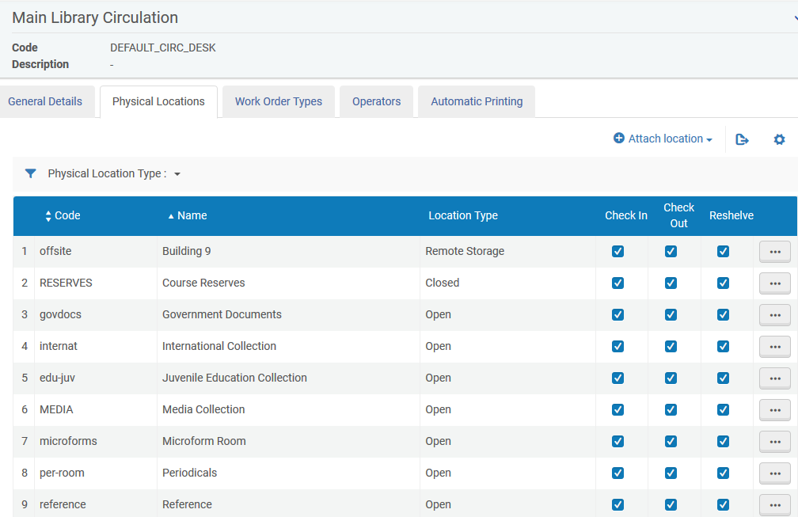
Physical Locations
Notes:
On the Physical Locations tab, we see all of the locations currently associated with the Main Library Circulation Desk. Scroll through the list to confirm that the locations make sense in the context of the Main Library. If your library adds, moves or removes locations, configuration in this area will requires updating.

Slide 14
Work Order Types
Notes:
It is quite possible that your library will have multiple types of Work Orders displayed on this screen. In most cases, the Work Orders will likely focus on missing items, items needing repair and other circulation activities.
The Technical Services Work Order, seen on the screen, might puzzle some of you. Many smaller libraries want to eliminate having to perform double barcode scans during receiving and processing of new physical items. Having the Technical Services Work Order handled by the Circulation Desk accomplishes this goal.

Slide 15
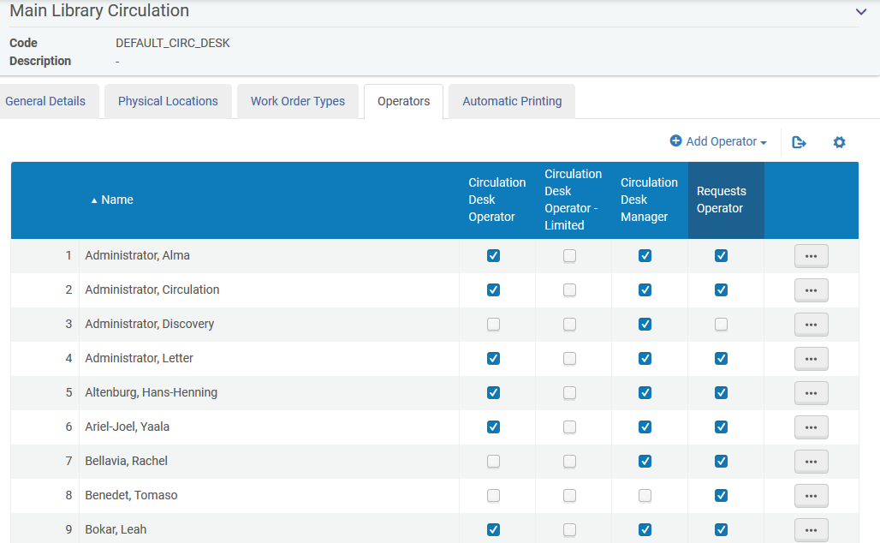
Operators
Notes:
On the Operators tab, we see one place where Circulation Desk and Requests Operator roles can be assigned. A major benefit of assigning operator roles here is that the context of library is already identified. In this example, the context is the Main Library.

Slide 16
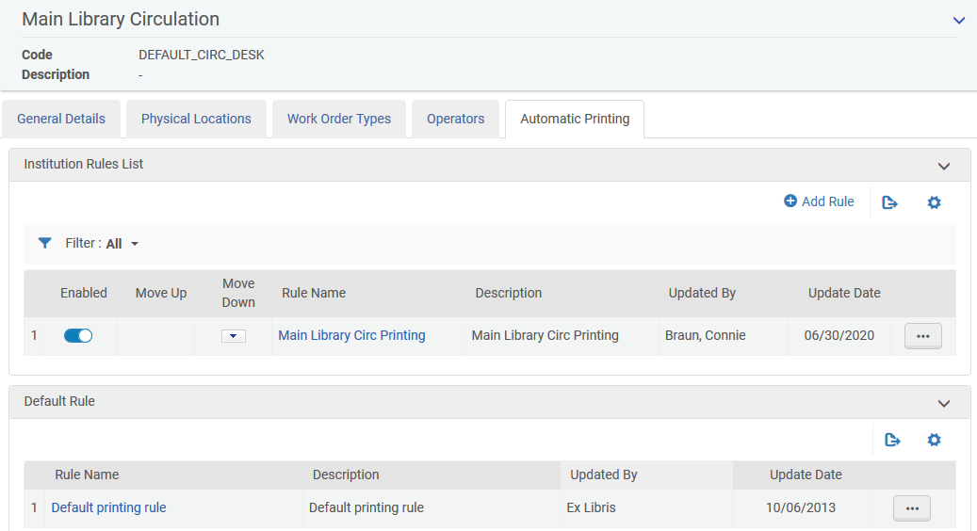
Automatic Printing
Notes:
The Automatic Printing tab, allows the library to specify rules for automated printing of request slips for items that need to be fetched from the shelf. When an item is not on the shelf, request processing begins when the item is scanned in at the Circulation Desk. This transaction will prompt printing to occur.

Slide 17
Blocks
Notes:
Moving on to Blocks

Slide 18
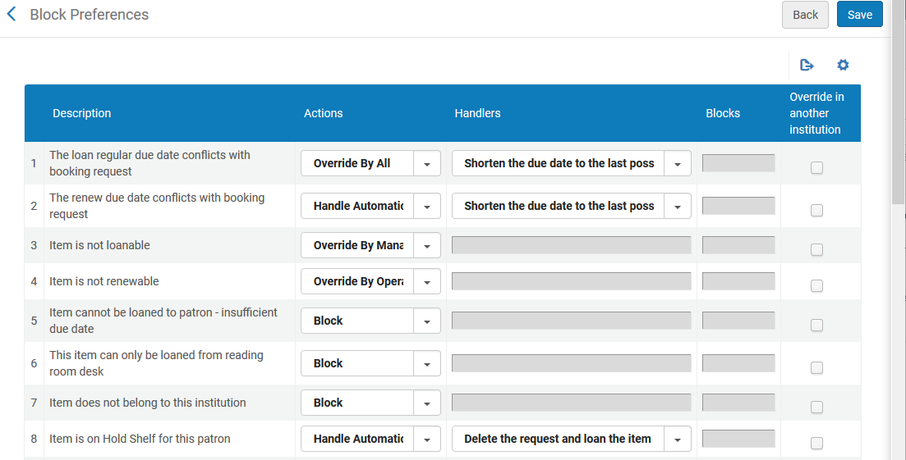
Block Preferences
Notes:
Block Preferences are system settings that control how various types of circulation transactions are handled at Circulation Desks. Knowing these settings and what is the expected behaviour is important for Circulation Desk Managers and Operators. Block Preferences apply to all libraries in the institution.
Block preferences are predefined in Alma. This means that you cannot add or delete any, however, you can modify the block preference’s settings to change behaviour.

Slide 19
Available Actions
Block | The ability to loan an item is blocked and the patron cannot borrow the item
Override by Manager | An override can be performed only by a staff operator with the Circulation Desk Manager role
Override by Operator | An override can be performed by a staff operator with the Circulation Desk Manager or Circulation Desk Operator role
Override by All | An override can be performed by any staff operator with one of these roles, Circulation Desk Manager, Circulation Desk Operator, or Circulation Desk Operator–Limited
Override in Another Institution | This option may be used by Fulfillment Network members to configure whether or not overrides may be performed by staff operators at another institution if the block occurs when the member’s item is being loaned at the circulation desk of another member institution
Handle Automatically | Sets specific actions to be performed by Alma
Notes:
Here are the different actions that can be associated with system blocks. In Alma, review some examples:
Item is not loanable
Perhaps the item is part of the Reference Collection and requires a Circ Desk Manager’s approval before the item can be loaned
Item cannot be loaned to patron – insufficient due date
This setting relates to the library’s active calendar dates; if a patron wants to borrow an item that would have a due date past the active calendar dates, the loan cannot occur
Patron is not active
Patron’s record has expired or is inactive for another reason; override allows items to be loaned to the patron
Item is currently on loan by another patron
In this scenario, a patron brings a book to the Circulation Desk wanting to borrow the item. When the staff operator scans the barcode, trying to loan the item to the patron, Alma indicates that the book is still on loan. This occurred when the student worker wasn’t paying attention while returning items and missed the fact that the item was not returned. So, while the item is on the shelf, it is also on loan. Then, because of the system settings for Block Preferences, the transaction cannot be completed. Alternately, the system settings permit the staff operator to perform an override.
Overall, staff operators at Circulation Desks need to understand what to expect when different scenarios occur. In this way, they are able to respond appropriately.

Slide 20
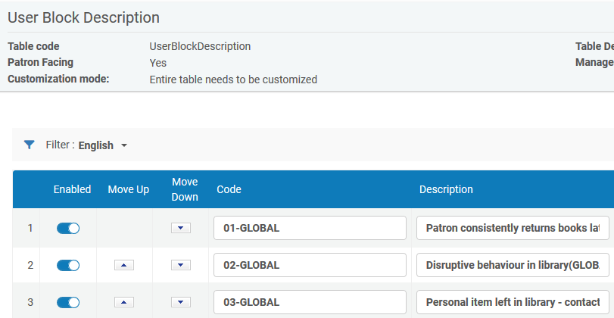
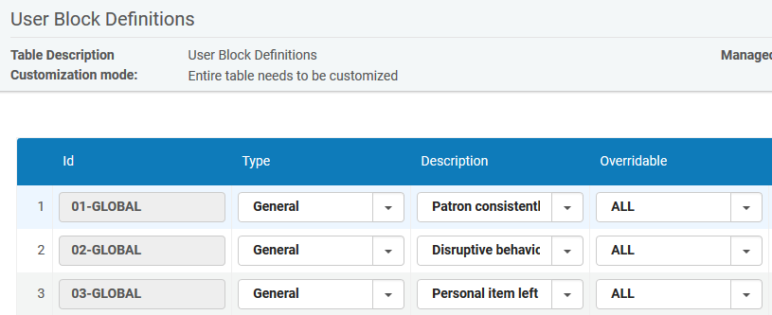
User Blocks Configuration
Notes:
As a reminder, User Blocks are manually associated with individual patron records or by creating a set of users to whom a user blocks applies and running a job to associate with all set members.
There are two parts to configuring user blocks: User Block Description and User Block Definitions.

Slide 21
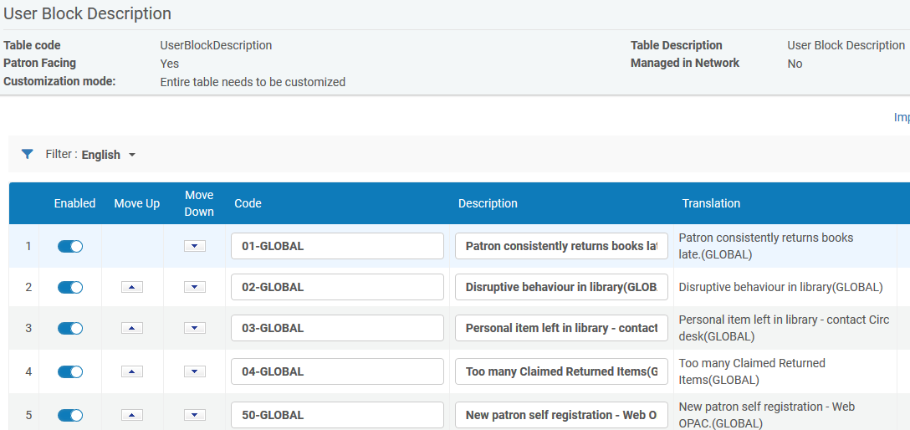
User Block Description
Notes:
Begin the process by configuring User Block Description. Descriptions entered here will be used when configuring User Block Definitions.
As you can see from the blocks on this page, the descriptions clearly state to what the block applies. Having evocative information like this makes it easy for staff operators to make the correct selection.

Slide 22
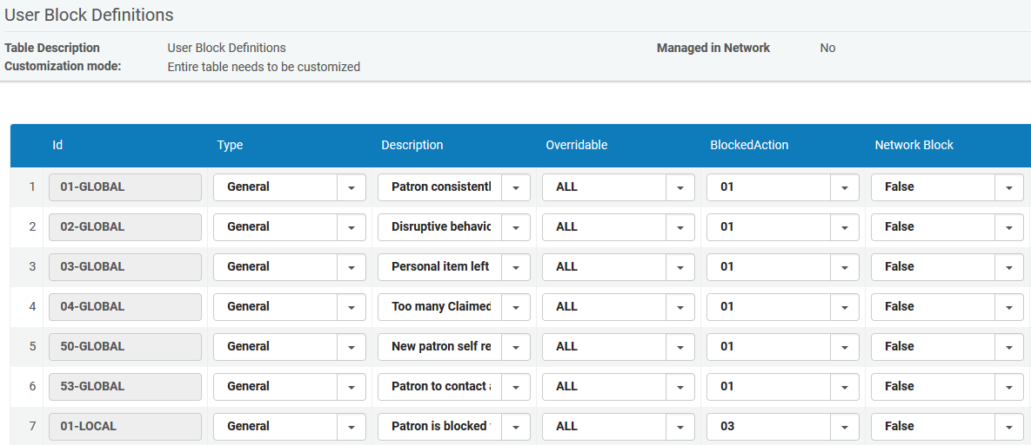
User Block Definitions
Blocked Actions
01: loan
02: loan, renew
03: loan, renew, hold
Notes:
In addition to relying on User Block Descriptions, User Block Definitions use three Blocked Action variables to act upon a patron’s record.
Blocked Actions are preconfigured in Alma and have the following meanings:
01 – blocks loans only
02 – blocks loans and renewals
03 – blocks loans, renewals and hold requests
Let’s look at some examples:
Disruptive behavior has Blocked Action 01
Patron’s override permission is blocked has Blocked Action 02
All patron’s privileges are blocked has Blocked Action 03
If other combinations are needed at your institution, such as a block for resource sharing requests, please contact Ex Libris Support.
User Block Definitions are configured at the institution level only.

Slide 23
Overdue Loan Profiles and Processes
Notes:
The third topic for this session is Overdue Loan Profiles and Processes.

Slide 24
Overdue and Lost Loan Profiles
Notes:
Overdue and Lost Loan Profiles monitor loans that are long overdue and turns them into lost loans when warranted.
These profiles are intended to automatically send progressive reminders to patrons along with creating fees and user blocks. Depending on your needs, profiles are flexible enough to apply rules based on the type of loan and the amount of time overdue. How many profiles your institution configures is completely up to you.

Slide 25
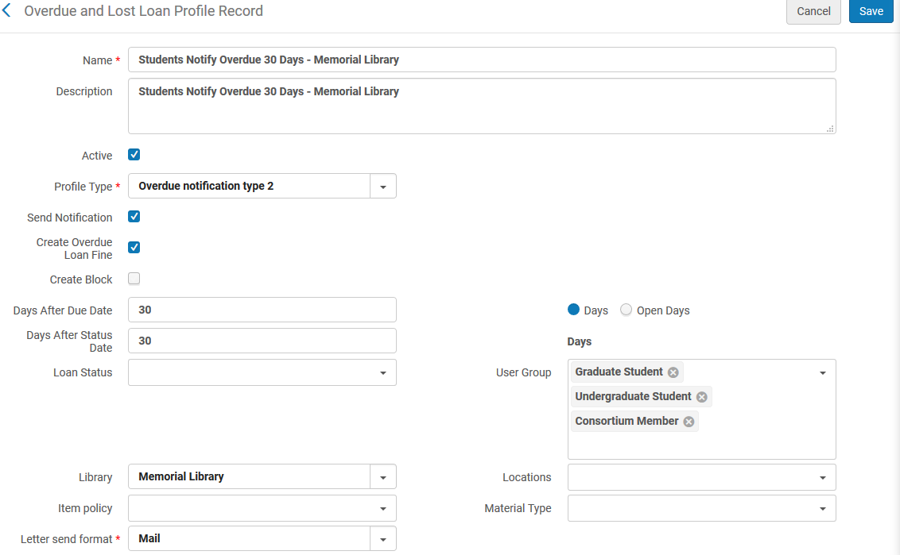
Overdue and Lost Loan Profiles
Notes:
Review Students Notify Overdue 30 Days profile, identifying that the profile is active, will send Overdue notification type 2, will create an overdue loan fine, is set to run 30 days after the due date, focuses on three user groups in relation to Memorial Library specifically. Notifications will be sent to primary user email addresses.
As you can see, there is plenty of flexibility in setting up Overdue and Lost Loan Profiles. You can have profiles for individual libraries, user groups either singly or in combination as well as specifying details such as item policy, material type and locations within libraries.
Alma can be configured to send five or more notification letters to patrons, providing plenty of opportunity for communication. More on these letters in a short while.

Slide 26
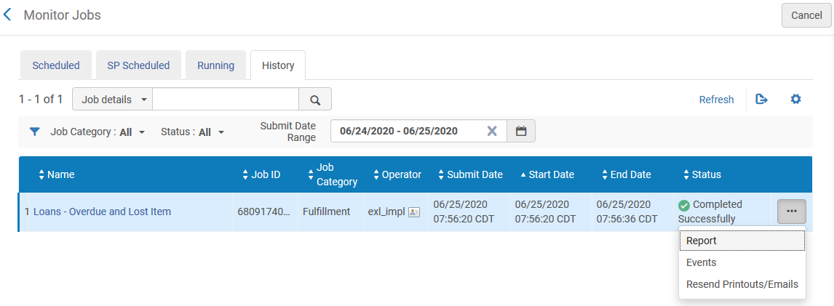
Overdue and Lost Loan Job
Notes:
Go to Admin > Monitor Jobs > Fulfillment > Loans – Overdue and Lost Item and view via the History tab
Click on the More Actions button to view the…

Slide 27
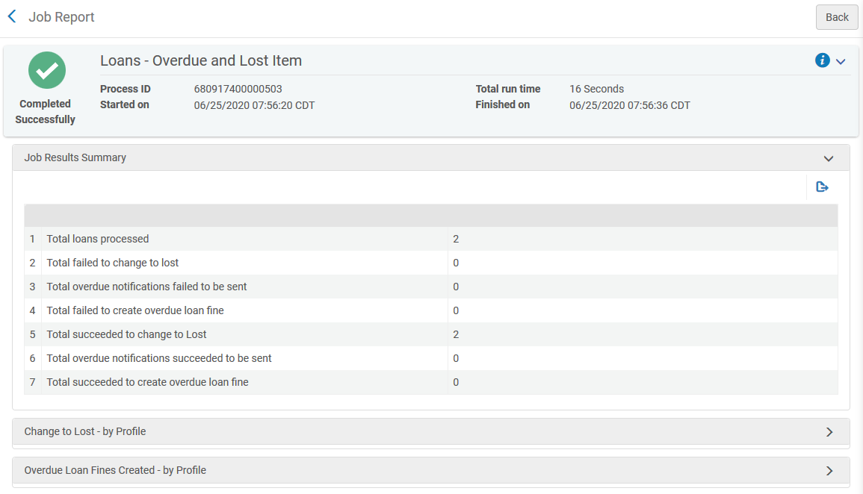
Overdue and Lost Loan Job
Notes:
…Report which indicates
How many loans were processed
How many loans were changed to Lost status
Which profiles were used
And, more

Slide 28
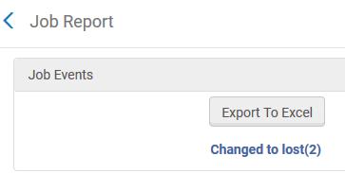
Overdue and Lost Loan Job
Notes:
We can then discover the details of the loans changed to lost and more.
Overall, this is another area worth checking to ensure that your Overdue and Lost Loan profiles are working as preferred at your institution.

Slide 29
Notification Types
Notes:
Overdue Notification Fine Types 1 – 5 may be enabled for any Terms of Use, where it is used to control the fines created with the associated notification type.
Open Terms of Use for Loan > 1 Month Undergraduate Students General to review location of Overdue Notification Fine Types 1 - 5.

Slide 30
Notifications to Patrons
Notes:
Overdue Notification Letters to patrons are controlled only in the profiles. We will not spend a lot of time looking at letters, however, I wanted to point out several things.
Go to Configuration > General > Letters Configuration, page 3. Look for Ful Overdue and Lost Loan Notification Letter.
The Ful Overdue and Lost Loan Notification Letter allows up to five notifications to be sent by Alma. These letters are sent over a period of time to inform the borrower of continuing overdue loan status and that fines and/or fees are accruing. A question to answer at your institution is this: How many of these notifications do you want to send?
Once the notification letters you have implemented complete their cycle, the Ful Overdue and Lost Loan Letter is sent to notify the patron that the item(s) has been designated as lost.

Slide 31
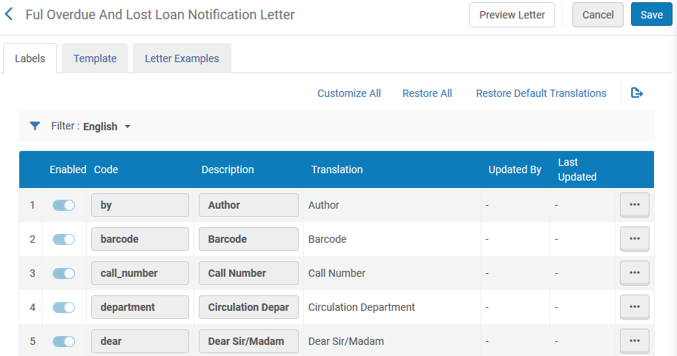
Ful Overdue and Lost Loan Notification Letter
Notes:
On the Labels tab, we can edit the content of the letter. For example, you may want to change the statement, “This is to inform you that the items with the details below” to something other than the default content.
Notice that there are multiple entries of this statement that represent the five notification types. If you choose to send all five notifications, you might add stronger language to notifications 3, 4, and 5.
The same approach can be taken for the charged_with_fines_fees_type* and declared_as_lost_type* statements.

Slide 32
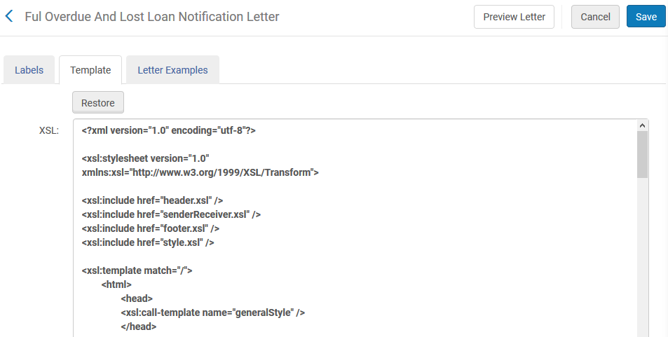
Ful Overdue and Lost Loan Notification Letter
Notes:
On the Template tab, we see the XSL that provides opportunity to customize the appearance of the letter and perform several other updates. The XSL needs to be adjusted to call any labels that you have modified. We will not be looking further at customization during this session.

Slide 33
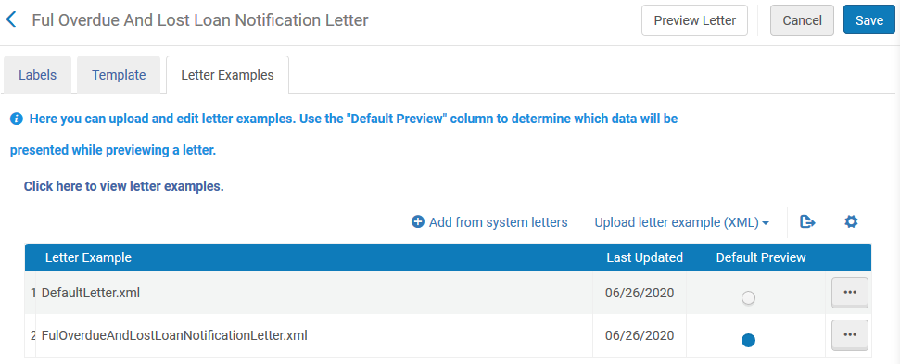
Ful Overdue and Lost Loan Notification Letter
Notes:
On the Letter Examples tab, you can see that we have opportunity to preview letters in several different ways. First, we can preview DefaultLetter.xml which does not show us very much. Second, we can add from system letters; this means that we would be previewing a letter that was sent to a patron. Third, we can upload a letter example from those made available via Ex Libris Developer Network; download these examples.

Slide 34
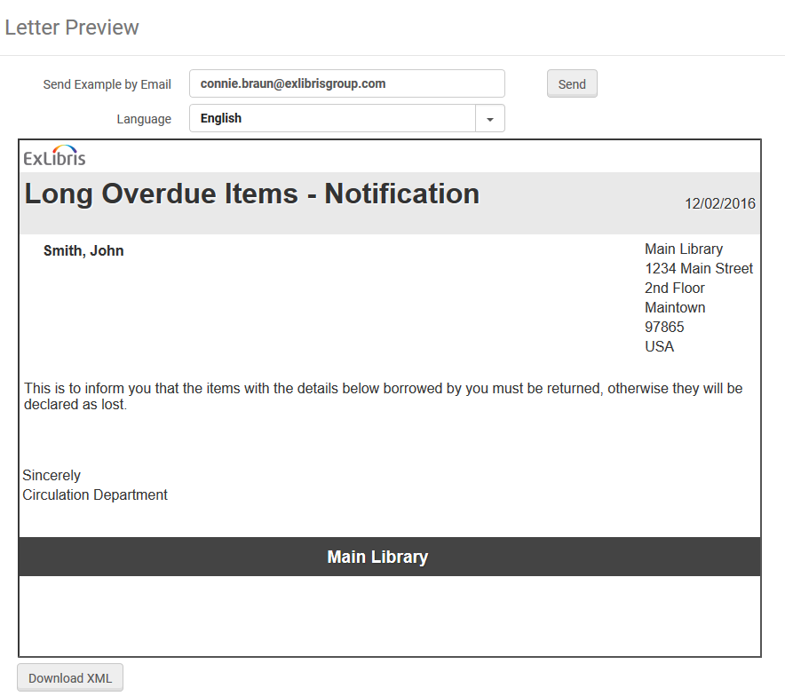
Preview Letter
Notes:
Let’s preview the example letter that I uploaded prior to this session. If desirable, operators working on letters configuration can email the letter to themselves or someone else as part of testing what notification patrons will receive.
More information on configuring letter notifications is available on the Additional Resources slide at the end of this presentation.

Slide 35
Fulfillment Jobs Configuration and Scheduling
Notes:
The final topic for this session is Fulfillment Jobs Configuration and Scheduling.

Slide 36
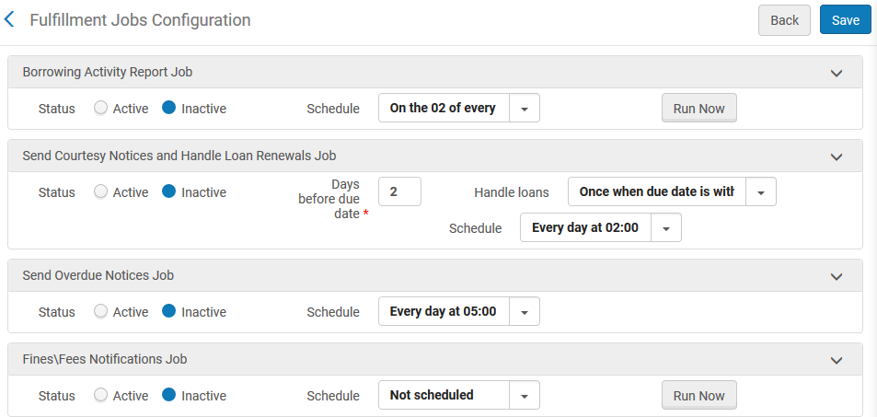
Fulfillment Jobs Configuration
Notes:
Go to Fulfillment Jobs Configuration page, where the institution can manage and update configuration of some Fulfillment jobs. The roles of General System Administrator or Fulfillment Administrator are required to perform these configurations. Each job may be activated, deactivated or scheduled.
Let’s focus on a few of them.

Slide 37
Send Courtesy Notices, Overdue Notices, Fines/Fees
Notes:
If sending courtesy notices and handling automatic loan renewals is something you do at your institution, you can indicate
when the courtesy notices should be sent, two or three or 10 days before the due date
how automatic loan renewals should be handled
when the due date exactly matches the defined day
once when the due date is within range
daily when the due date is within range
When these jobs are scheduled to run can be changed.
How this job functions depend on settings currently in place for automatic loan renewals, Terms of Use and existing recalls.
Overdue notices are scheduled to run every day, however, the institution can decide at what time of day the job runs. Fines and fees notification can be scheduled to run at various intervals. The job can also be run now.

Slide 38
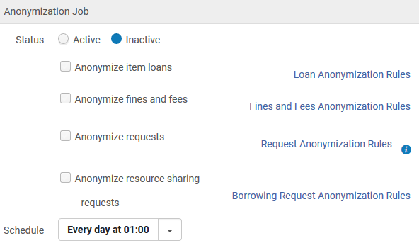
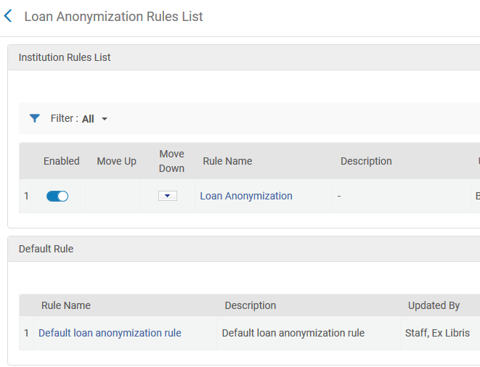
Anonymization Job
Notes:
There are several parts to configuring the Anonymization job.
If an institution is going to anonymize loans, there is a set of rules that can be applied. Rules can focus on
Number of days since the loan ended
Number of days since the user record expired
By Library
By Location
Number of loans to retain
By User group
For Fines and Fees, rules can be set for
Number of days since the fine/fee was closed
Number of days since the user record expired
By Library
By User group
For Requests (new in the July release), rules can be set for
Number of days since request ended
Number of days since the user record expired
By Library
By Location
By User group
Resource sharing requests may also be anonymized.

Slide 39
Activate/Deactivate Course
Notes:
This job changes the statuses of courses so that they are aligned with their start and end dates. When activating courses, this job republishes all bibliographic data with the course data. When deactivating courses, this job republishes all bibliographic data without the course data.

Slide 40
Additional Resources
Notes:
That’s all I have for you today. Please review these additional resources.

Slide 41
Additional Resources
Configuring Fulfillment Activities – Overview
Configuring Physical Locations
Configuring Overdue and Lost Loan Profiles
Configuring User Block Descriptions and Definitions
Configuring Fulfillment Jobs
Configuring Alma Letters

Slide 42
Thank you!
Notes:
Thank you for joining me today.

