Slide 1
Circulation Services While Operating Remotely
LSP Circulation Work Group
Nov. 18, 2020

Slide 2
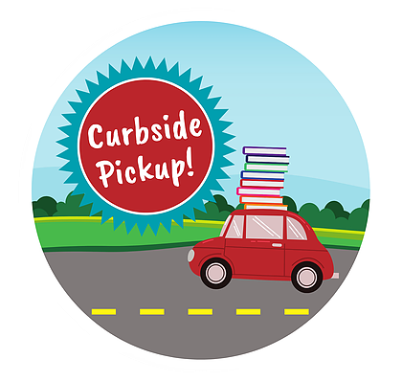
Agenda
Introductions
Resources
Circulation services overview
Member perspectives
Sharing successes and challenges
Future projects

Slide 3
Work Group Members
Amanda Cronkright, City College of San Francisco
Anne O'Toole, Santa Rosa Junior College
Cathy Tully, College of the Sequoias
Efrain Villanueva, Fullerton College
Jay Hartzell, MiraCosta College
Kymber Ensele, Lake Tahoe Community College
Lena Hicks, Pasadena City College
Lisa Brlas, Grossmont College
Lori Lisowski (Lead), Skyline College
Parisa Samaie, Los Angeles Southwest College
Patricia Torres, Southwestern College
Rebecca Mendell, Folsom Lake College
Tatiana Pak, Diablo Valley College

Slide 4
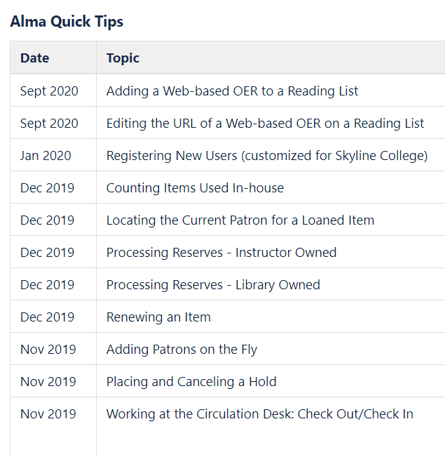
Available tools on our wiki page
Group charge
Best practices
Recommendations
Alma Quick Tips
Resources and documents
Presentations
Meeting minutes and recordings
Roster and contact info
https://cccnext.jira.com/wiki/spaces/CLSPP/pages/800030789/Circulation+Work+Group

Slide 5
Circulation Services While Operating Remotely
Campus and library access
Loan of library materials
Technology
Print and non-print
Course reserves
Interlibrary loan
Loan of non-library materials
Scanning
Internet access/wi-fi
Communications
Quarantines
Document link

Slide 6
Circulation Services While Operating Remotely
General Observations:
Safety with creativity and flexibility
Gold rush for hot spots and wi-fi
Alma used beyond the library
Libraries prove they are essential partners
Document link

Slide 7
Circulation Services While Operating Remotely
Local Perspectives:
Lena Hicks, Pasadena City College
Kymber Ensele, Lake Tahoe Community College
Tatiana Pak, Diablo Valley College
Jay Hartzell, MiraCosta College
Document link

Slide 8
Pasadena City College
Remote Services: https://libguides.pasadena.edu/remoteservices

Slide 9
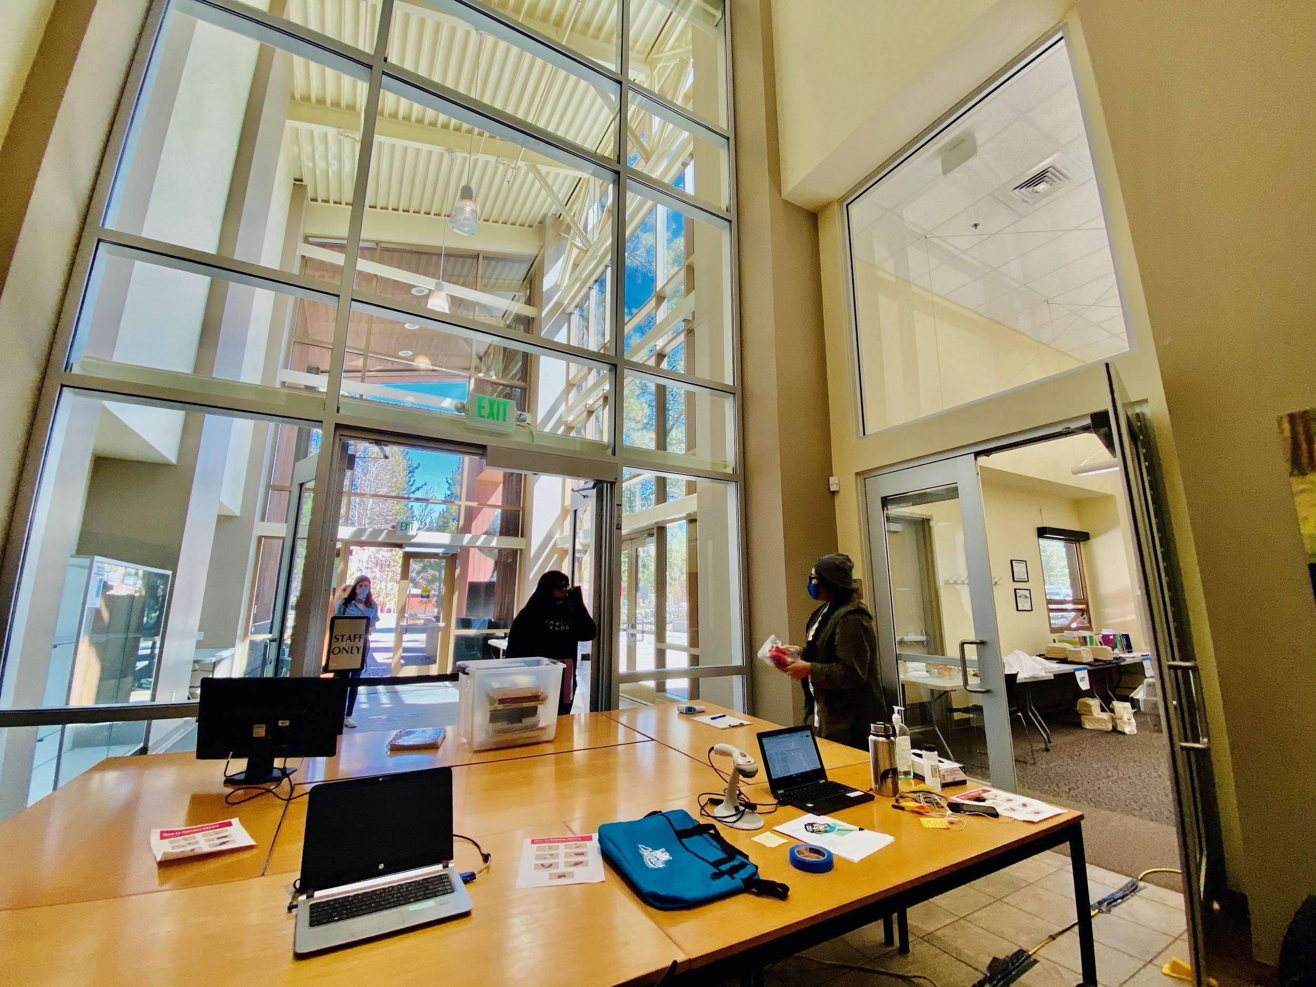
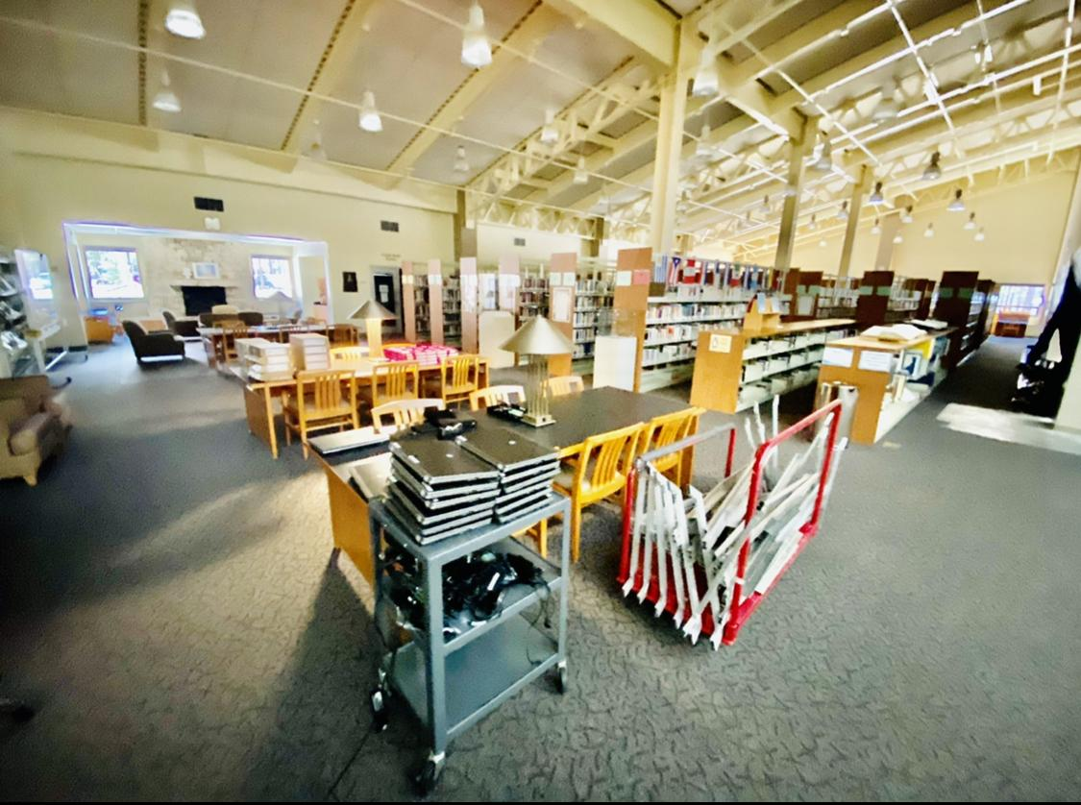
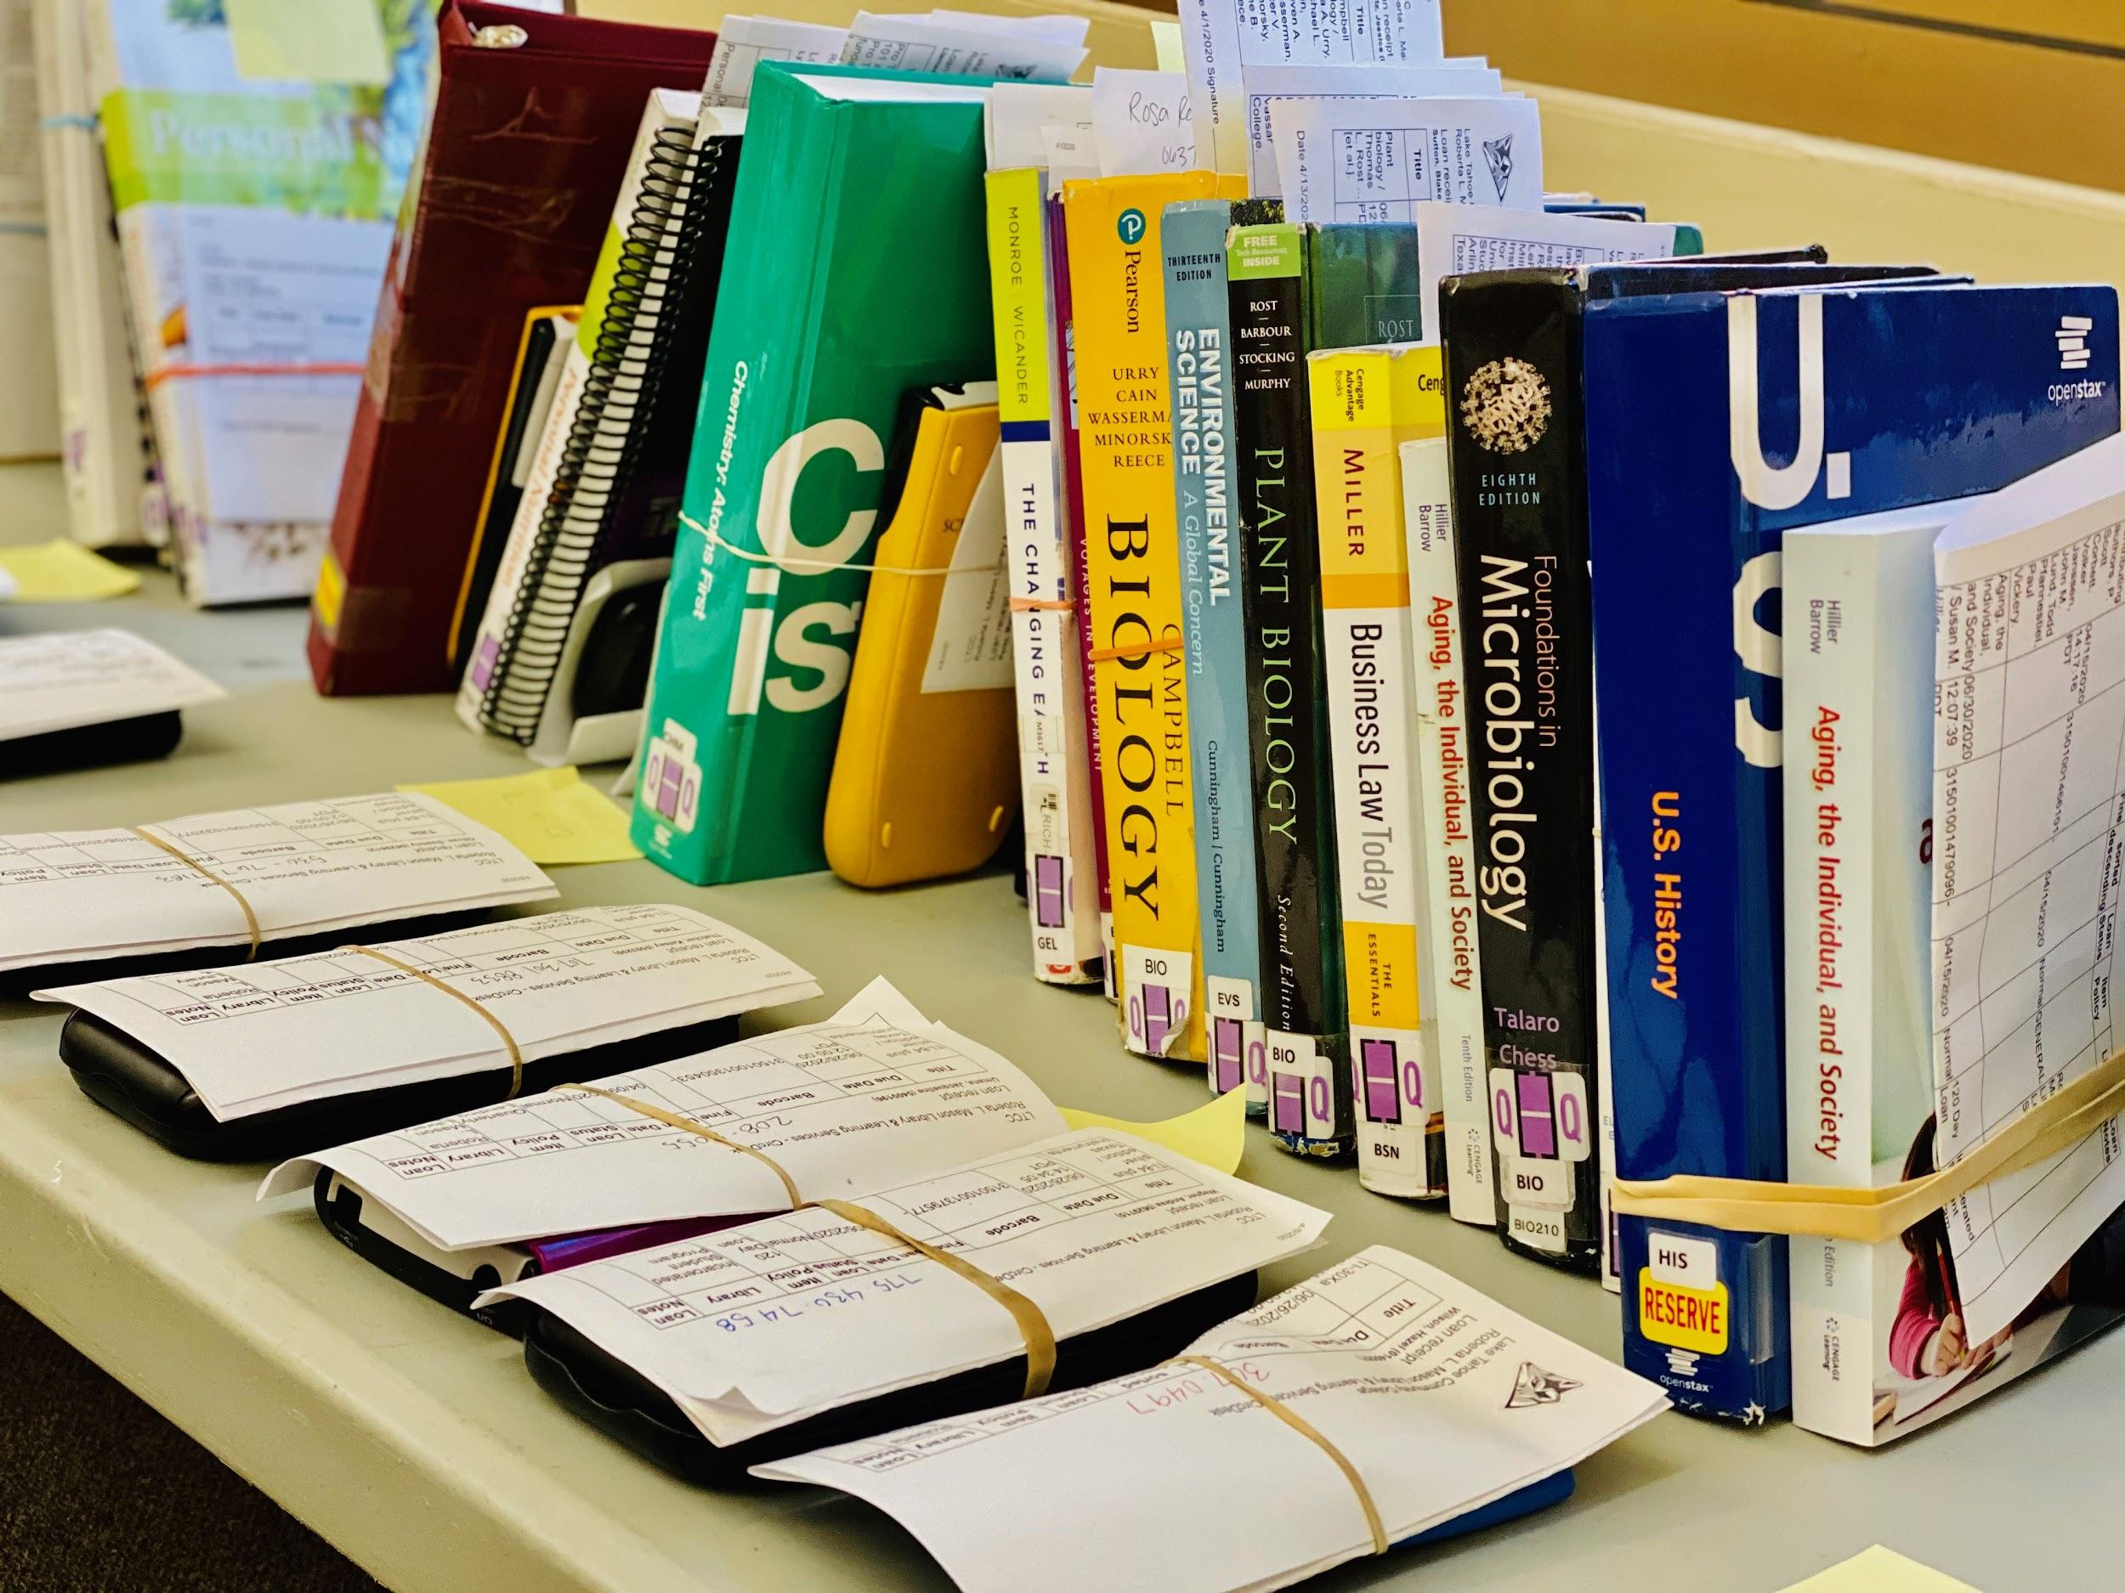
Lake Tahoe Community College
LTCC Distribution “Aspen”
Library Staging Area “Learning Commons”
Quarterly Lending Library

Slide 10
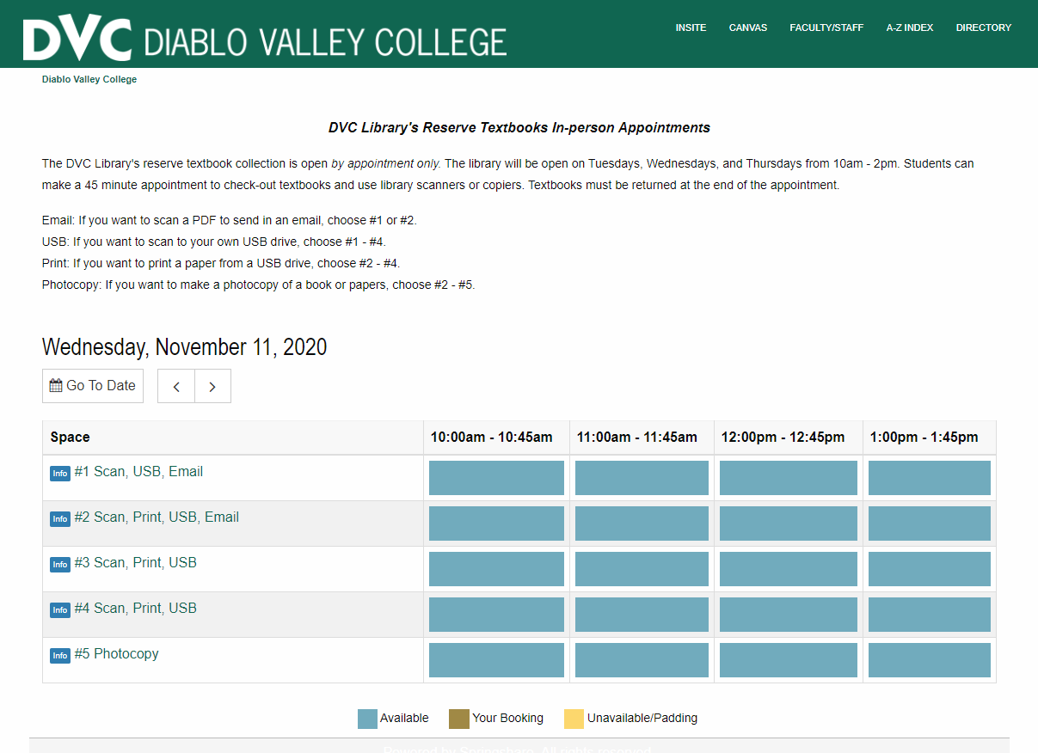
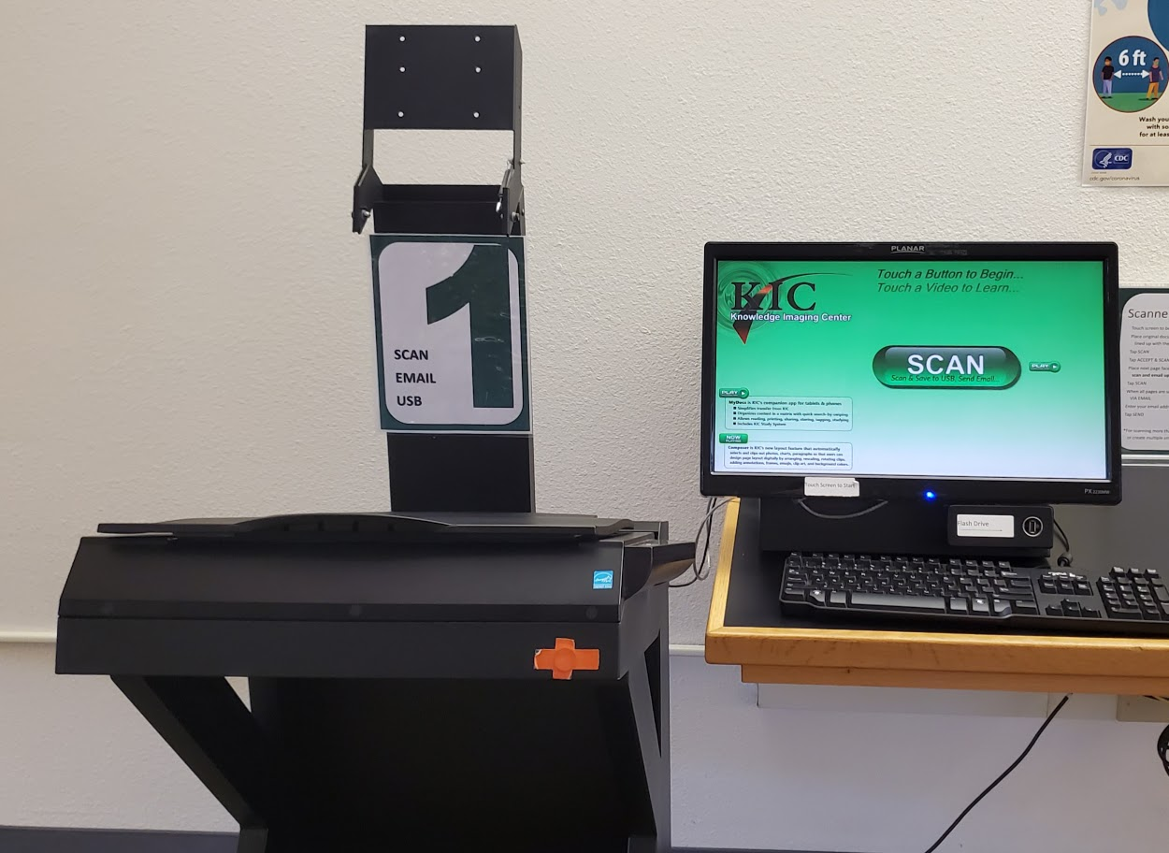
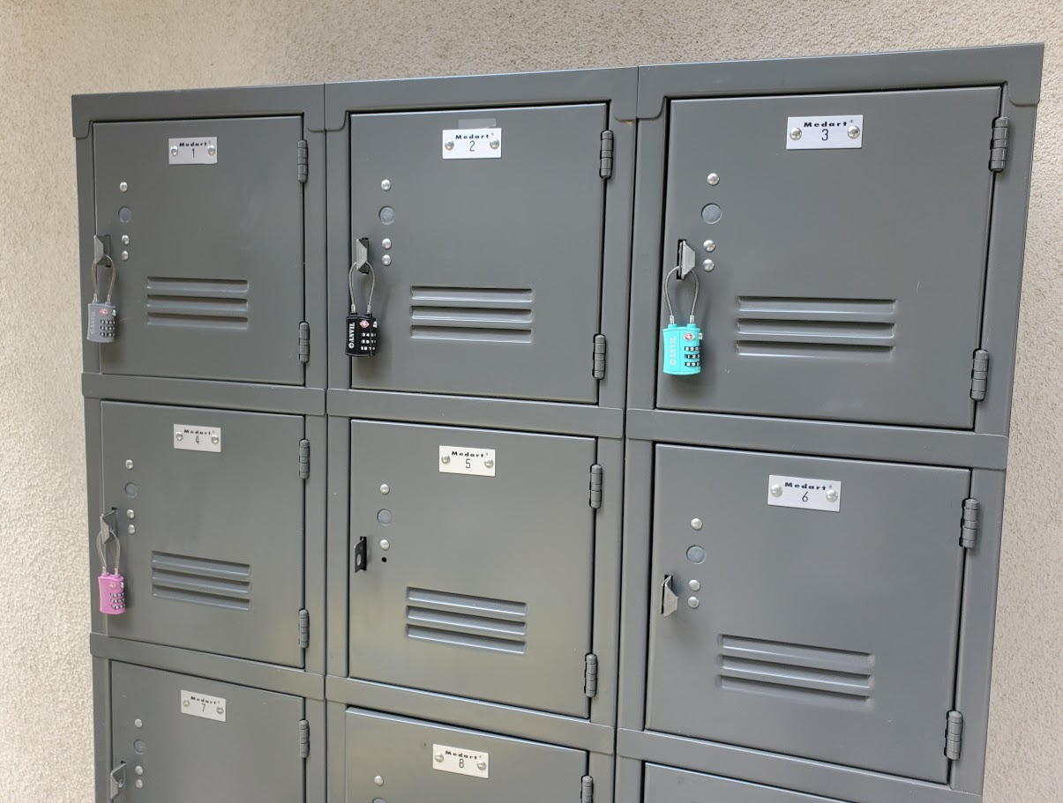
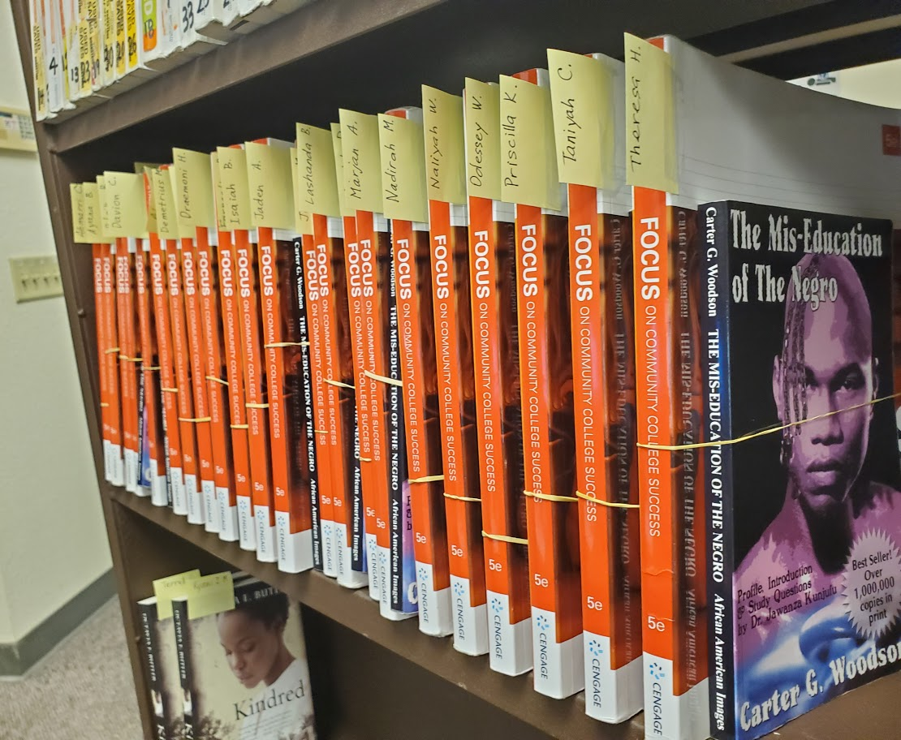
Diablo Valley College
Scanning Requests by Email
https://dvclib.wufoo.com/forms/x95otlk1bpbsym/
Reserve Textbooks In-person Appointments
https://dvc.libanswers.com/faq/322114
Contactless Locker Pickup
https://dvc.libanswers.com/faq/329908
Learning Communities Textbooks: Pickup Events and Mailing distributions (https://dvclib.wufoo.com/forms/k1bll2di0wqaznb/)

Slide 11
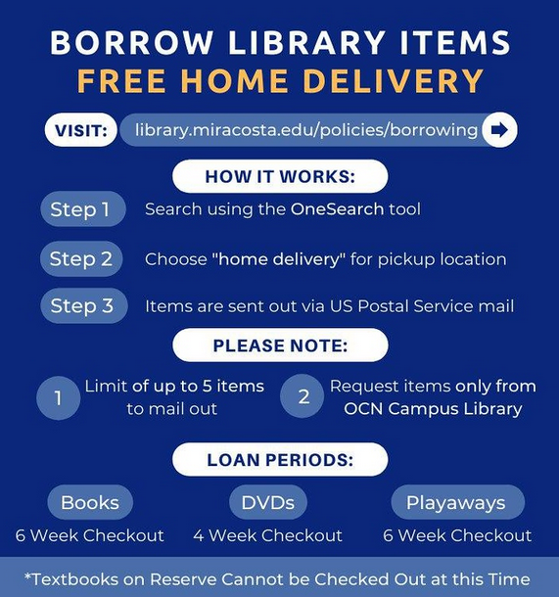
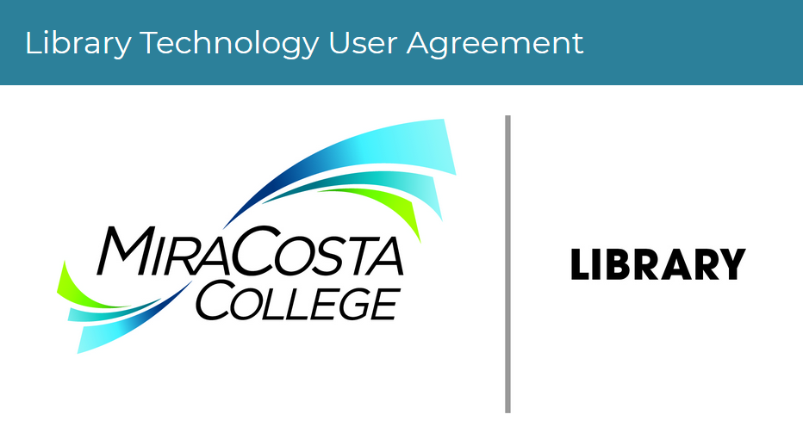
MiraCosta College
Electronic Reserves & Scanning
https://library.miracosta.edu/faculty/reserves
Home Delivery
https://library.miracosta.edu/policies/borrowing
Circulating Technology
https://library.miracosta.edu/instruction/libraryclosure

Slide 12
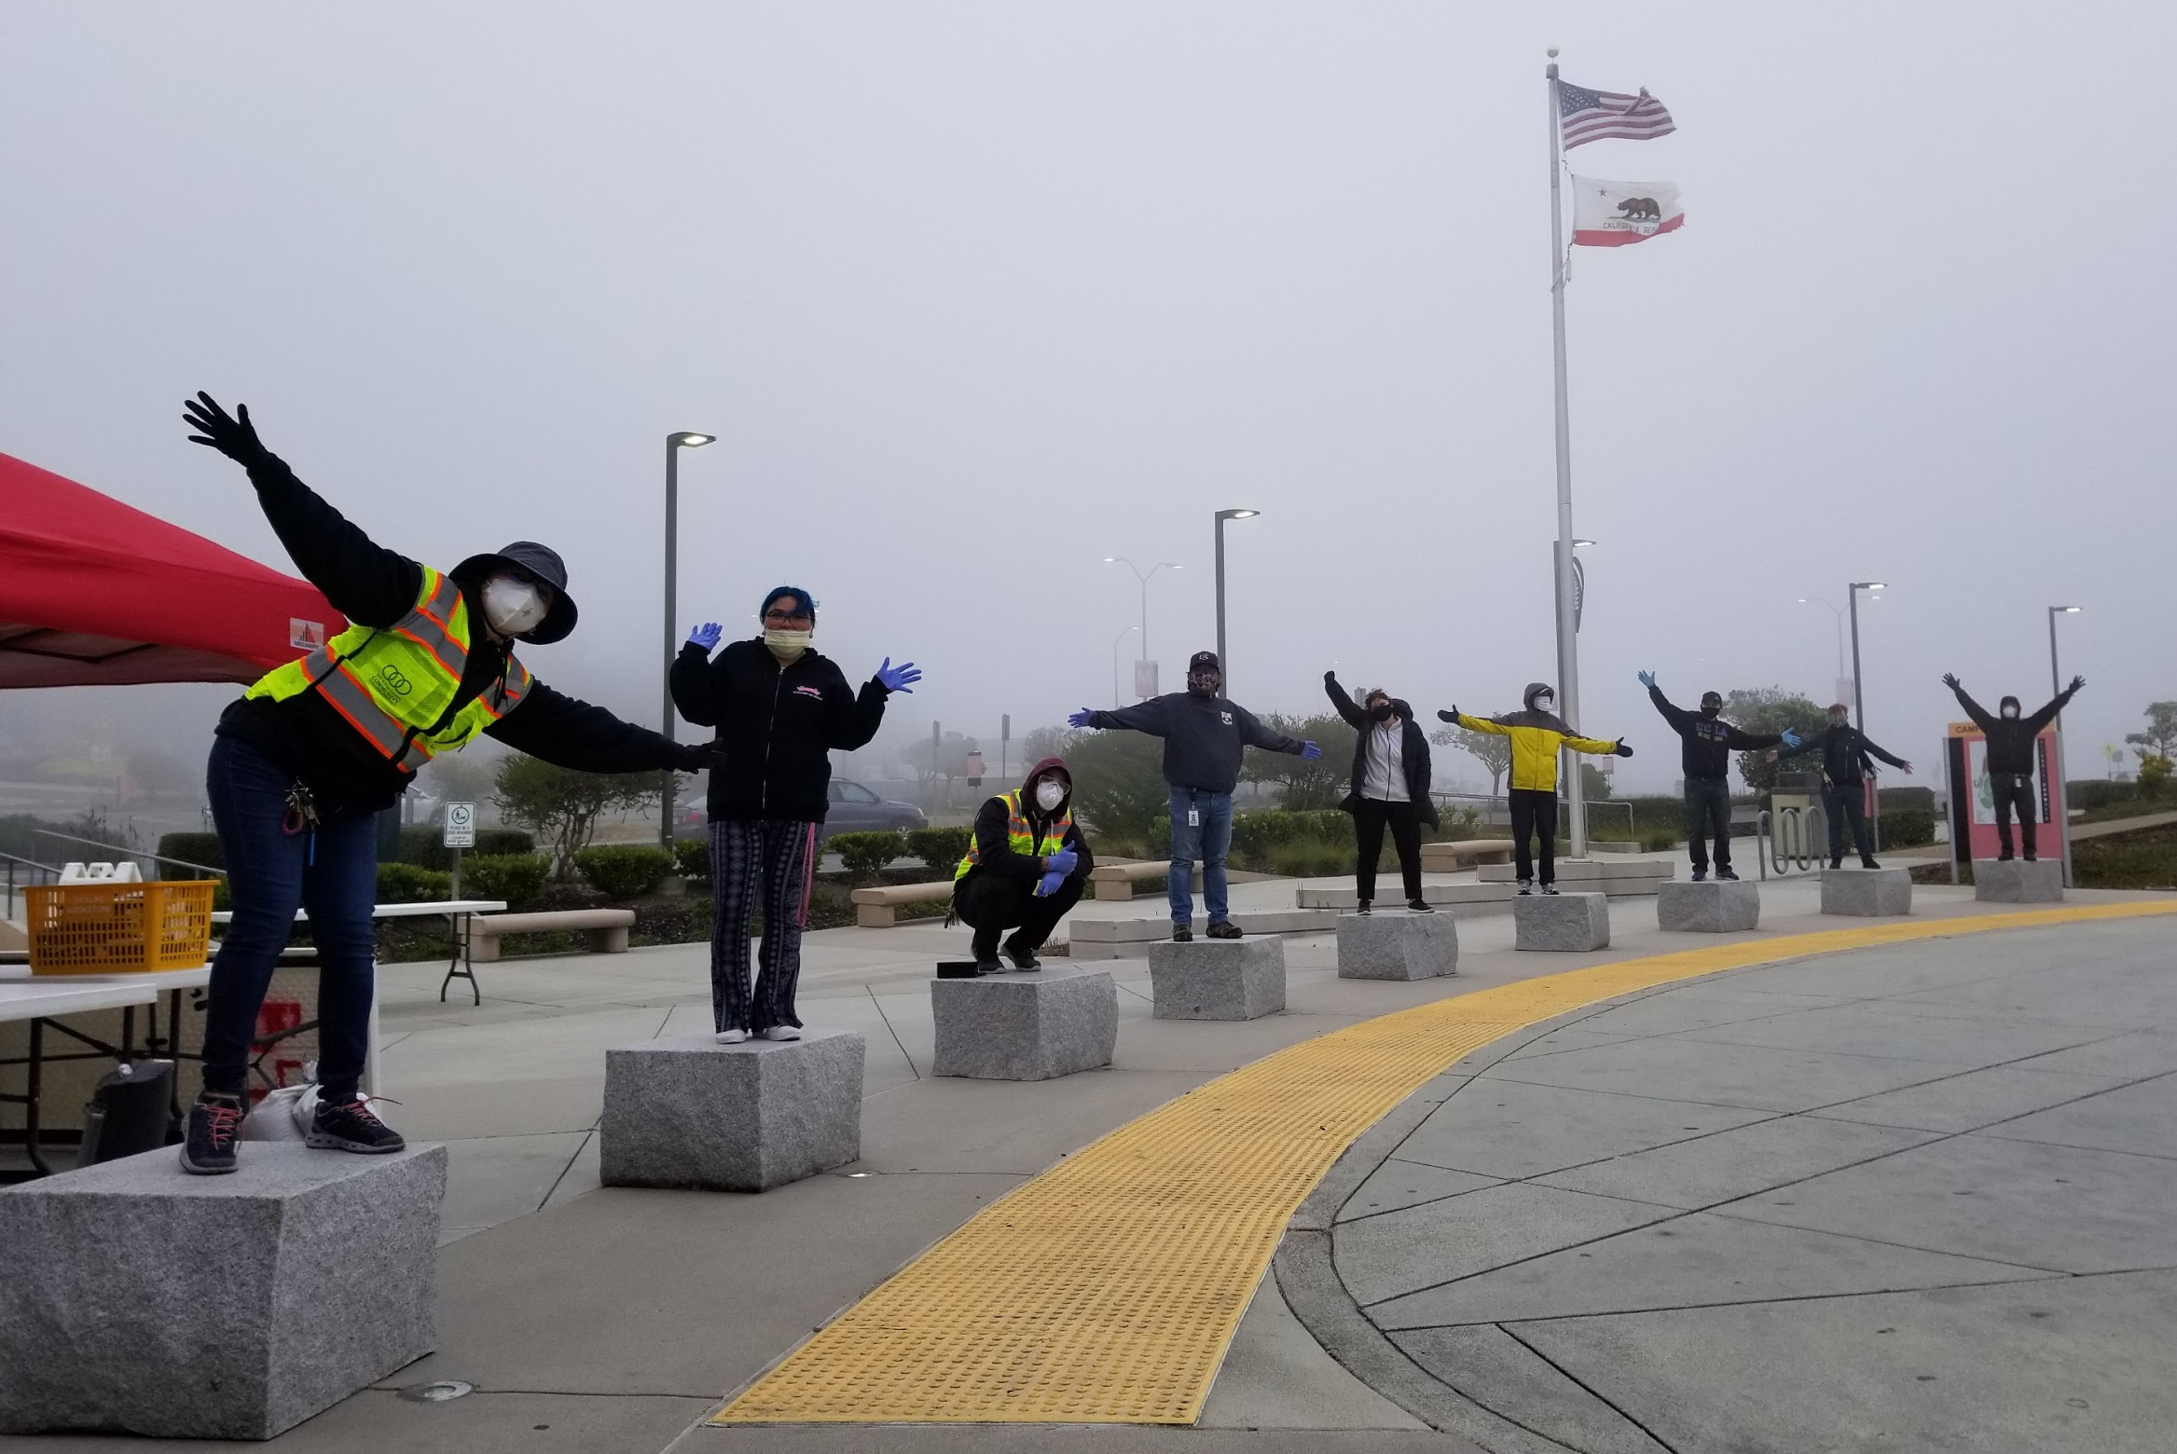
Circulation Services While Operating Remotely
Discussion: Successes and Challenges
Document link

Slide 13
Future Projects
Working with letters and notices
Handling lost items
FAQs and Quick Tips

Slide 14
Questions? Comments? Suggestions?
Let us know. Our contact information is on the wiki page.

