Slide 1
Library Service Platform
Project Update
East Central Region Meeting
October 10, 2018
Amy Beadle, LSP Statewide Program Manager
Doug Achterman, LSP Task Force and CCL President

Slide 2
LSP Project Purpose and Plan
On behalf of the California Community College libraries, the California Community Colleges Chancellor’s Office (CCCCO), and the CCC Technology Center (CCCTC) have initiated a state-funded project to obtain a single cloud-based library services platform (LSP) to replace the various ILS systems now in use in any of the 114 libraries which choose to participate. The CCCCO and the CCCTC have partnered with the CCL to form project governance, develop a project workplan, select representative vanguard colleges and complete the procurement process.

Slide 3
LSP Project Purpose and Plan
After an in-depth evaluation process, the Ex Libris Alma and Primo products were selected to serve as the LSP platform for the California Community Colleges. The project team, CCL, vanguard schools and other stakeholders are now working with Ex Libris to assure a successful implementation across the system. A single implementation for all participating libraries will begin in January 2019 with all participants going live on the system in December 2019 or January 2020. The implementation fee and the 2020-21 subscription costs will be funded by the LSP project for all participating institutions.

Slide 4
LSP Project Ongoing Funding
A request for ongoing funding for an additional five years was submitted by the Council of Chief Librarians for consideration in the 2019-20 Legislative Budget. That proposal was approved by the Board of Governors on September 17, 2018. If awarded, funding would include the ongoing Alma/Primo subscriptions for all 114 colleges, the possible addition of the Ex Libris Leganto product (implementation and subscription) for all 114 colleges, as well as ongoing project management, administration and library systems expertise at the program level.

Slide 5
Reasons to Join the Statewide LSP
Cost Savings
Enhanced Discovery
Integrated Workflow
Improved Maintenance
Support Staff at the System-level
Robust Analytics
State of the Art Architecture and Design
Collaboration with other CCC libraries
Better User Experience – for students and staff!
Notes:
16 + 67 = 83 (of 86 contractually obligated)

Slide 6
CCL Task Force
CCCCO
CCCTC
LSP Project Leadership
Doug Achterman, CCL President
Leslie Tirapelle, CCL President Elect
Alicia Virtue, CCL Treasurer
John Taylor, CCL Regional Rep
Gregg Atkins, CCL Executive Director
Gary Bird, CCCCO Project Monitor
Amy Carbonaro, LSP Statewide Program Manager
Amy Beadle, LSP Statewide Program Manager/Project Lead

Slide 7
LSP Workgroup Structure
LSP Governance Committee
ELUNA Work Group
Acquisitions
Analytics
Cataloging
Circulation
Discovery & User Experience
Resource Sharing
Systems

Slide 8
Vanguard Phase
11 previously selected colleges will participate in a pre-implementation phase of the project, lasting approximately four months (September 2018-December 2018). During this phase the participating colleges will go through the major steps of implementation, including training, data migration, network zone building, system configuration and initial workflow planning. The lessons learned from this phase will influence decisions to be made on collaborative workflows, new policies, new services, etc. that may be facilitated by the LSP.

Slide 9
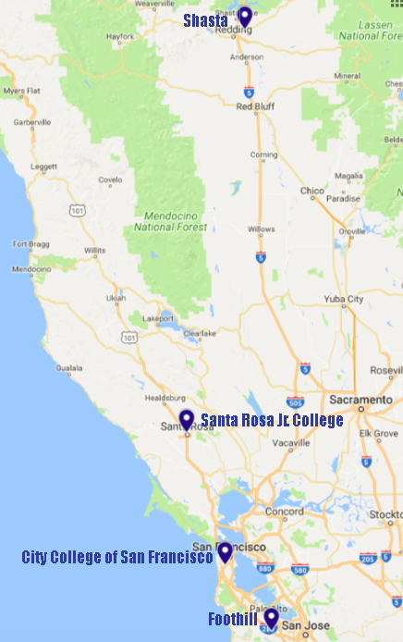
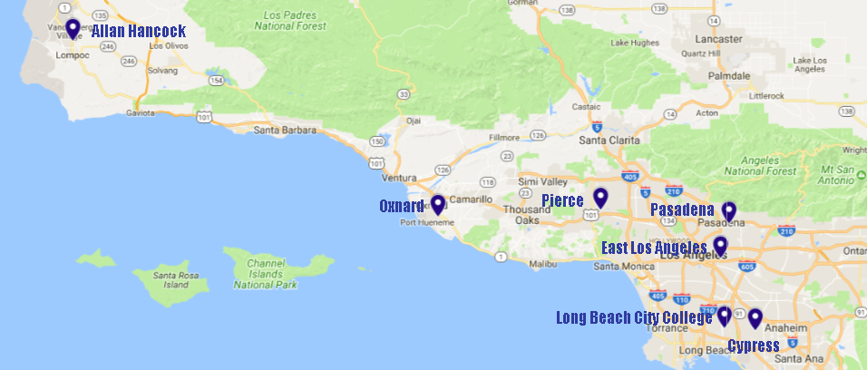
LSP Vanguard Colleges

Slide 10
LSP Implementation Schedule - Tentative
September 2018 | Vanguard Phase Kick-off
October 31, 2018 | Agreements Signed from all Participating Institutions
December 2018 | Vanguard Phase Concludes
Late January 2019 | Implementation Kick-off
March-April 2019 | Implementation Test Loads Delivered
April 2019 | Implementation Alma/Primo Env. (Sandboxes) Available
April-October 2019 | Implementation Data Review & Integrations
May 2019 | Implementation Workshop 1 (2) x 2 days
May 2019 | 2019-20 Budget Released – Phase II Planning

Slide 11
LSP Implementation Schedule - Tentative
October 2019 | Provision local SFTP servers for SIS loads
October 2019 | Authentication Forms complete
October 2019 | 3rd Party Integrations complete
October 2019 | Implementation Workshop 2 (2) x 2 days
October-November 2019 | Alma Certification complete
October-November 2019 | Primo Certification complete
December 2019 –January 2020 | Implementation Go-Lives
January-Feb 2020 | Configuration refinements/review
March 2020 | Switch to Support/ Project Close

Slide 12
LSP Interest and Participation
As of today, 84 Letters of Intent and 48 Institution Participation Agreements (IPA) have been received. There are currently 54 IPAs pending in the signatory process.
Notes:
48 + 54 = 102 (of 86 contractually obligated)

Slide 13
LSP Participation in the East Central Region
100% have submitted Letters of Intent
20% have the Institution Participation Agreement (IPA) in the signatory process
80% have submitted a signed and executed IPA
Well done, East Central Region!
Notes:
Reedley and College of the Sequoias are pending

Slide 14
What Now?
If your IPA has not been signed and submitted, please talk to your administration about the LSP project and make a plan for getting your Institution Participation Agreement signed and submitted by October 31, 2018.
If your IPA has been signed and submitted,
Take a deep breath
Pat yourself on the back
Determine who your LSP project lead will be on your campus
Look for communication regarding next steps in early November

Slide 15
Q & A

Slide 16
Contact:
Amy Beadle
Statewide Program Manager/Project Lead
abeadle@ccctechcenter.org
530.879.4170
Doug Achterman
CCL President and LSP Task Force dachterman@gavilan.edu

