Slide 1
CCCCO Technology Update
Omid Pourzanjani, Ed.D.
Visiting Vice Chancellor
Digital Futures Lab
Notes:
Good morning!
My name is Omid Pourzanjani. Many of you know that I was at Golden West College for many years as CIO and CSSO. And recently joined the Chancellor's office as a visiting vice chancellor.
Our goal for the webinars this week is to bring you up to speed on what is happening at the Chancellor’s office with regards to technology and engage you in a conversation on where we need to go.
The presentation today has two parts. The first part looks at student onboarding and the technologies we have there.
The second part of the presentation focuses on the Grant Management tool called NOVA and how we are envisioning that tool as a place to centralize grant and categorical fund management portal.
But mostly, the intent of all of this is to increase the collaboration and integration not only within the Chancellor’s Office and the tools and services it provides to you, but to increase the Chancellor’s Office’s collaboration and integration with you and the tools and services you are evaluating and or deploying to support students.

Slide 2
Student Support Technologies Are Fragmented (Partial List)
cccApply
Canvas Orientation
CaCareerCafe
EduNav
College-Scheduler
iCanAffordCollege
Career Coach
Starfish
Banner Registration
CampusLogic
Here2Career
DegreeWorks
EduNav
Registration
eLumen CRM
EAB Navigate
Program Planner
Notes:
Incomplete/fragmented student experience. The cafeteria model.

Slide 3
Student Journey Maps
A way to create a vision for what the ideal student journey could be.
Using the vision to guide the planning, designing, and enhancing technology solutions
Personas reflect common student journeys

Slide 5
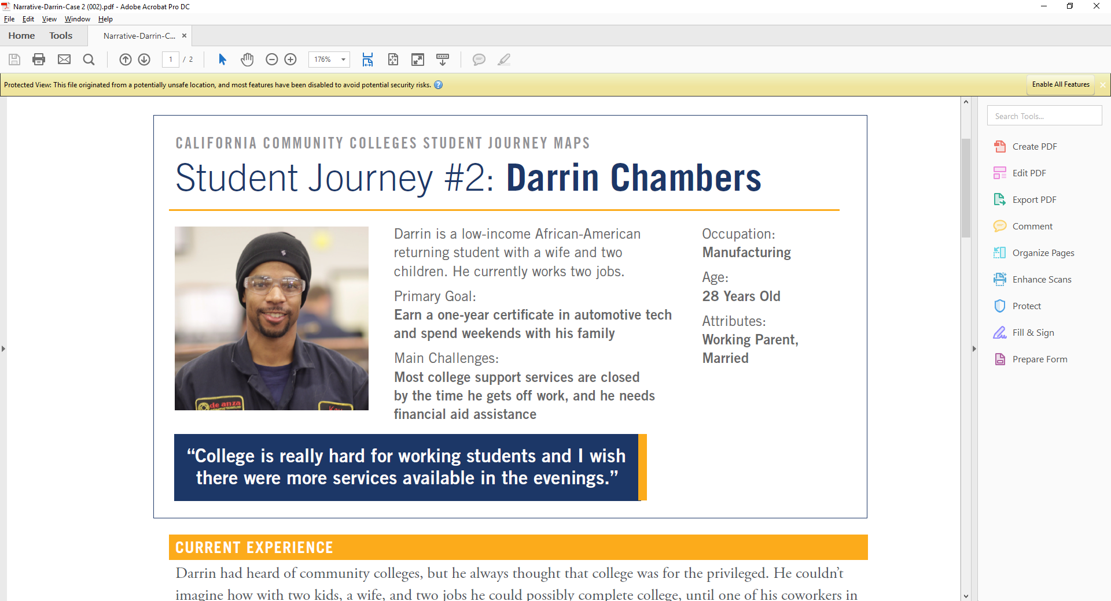

Slide 6
And More
A 22-year-old single-parent female Hispanic student that is a first generation college student. She would qualify for EOPS but has no idea that such a service exists and what it is. She is seeking the education needed to get a middle-income job.
A returning veteran that wants to pursue a career in Health. He had medic experience in military. He works full time and wants a flexible schedule.
A white LGBTQ female that was an honor student in high school. She can’t afford going directly to a four-year university. So she is looking for similar opportunities at a community college before transferring.
A 32-year-old male working-adult coming back for upskilling and a CTE certificate.
Recent immigrant with ESL needs that comes in through Adult Ed with the goal to get accelerated CTE training that would lead to a job.

Slide 7
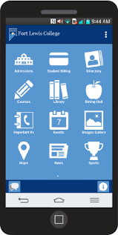
Vision: Integrating and Personalizing Onboarding
Create a Account
OpenCCC
Career Exploration
Program Planning
English/Math Placement (Multiple Measures)
Complete
Application
CCCApply
Guided Student Services Selection
Schedule Builder & Registration
Handoff
Orientation information shared before each step
CCCApply information collected throughout the onboarding process
Common data storage and security
Branded solution for each college
Added features including Spanish language support, Universal Access, text notifications, mobile support, consistent user experience, plug-&-play infrastructure

Slide 8
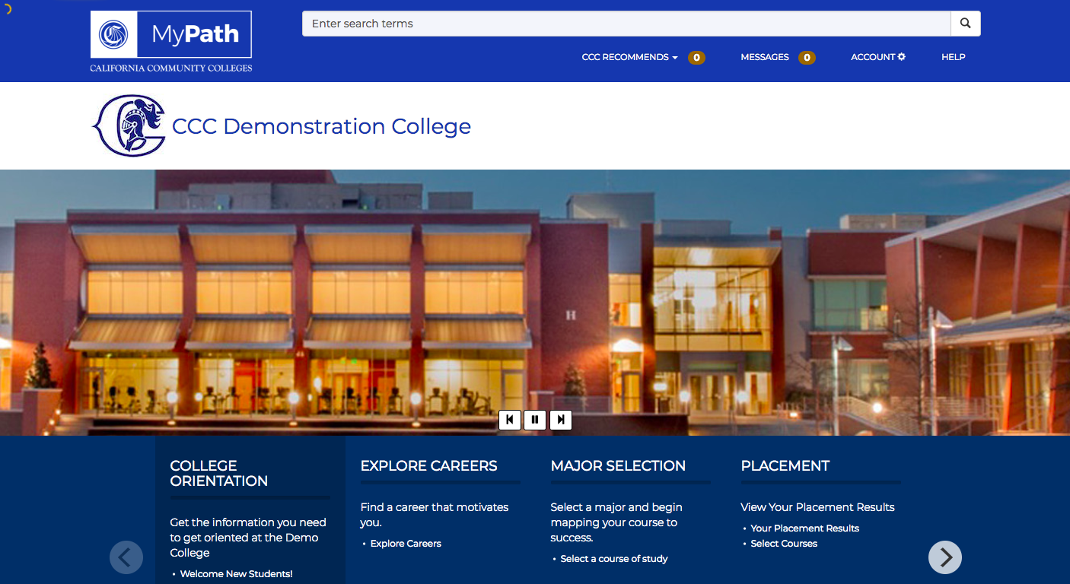
Customizing Onboarding Sequences
Notes:
In initiating this discussion with you, I had the choice of starting with a blank sheet and asking “where do you want to do?”
But my experience is to have something people can look at, critique, add to, scrap and come up with something new… But at least have a starting point.
MyPath is a tool that the Educational Planning Initiative Advisory group has been working with the Tech Center for the past couple of years to develop. From what I am told, the tool is in production in one shape or another at 35 different colleges. What I have been working with them to do in the past month or so, has been to showcase how the tool could be used to GUIDE student through the onboarding process as opposed to providing a large number of links to the students that they can pick from like a cafeteria model.

Slide 9
Vision: Onboarding Process Hand-Off
Student Information
System (SIS/ERP)
Alerts
Canvas
Assignments and Exams
Alerts
Starfish
Early Alerts
Student Services Alerts
Student Engagement
Activities & Reminders
Onboarding Handoff
Student
Academic Progress Tracking
& Support
Student Financial Health Tracking
& Support
Student Health Tracking
& Support
Handoff from onboarding to the actual education journey via a common device
Continuous engagement with critical information such as class schedule, class assignments, performance in class, grades, educational plan, financial aid status, classroom reading material, upcoming registration deadlines, upcoming graduation deadlines (and pre-populated forms), student services info (DSPS, EOPS, CalWorks, …), and student engagement info (athletic events, performances, presentations, club meetings, …)

Slide 10
Expansion of Data Projects
LaunchBoard
(Example Dashboard)
NOVA
(Fund Management,
Example application)
MyPath
(Example application for Real-Time Student support Applications)
S
W
P
A
E
B
G
G
P
O
T
H
E
R
Simplified Metrics
Big Data
Cal-PASS
CCGI
ccc Apply
Curri-culum
Other
Current
AB-705
Multiple Measures
(Example initiative)
CDE
MIS
Canvas
CSU/UC
Other
Future

Slide 11
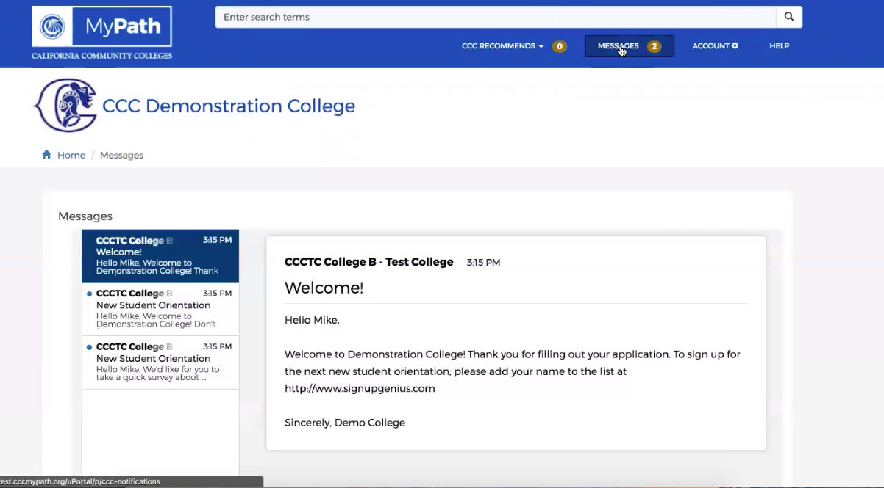
Integrated Text Messaging and Inbox

Slide 12
Seamless Student Experience
Internship/Apprenticeship/Job Placement
Canvas
Learning Management System
Financial Support Services
Onboarding
(MyPath)
SIS/ERP
Student Information/
Resource Planning
Program Planning/Guidance
High School Engagement
(CCGI)
Career
Plan
Major
Selection
CCC Apply
Registration
Starfish Early Alert
Continuous Engagement
Data Services – Personalization - Engagement
Web Portals

Slide 13
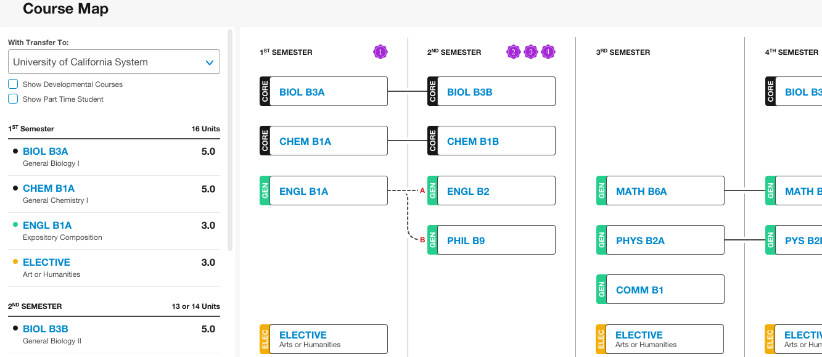
Possible Graphical Pathways

Slide 14
Program Planner & Curriculum
Curriculum Inventory
DegreeWorks
Starfish
Program Planner Data
C-ID
Data
EduNav
Bakersfield Program Planner
Others
ASSIST

Slide 15
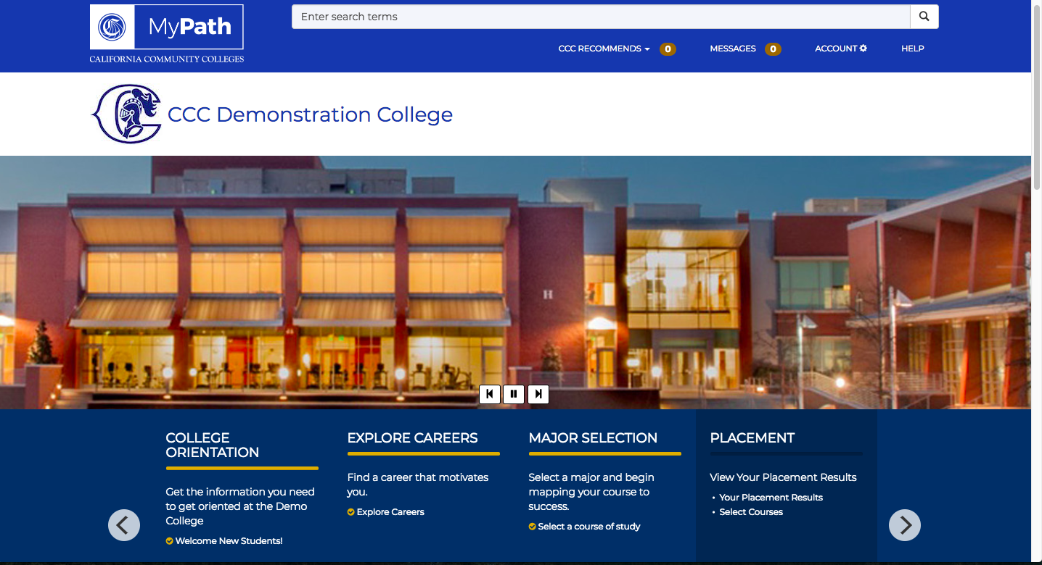
Consideration for Placement (AB-705)

Slide 16
Proposed Placement Logic
cccApply/MyPath
Process
Steps
Yes
Does record exist in CCGI
Other cccApply Steps…
no
Yes
Does record exist in CalPASS
MM
Placement Step
no
Yes
Does record exist in CDE
Application and Placement Data
Math/English
Placement
Recommendation
no
Present
Self-Reporting Screen
Colleges

Slide 17
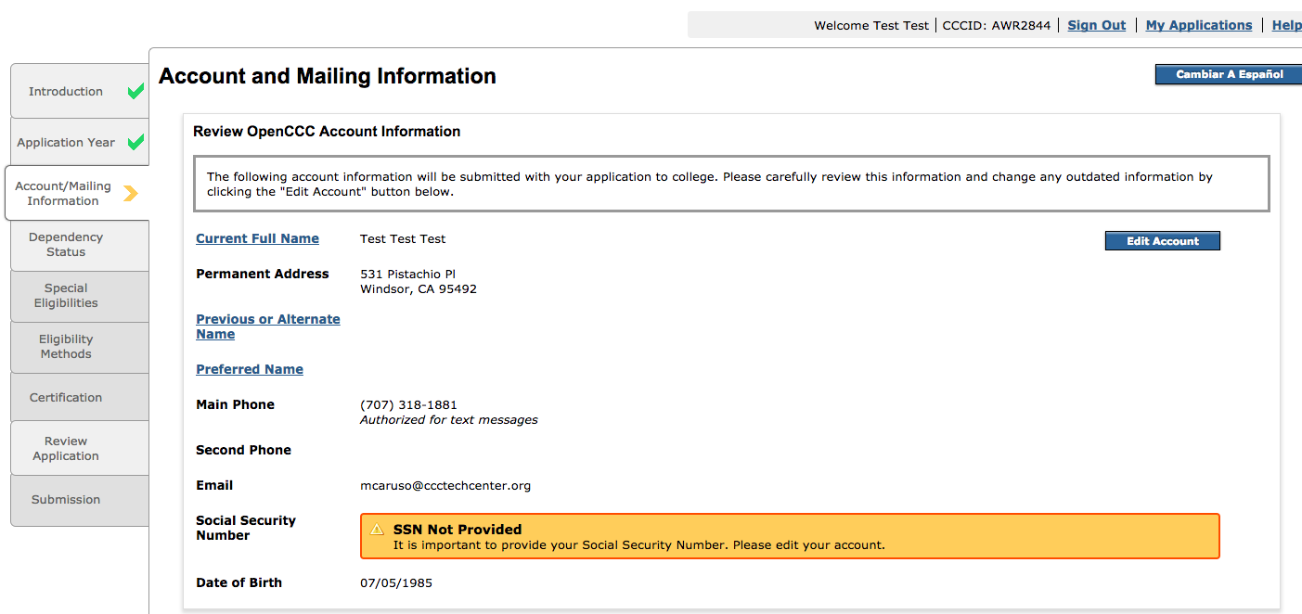
Possible Auto-Population of Forms
(Example: California College Promise Grant Application)

Slide 18
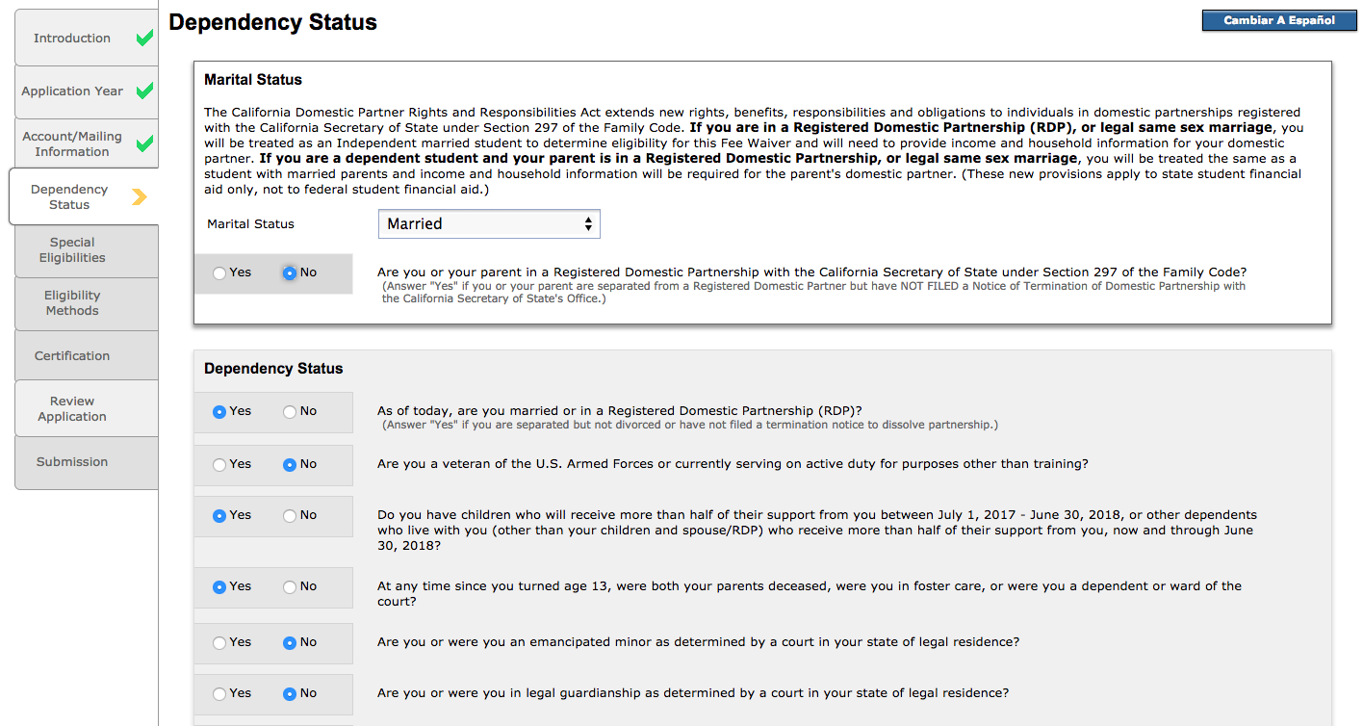
Spanish Language Support

Slide 19
Integrated Student Support Links

Slide 20
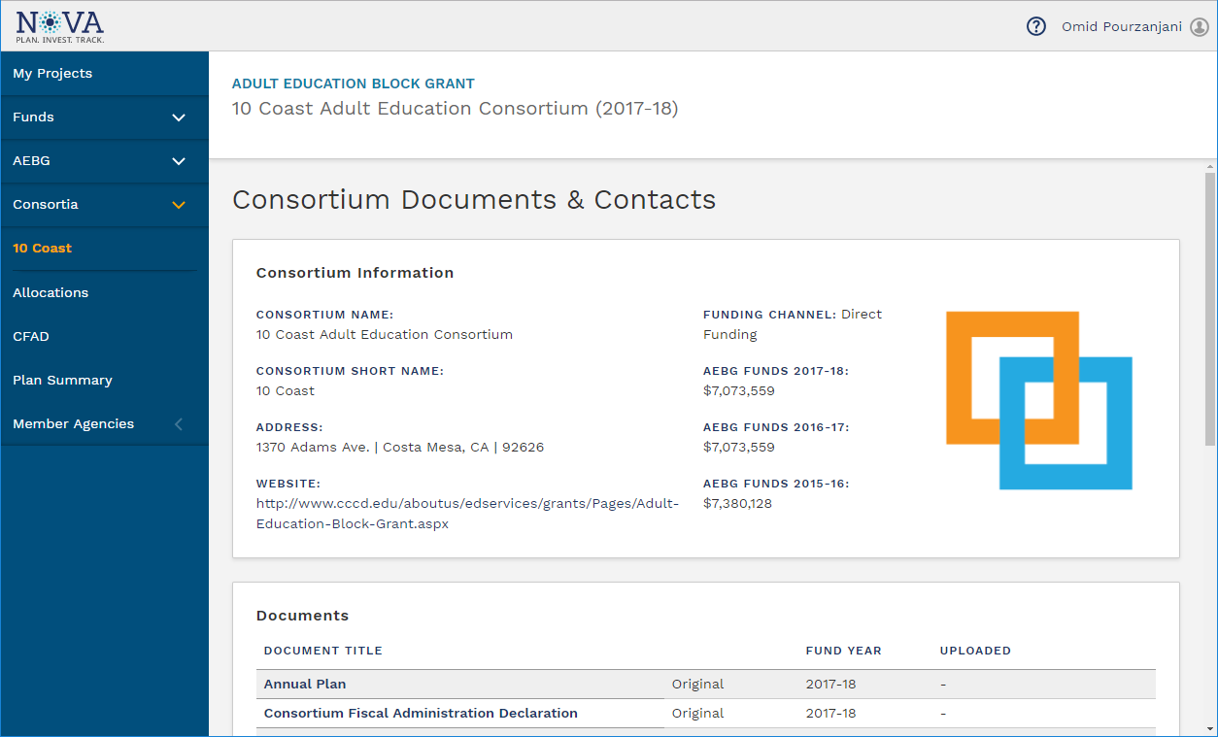
Integrated Funds Management

Slide 21
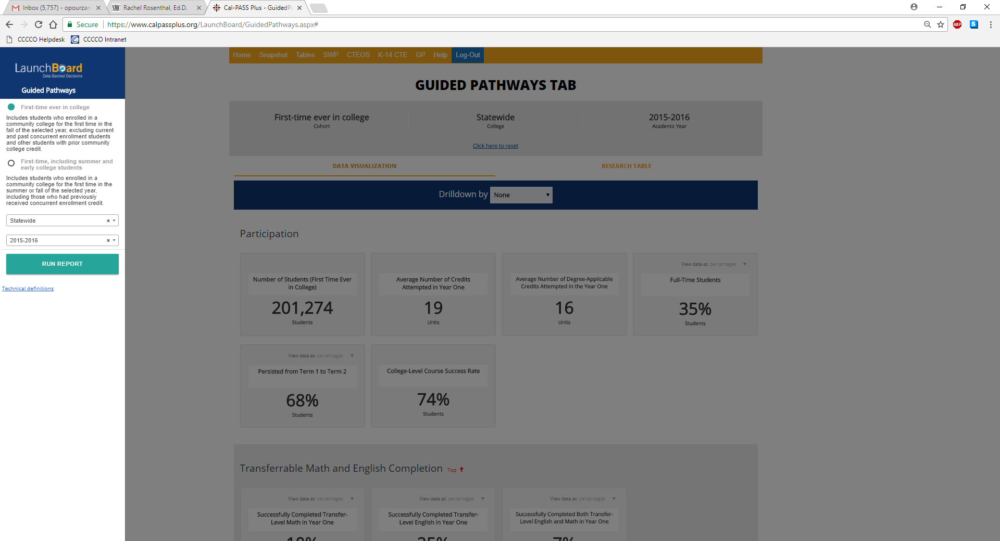
Integration with LaunchBoard

Slide 22
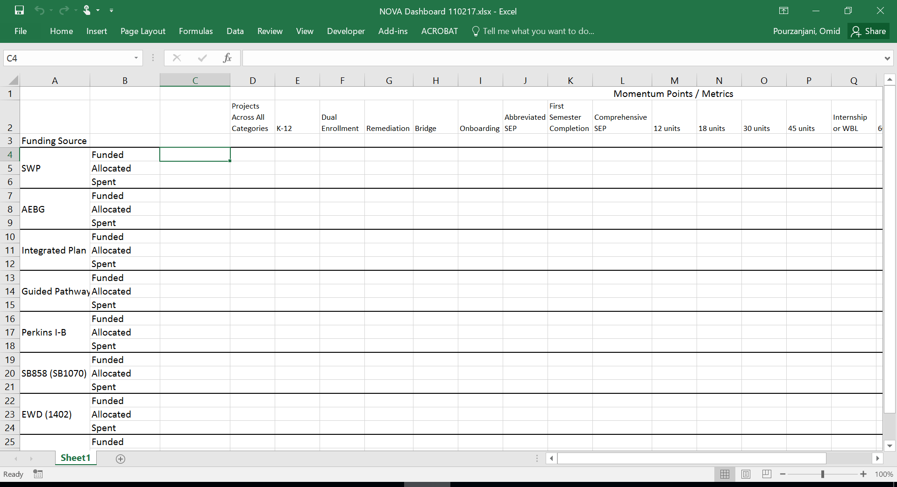
Managing the Investments

Slide 23
Metrics Simplification Initiative
The focus will be strictly on students and their educational journeys from recruitment to completion, not on functional divisions, grants, funding sources, etc.
The outcome will be ONE set of metrics drillable for details. This set of metrics will displace all other student-specific metrics (except for Federal metrics such as Perkins).
Equity will not be viewed as a separate activity. Instead, it will be observed across all metrics. Therefore, each metric will be drillable by gender, age, ethnicity, first gen, SES, etc.
Metrics will be broken into three categories: access (input), practices (process), and student outcomes (output).
Number of recommended metrics will be limited to ensure that we focus only on critical measures.
Each metric will be closely reviewed to ensure it is valid, viable, drillable, measurable, and critical.
An implementation/transition plan will be created for when each metric in the set can be put into production and which ones need legislative work. Extensive analysis and modeling of data will be performed before the presentation of the implementation/transition plan.

Slide 24
From Silos to Integration
Develop standard IT service-delivery practices across the technology portfolio to improve consistency, transparency, and quality
Shared Infrastructure
Core Applications
Online Education Initiative (OEI)
Data Services
Data Research & Analytics
User Interface & User Experience
Project Management Office: Schedule, Budgeting, Asset, Issue/Risk, Operational Metrics & Portfolio Mgmt.
Enterprise Architecture: Alignment of Strategy, Business & Technology across Technology Portfolio
Edtech Standards
Information Security: Compliance with State & Federal IT Security Policies & Regular Monitoring
Commercial IT Vendor & Product Selection Standards: Interoperability, Sustainability & Avoid Duplication

Slide 25
Q & A

