Slide 1
CaliforniaColleges.edu and CCCApply
Ben Baird, Director of Data Management, CCGI
March 28, 2018

Slide 2
What are we going to cover this hour?
What is the California Colleges Guidance Initiative?
(super) Brief tour of CaliforniaColleges.edu
Review integration between CaliforniaColleges.edu and CCCApply
Review current functionality for students and K-12 educators
Next steps – PESC XML High School Transcript to support
AB 705 implementation
Education planning
…other college efforts?
Aligning effort – CCC/CSU/CCGI Central Valley Pilot
Data security
Questions?
Notes:
(give my intro here)

Slide 3
Who?
Notes:
What is the California Colleges Guidance Initiative?

Slide 4
What is the California College Guidance Initiative?
CCGI provides a data and planning infrastructure that helps increase postsecondary preparation and attainment for students in California.
Our Objectives:
All high school seniors graduate with clear postsecondary goals and a plan for how to achieve them.
Students’ academic transcript data follows them as they advance across educational systems to reduce information gaps that could otherwise hinder their success.
Our Tools:
CaliforniaColleges.edu
Data Team and Data Standards
Implementation Support Team

Slide 5
Approach
Our Approach:
Manage the State of California’s college and career planning platform, CaliforniaColleges.edu and its embedded 6th-12th grade curriculum.
When appropriate, utilize CaliforniaColleges.edu as hub which facilitates the reliable matching of unique student identifiers and the transmission of students’ transcript records between K-12 districts and the California Community Colleges, the California State University System, the California Student Aid Commission, and the Free Application for Federal Student Aid.
Increase the capacity of K-12 school districts to make college and career planning a systematic part of all 6th-12th grade students’ education.

Slide 6
Governance
The Foundation for California Community Colleges (FCCC) provides the fiscal and legal home for CCGI.
An inter-segmental advisory committee includes campus and community-based college guidance practitioners as well as admissions and student services professionals from the higher education system offices (CSU, CCC, UC and independent colleges and universities).
Notes:
FCCC is the official and statutorily authorized foundation of the CCC system (BOG and CCCCO).
FCCC is a $30M/year organization with over $90M in assets under management. They are in statute as the support organization to the California Community Colleges, and/but house CCGI on behalf of all the segments since there is no inter-segmental entity in which to house the effort.

Slide 7
Why We Exist: K-12
750 : 1
Notes:
Notes
Average counselor caseload in California’s public schools is 750:1 – since most counselors are in secondary schools, average ratios are approximately 500:1, but even that is twice the American School Counseling Association recommend ratio of 250:1, and still one of the worst caseload ratios in the country.
The CaliforniaColleges.edu platform and its embedded curriculum provides a a baseline college and career planning standard that students should complete, a way to store and track student progress toward meeting that standard, and a way to coordinate among relevant adults (educators, counselors, parents, etc.) around a unified plan for each student.

Slide 8
K-12 College and Career Guidance Reality
16 Standards
No College Planning
Notes:
16 core standards under the PPS credential, and not one is specific to college planning.
This means that counselors have to learn this on their own and there is widely variable knowledge in the field.

Slide 9
In alignment with guided pathways
Notes:
CCGI is all about helping students to get on a path – define a career goal, figure out an associated educational pathway, provide both academic transcript data to support placement and all educational planning data that might be relevant to a student who is transitioning from K12 to higher ed.
We can really support preparation/awareness

Slide 10
Two Use Scenarios
All California K-12 Students
Students in data-informed partner districts
Access to college and career planning tools a
Access to academic planner using CMP course data
General regional training and user support
Account can connect to CCCApply and CalState.edu/Apply
Data-informed academic planning tools
CSU/UC eligibility tools to inform increased “a-g” completion rates
Pre-verified data can inform application to CSUs and CCCs
Data match pilot with California Student Aid Commission
Intensive, customized consultation and user support
Notes:
Partner districts have legal agreements that enable us to receive student transcript data without which the data informed functionality won’t work

Slide 11
Foundation of Partnership
California College Guidance Initiative
Local Implementation Team
Data Analysts
District
CCGI Lead
District Data Team or Lead
School Site Leads
Counselors
Principals
APs
Teachers
Strategy
Full immersion across counseling and instructional time
Leadership Teams
Cross-functional group of district educators, whose purpose is to guide the CCGI implementation process
Speaks to various district perspectives and priorities and collectively make decisions about the CCGI partnership
Develop and execute district’s multi-year plan
Track metrics
Conduct ongoing evaluation of district’s capacity

Slide 12
CaliforniaColleges.edu tour (brief)

Slide 13
History of CaliforniaColleges.edu
Established in 1998 through an inter-segmental budget proposal by the California Community Colleges, California State Universities, University of California, California Department of Education and the Association of Independent California Colleges and Universities with the purpose of providing:
1) A common front door to higher education in California, and
2) An electronic transcript platform
CCGI assumed management in July of 2013
Rebuilt from scratch in 2017 based on user feedback

Slide 14
Curriculum
The embedded 6th-12th grade curriculum guides students through a series of developmentally appropriate college and career planning activities so they can:
Discover their path
Plan their future
Launch their plan
Notes:
Notes
The CCGI curriculum has been carefully designed to walk students step by step through the entire process.
Activities take students from initial discovery, to thoughtful planning, to the launching of an informed postsecondary plan.
Each student’s situation and goals are unique, and the curriculum allows them to create a plan that’s truly right for them.

Slide 15
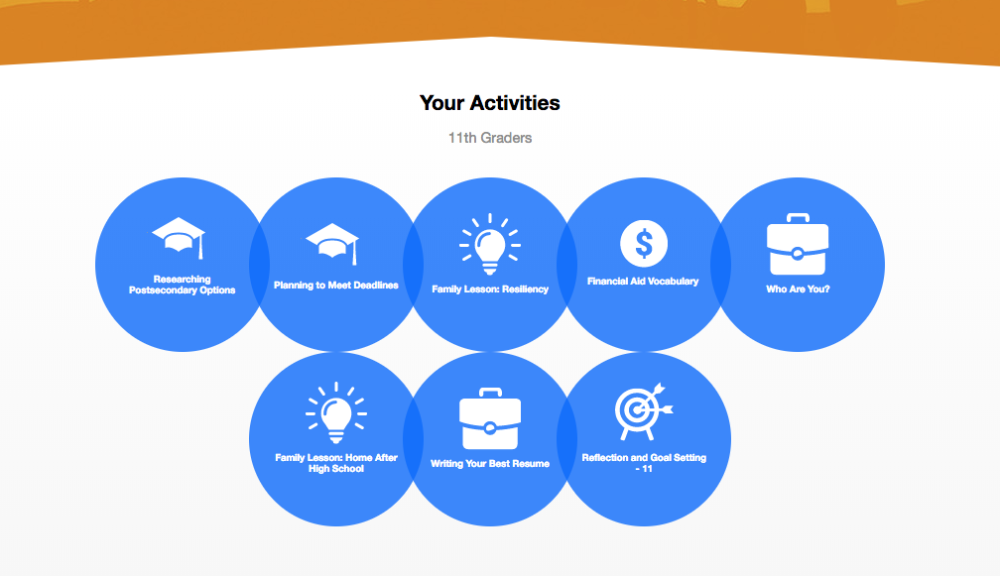
Curriculum
Students sign in and find a customized home page for their grade level.
They click on any of the blue bubbles to access the embedded curriculum and get started.
Notes:
Notes
At the core of the student experience are the blue buttons.
The blue buttons on the homepage show the default activities for the student’s current grade level.
Clicking on any bubble takes students to My Tasks, where they can download worksheets to complete the grade-level activities.
These activities include a series of actions students can take on the platform, such as:
Completing an assessment
Researching and favoriting colleges, careers, or majors
Planning coursework
Completing a journal entry.
Activities have been carefully selected and developed by counselors, teachers, and CCGI and represent what students should minimally do to develop and launch a post-secondary plan.

Slide 16
Curriculum
The curriculum has associated lesson plans that educators can use during instructional time and counseling interventions.
Notes:
Notes
While students can click on a blue bubble and complete a worksheet on their own, the activities are more powerful when completed in the context of a classroom or counseling environment.
Each lesson plan incorporates one or more trackable activities, supplemented by appropriate research, classroom-based discussions, and/or presentations to help deepen students’ thought processes and ability to make sense of the information.
The lesson plans are designed to build on each other in sequence, but are flexible enough to let students start wherever they are.
In other words, if a student doesn’t begin using CaliforniaColleges.edu in 6th grade, he or she can still use the platform to create an informed plan.
Educators can assign activities intended for other grade levels as necessary to meet the needs of students.
The lesson plans incorporate Common Core standards like reading for information and narrative writing, and 21st Century Skills like critical thinking, digital skills, and effective research practices.

Slide 17
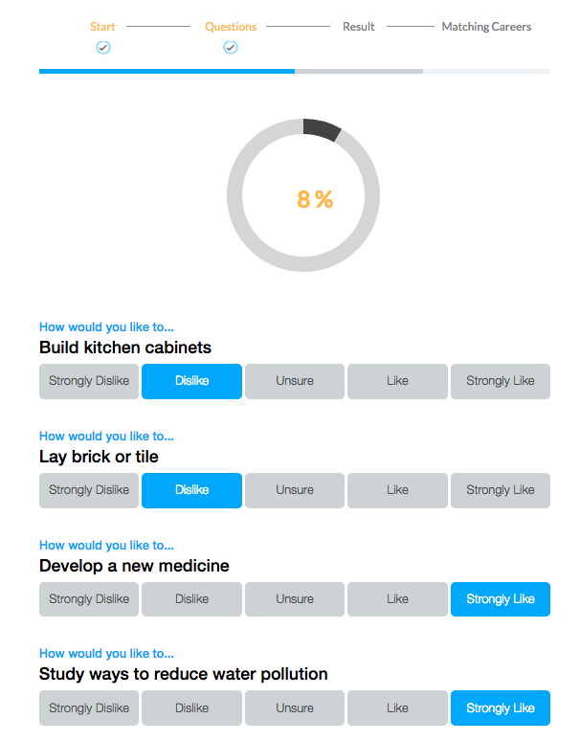
Career Assessments
Career assessments help students connect their personal preferences, interests, and skills to their career goals.
Interest Profiler (All Students)
Learning Styles Inventory (Middle School Students)
Multiple Intelligences (High School Students)
Do What You Are (High School Students)
Notes:
Notes
Four assessments are available to students to help them engage in personal exploration.
The Interest Profiler is available to all students, and helps students discover their level of interest in activities in six career-based areas: Enterprising, Social, Artistic, Conventional, Investigative, and Realistic. Students can then explore careers that match their interests.
The Learning Styles Inventory helps middle school students discover their environmental, physical, emotional, and sociological needs when it comes to learning. It can help resolve learning and productivity issues and build student confidence as they continue with their education.
The Multiple Intelligences assessment helps high school students identify their potential in nine different intelligences (bodily-kinesthetic, interpersonal, intrapersonal, linguistic, logical-mathematical, musical, naturalist, spatial and existential.) Students can then work to strengthen their intelligences and explore recommended careers based on their strengths.
The Do What You Are assessment (MBTI) helps high schoolers make more informed decisions about their future by identifying their personality type. Students can explore suggested careers and majors in which those with similar traits have been successful.
Once students have completed an assessment, the results are saved to their account for later reference.

Slide 18
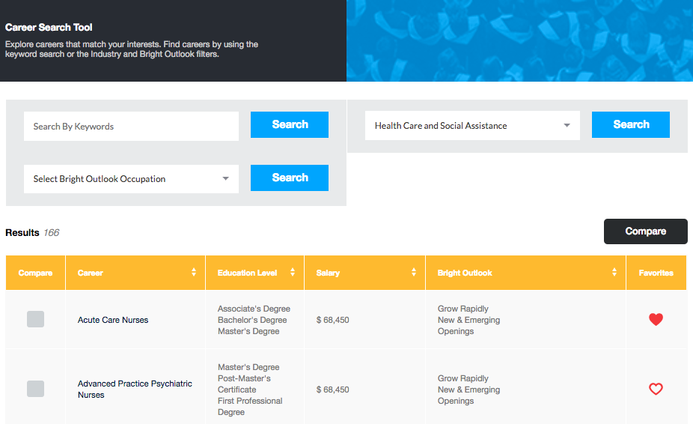
Career Search Tool
Students can use the Career Search Tool to explore careers that match their preferences.
Notes:
Notes
Once students have learned about themselves and their preferences, they can research and compare potential careers using the Career Search Tool.
They can search by keyword or industry, or search Bright Outlook Occupations, which are jobs expected to have high growth and/or many openings over the next 10 years, or which are in new and emerging fields.
When students click on the name of a career they are interested in, they are taken to a detailed fact sheet containing information about responsibilities, salary and potential for growth. The fact sheet also lists the required education for that career, and suggests related majors and links to colleges that offer them. Finally, the fact sheet includes a list of related careers for further research.
Students can click the heart icon to favorite careers to save them to their accounts for later reference.

Slide 19
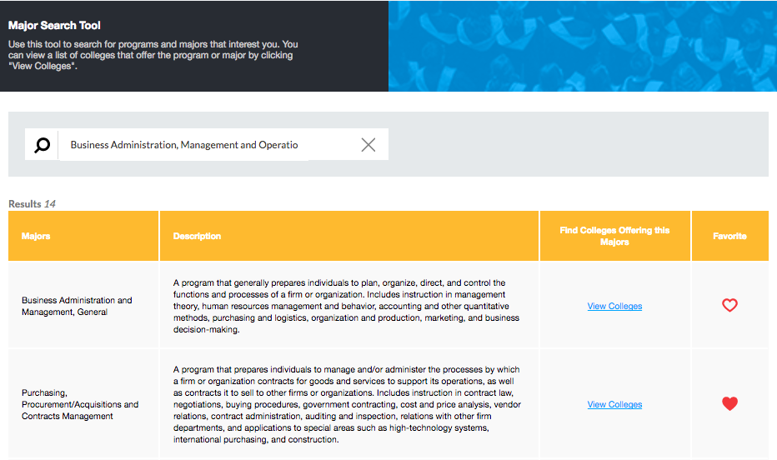
Major Search Tool
Students can use the Major Search Tool to explore majors or programs of study related to their interests, and then see which colleges offer those majors.
Notes:
Notes
The type-look ahead feature provides suggestions based on what the student is typing. So, if a student starts typing “Engineering,” they will see several options, such as Engineering Mechanics; Engineering Physics, etc.
The results will show that major, plus any related majors (if applicable), along with a description, and a link to view colleges that offers that major.
Students can click the heart icon to favorite majors to save them to their accounts for later reference.

Slide 20
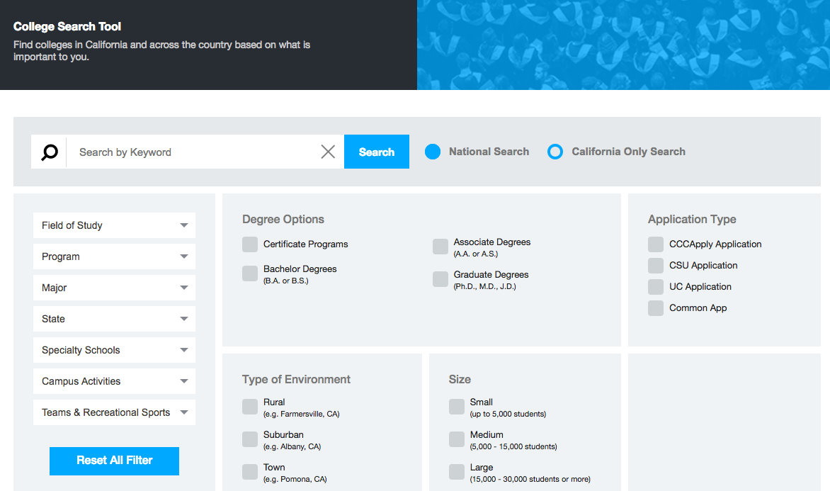
College Search Tool
Students can use the College Search Tool to research and compare colleges and find the best fit.
Notes:
Notes
Students can use the College Search Tool to search for colleges nationally or only in California.
They can choose to filter their search by the criteria that are important to them, such as degree options, environment, or size.
The tool includes public and private, not-for-profit colleges and universities offering certificates, associate degrees, bachelor’s degrees, and above.
When students conduct a search, the results provide an overview of matching colleges, including each college’s acceptance rate, institution type, and size.
Students can click on the name of a college they are interested in to access a detailed fact sheet, which includes information about admission requirements, cost and financial aid, degrees and majors offered, and campus life.
Students can click the heart icon to favorite colleges to save them in their accounts for later reference.

Slide 21
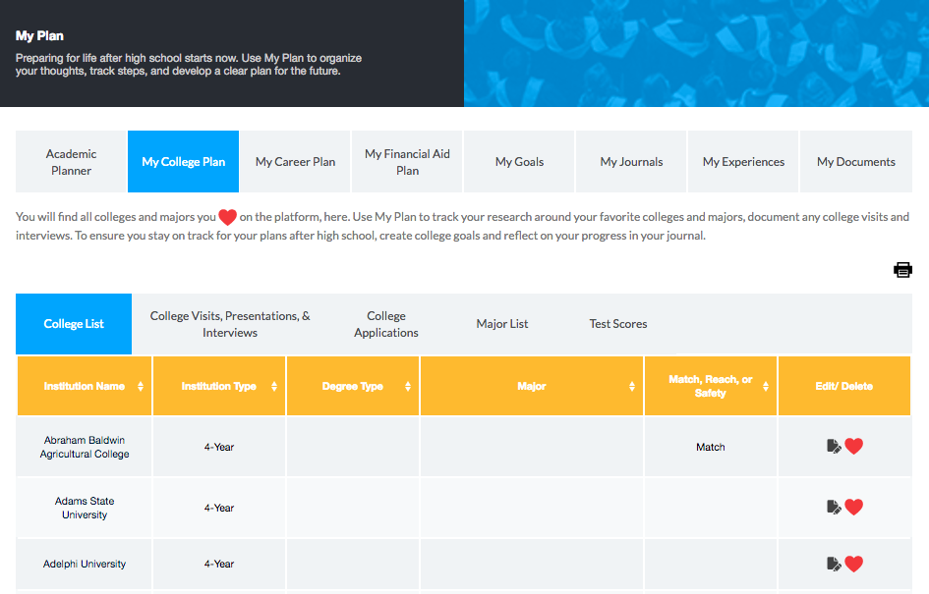
My Plan
Students’ college and career planning activity is saved in a personalized digital portfolio called My Plan.
Notes:
Notes
Student progress is saved in one convenient location, and is available via students’ CaliforniaColleges.edu account whenever they need it.
My Plan is broken up into eight sections:
Academic Planner (for thoughtful course planning and tracking of CSU/UC eligibility)
My College Plan (favorited colleges and majors, college application deadlines, and other college planning milestones)
My Career Plan (assessment results and favorited careers)
My Financial Aid Plan (Federal and state financial aid application, deadlines and submissions, favorited scholarships (Coming later in 2018), and completion of Financial Aid Eligibility and Comparison tools)
My Goals (Gives students a structured approach to determining their academic, college, career, and financial aid goals and how to achieve them.)
My Journal (Allows opportunities for self-reflection on academic, college, career, and financial aid topics.)
My Experiences (Gives students a place to log volunteer, work, or extracurricular experience)
My Documents (Students can upload and store college essays, resumes, brag sheets, and other planning documents)

Slide 22
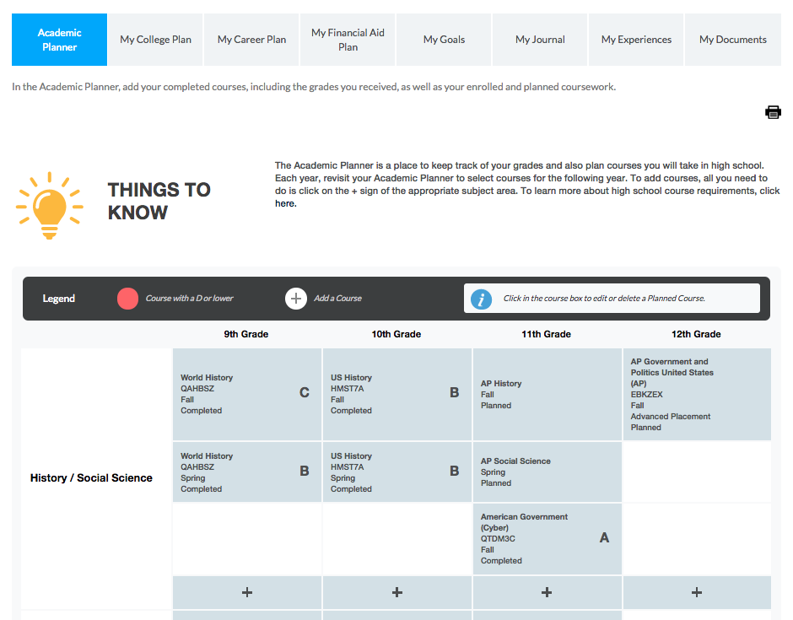
Academic Planner
Students can use the Academic Planner to intentionally plan their high school coursework.
Notes:
Notes
Some features of the platform are only accessible to districts with whom CCGI has a partnership agreement.
The agreement allows student transcript information to be uploaded from the district to CaliforniaColleges.edu, unlocking advanced functionality.
All students have access to an Academic Planner for intentionally planning high school coursework. The features of the Academic Planner differ depending on whether or not the student is in a CCGI Partner District.
The advanced Academic Planner (for students in Partner Districts) is automatically populated with students’ completed and enrolled coursework and grades. Students can also choose classes directly from their school’s course catalog.
The basic Academic Planner (for students in non-partner/open access districts) requires students to self-report courses and grades, and course selections are taken from the Course Management Portal (CMP) instead of district course catalogs.

Slide 23
Data-informed Functionality
While most functionality on CaliforniaColleges.edu is free to students and educators, there is sub-set of functionalities that can only be used if students have transcript data in their account.
This requires data sharing and fee agreements with CCGI
Data-informed Functionalities:
CSU and UC Eligibility Tools
Transcript data pushes to CCCs and CSUs to inform enrollment and placement

Slide 24
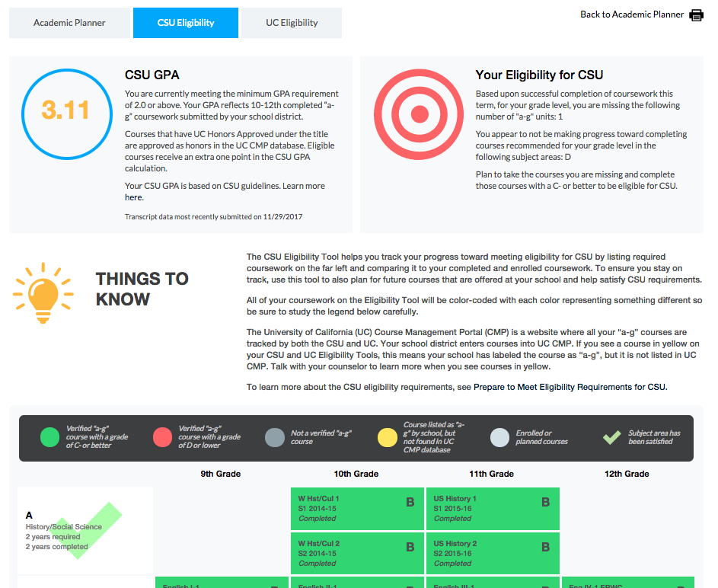
CSU and UC Eligibility Tools
In partner districts, the CSU and UC Eligibility Tools allow students to quickly track their progress toward meeting “a-g” requirements.
Notes:
Notes
The CSU and UC Eligibility Tools are located only within the advanced Academic Planner and are automatically populated with students’ current and enrolled coursework and grades.
Test scores are also factored in when the districts include them in their transcript file uploads.
Students can easily see whether or not they are on track to meet GPA and ”a-g” course requirements by the time they graduate from high school.

Slide 25
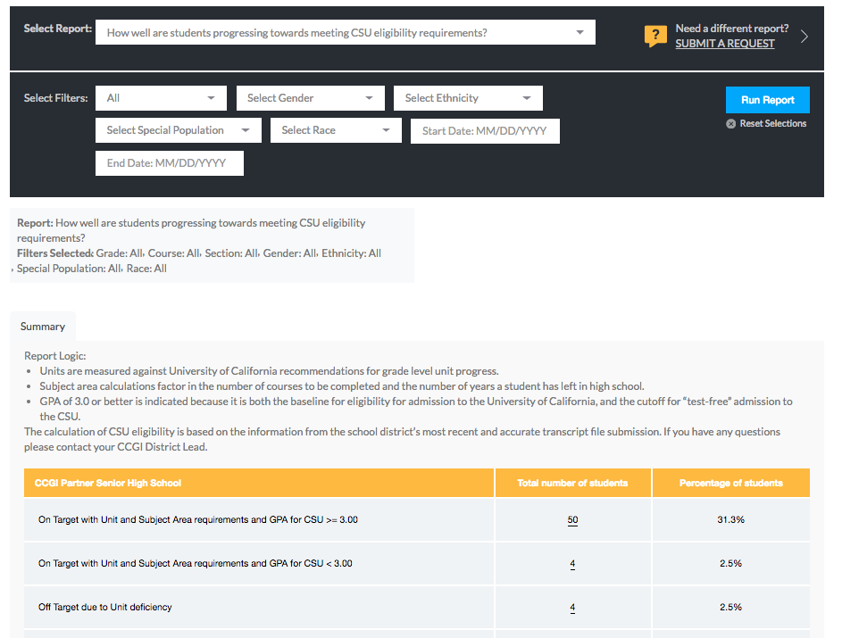
CSU and UC Eligibility Tools
Educators in Partner Districts can run reports to monitor student progress toward CSU and UC eligibility.
Notes:
Notes
All educators have access to reports to monitor student activity on the platform.
Basic filters include grade level, start and end date.
Educators in partner districts have access to advanced reporting features, including:
Additional filtering options (gender, ethnicity, and special populations)
Reporting on CSU and UC eligibility, including
Deficiencies by subject area and deficiencies in units
Courses flagged as “a-g” by school, but not found/matched in CMP

Slide 26
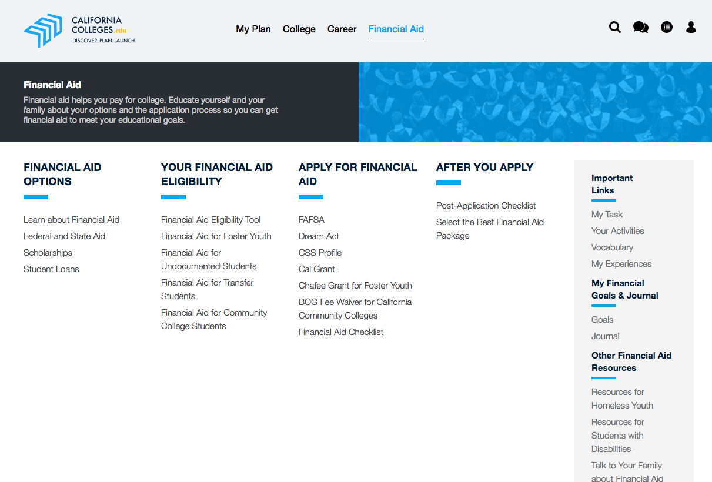
Financial Aid Planning
Students have access to valuable information and tools to help them make college affordable.
Notes:
Notes
Students have access to information and tools to help them learn about the many financial aid options open to them, including federal and state aid, scholarships, grants, loans, and fee waivers.
CaliforniaColleges.edu even includes helpful content for special populations, including undocumented students and foster youth.
Students have access to financial aid planning tools, including:
A Financial Aid Eligibility tool to help students calculate their Expected Family Contribution (EFC)
A Financial Aid Comparison tool to compare cost of attendance and financial aid packages from different colleges
Financial Aid and Post Application checklists to help students stay on track.
Coming later in 2018, the Scholarship Search Tool will allow students to research scholarships and save favorites within their accounts.

Slide 27
My Tasks, Journals, Goals…
My Tasks is students’ digital “to do” list for creating a college and career plan.
Notes:
Notes
My Tasks helps students store and track all of their important college and career planning tasks in one place. My Tasks is split into three tabs:
Your Activities – These are the same grade-level specific activities that appear in the blue bubbles on the student’s homepage.
Current Tasks – Lists other important tasks to be completed during the current school year.
Looking Ahead – Lists tasks to be completed in future school years.
Default tasks for each grade level will appear automatically in My Tasks and cannot be changed. Students also have the ability to add their own tasks, or educators can assign additional tasks to students.
Students can download the associated worksheet for each task, if applicable, under “attachments,” and then check off each task once it has been completed.
Educators can create additional tasks for students to appear in Current Tasks.

Slide 28
CaliforniaColleges.edu and CCCApply Integration
Notes:
Out now!

Slide 29
CCCApply Integration – Thank you
First, only possible thanks to support from:
CCC Chancellor’s Office
Foundation for California Community Colleges
CCCO Technology Center at Butte College
CCCApply Steering Committee
K-12 districts
CCC’s
Notes:
Not listed – a whole bunch of lawyers

Slide 30
California Community College
Students launch CCCApply from within account on CaliforniaColleges.edu
Current state
Hard match between SSID and CCCID
Future state
Academic, as well as career and educational planning data, will feed centrally to CCCApply/My Path
Data will flag foster youth (optional field), as well as students who are eligible for AB540 benefits
Notes:
Working with a few Individual colleges so they can request data extracts to support Multiple Measures Placement

Slide 31
California Community Colleges: Legal Agreements
Current state
Agreement between CCCCO and Foundation for California Community Colleges (CCGI’s fiscal and legal entity) governs ability to push data to CCCs for students who launch CCCApply from within their accounts on CaliforniaColleges.edu.
If students do not use CaliforniaColleges.edu to launch their CCCApply applications a supplemental agreement must be in place with each college requesting data in order for them to share applicant information and request academic transcript data
Future state
Expanded legal agreement between CCCCO and FCCC will govern the ability for:
CCGI to send academic and career/educational planning data centrally to CCCCO for the colleges to access via CCCApply/My Path, and
CCCCO to share enrollment, placement, persistence and completion data back to K12 districts via CaliforniaColleges.edu.
Supplemental legal agreements with individual CCCs will be needed to:
obtain an “affiliate account” on CaliforniaColleges.edu in order to track student accounts prior to the point of application.
Request data for students who do not launch their CCCApply from within CaliforniaColleges.edu
Notes:
The use of CC.edu as the launching point for CCCApply will have to be “normed”

Slide 32
Support the transition to college
Next, transcript data for those students who have completed such an application can later be securely transmitted to the college or directly to CCCO Tech Center
Will be submitted as PESC XML
High School Transcript (version 1.5.0)
Academic Record (version 1.8.0)
CoreMain (version 1.13.0)
Notes:
Note that Data for CSU applicants goes directly to CalState.edu/Apply

Slide 33
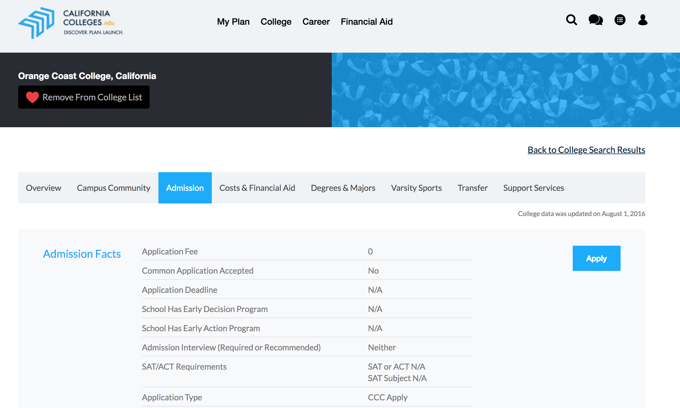
Current state – Apply link option 1

Slide 34
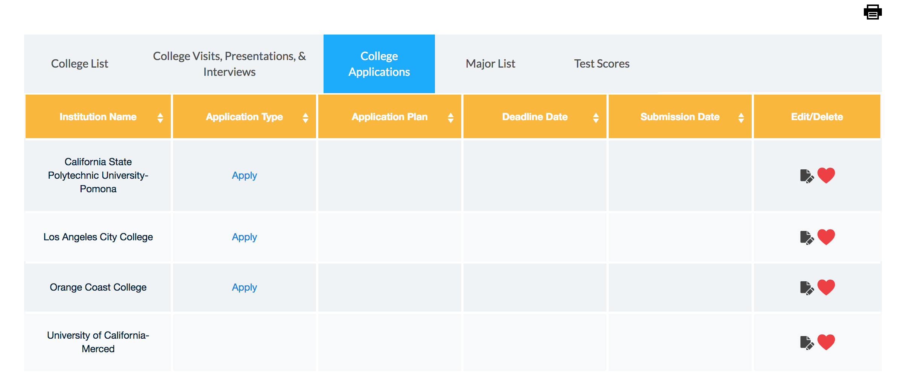
Current state – Apply link option 2

Slide 35
Central Valley Pilot
Notes:
That doesn’t mean all can’t take advantage of this stuff – but we are already learning that when the CO and CC approach the K-12’s that it is very powerful. UC...

Slide 36
Why a Region-wide Approach
The California Community Colleges and California State University campuses across the state need “real time” data to support decision making about admissions/enrollment, placement and guidance. This includes:
High School Transcript Data
Educational Planning Data
The two system offices are collaborating with the Central Valley Higher Education Consortium (CVHEC) and CCGI to promote a unified approach to college preparation and transition across the Central Valley.
Proof of concept for statewide scaling
Notes:
CCC- Guided Pathways Pillar 2
CSU - Graduation Initiative
Investment of financial resources AND more importantly invested vision in articulation.

Slide 37
What and Where
Waives the fees for the CCGI Partnership Model for all K12 districts across the nine county region:
Fresno
Kern
Kings
Madera
Merced
San Joaquin
Stanislaus
Tulare
Tuolumne
The aim is to have coordinated efforts to promote this work among the 3 CSU and 14 CCC campuses in the region.
Notes:
Costs are assumed by the CCCCO and to a lesser extent the CSUCO
73 K-12 and union high school districts

Slide 38
When: 2018-2022
June 2018: Campaign Launch
2018-2019:
Use of educational and career planning tools
Execute legal
Initial data uploads and cleansing
2019-2020:
Data-informed account usage
Use of data for placement in CCCs
Use of data for admissions and placement in CSUs
2020-21 and 2021-2022: Continued subsidy for K12 participation to allow time for full adoption
Notes:
Sustainability is anticipated through increased state funding and/or system office funding

Slide 39
Quotes in support of Central Valley effort
California Community College Chancellor Eloy Ortiz Oakley
“The partnership taking place in the Central Valley represents a vital inter-segmental collaboration that will bolster the college-going culture in the region and pave the way for improved educational outcomes for students. Together the chancellor’s offices of the California Community Colleges and the California State University are investing in a unified approach to help students prepare for and successfully transition to college.”
California Community College Executive Vice Chancellor for Educational Services, Laura Hope
“Our campuses are committed to using high school transcript data to ensure course placements that maximize each student’s opportunity to succeed. As we move towards defining clearer pathways for students to achieve their post-secondary goals, a key step is helping students to understand their academic and career options. The partnership taking place in the Central Valley is perfectly aligned with these commitments. Students throughout the region will use CaliforniaColleges.edu and its embedded curriculum to engage in intentional college and career planning starting in the 6th grade. When students are ready to apply to college, not only will they have a well-informed plan in place, their complete and current transcript data will follow each student to support the college placement process.”

Slide 40
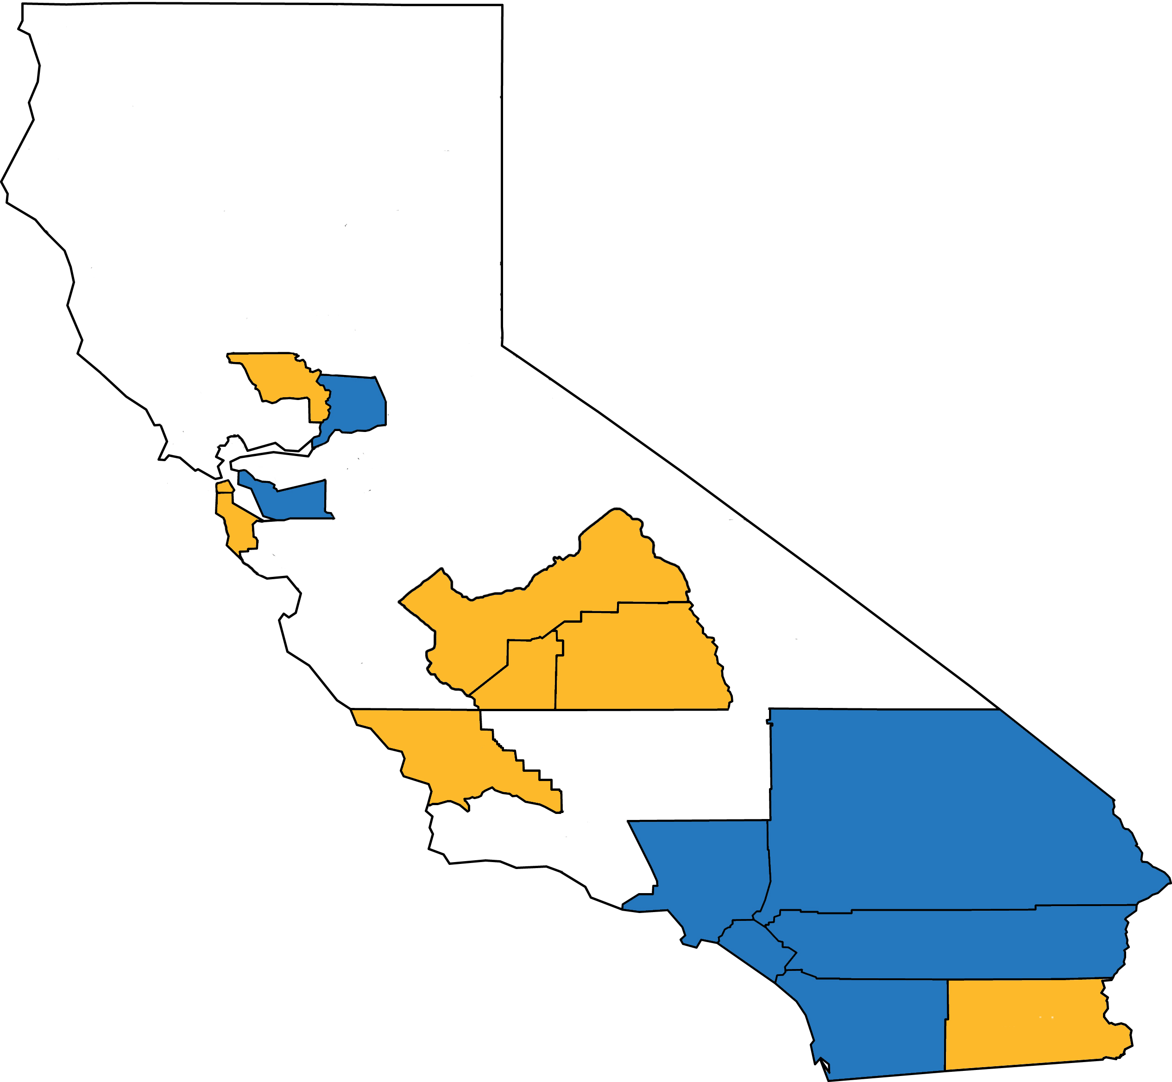
District Partnerships
Alameda County
Hayward
Fresno County
Firebaugh Las Deltas
Fresno*
Selma*
Imperial County
Brawley Union High*
Kings County
Hanford Joint Union High
Los Angeles County
Centinela Valley *
Compton
El Monte Union High
El Rancho
Green Dot*
Hacienda la Puente
Norwalk‐La Mirada
Pasadena*
Pomona
Rowland
Orange County
Anaheim Union
Garden Grove
Santa Ana
Riverside County
Corona-Norco
Desert Sands
Hemet
Jurupa
Moreno Valley
Murrieta Valley
Perris Union High
Temecula Valley
Val Verde
Sacramento County
Sacramento City
Elk Grove
San Bernardino County
Chaffey Joint Union High
Chino Valley
Redlands*
Upland
San Diego County
Oceanside*
San Marcos
Vista
San Luis Obispo County
Coast
Paso Robles Joint
San Luis Coastal
Shandon Joint
Templeton
San Mateo County
Jefferson Union High
Santa Clara County Gilroy*
Tulare County
Cutler‐Orosi Joint
Woodlake
Yolo County
Woodland Joint
Counties with CCGI Partner Districts
prior to 2017-18
Counties with new or potential CCGI Partner Districts as of 2017-18
*Potential 2018-19 expansion districts

Slide 41
Data Security, Questions, Contact Info

Slide 42
Data Security
CCGI handles Personally Identifiable Information (PII) carefully and is compliant with the following:
Family Educational Rights and Privacy Act
Protection of Pupil Rights Amendment
Fair Information Practice Principles
Privacy Technical Assistance Center Requirements and Best Practices
CA Senate Bill No. 1177
CA Assembly Bill No. 1584
Children’s Online Privacy Protection Rule
CaliforniaColleges.edu Privacy Policy for Student Users
California College Guidance Initiative Memorandum of Understanding

Slide 43
Contact Information
Interested in talking more about this subject? Email us at:
CollegePartnerships@CaliforniaColleges.edu
Benjamin Baird
Director of Data Management
916.581.1643
BBaird@californiacolleges.org
Notes:
Questions?

