Slide 1
What’s Next for eTranscript California Presenter: Mark Cohen Transcript Product Owner, CCCTC
Presented March 28, 2018

Slide 2
Agenda
An Overview of eTranscript CA
The eTranscript CA Mission
Transcript Data Supporting Student Success
How We Fulfill Our Mission
What’s Next for eTranscript California
Q & A

Slide 3
eTranscript CA
Overview
XAP awarded RFP in 2005
eTranscript CA launched in 2007
Facilitates electronic transcript exchange across CA postsecondary systems
Data exchanged in California Electronic Transcript Standard (supporting IGETC & CSU GE data)
Performance
71 Community Colleges
26 California State Universities
5 University of California campuses
Several major independent institutions
1.5MM transcripts exchanged
Challenges
55% CCC’s participating as senders, with varying levels of adoption
22% CCC’s accepting receiver initiated requests
Not all UC’s/CSU’s on board as receivers
Not all transcripts validate to schema due to missing required data elements
Feedback
Senders generally satisfied, receivers less so
CCC’s would like an integrated ordering portal
Demand for inbound (HS) transcripts
Inconsistent vendor integration
Availability of IT resources and incomplete functionality reported as barriers to adoption

Slide 4
The eTranscript CA Mission
The ubiquitous exchange of transcripts in the California electronic transcript data standard between, and from California Community Colleges campuses and districts with the UC and CSU systems.

Slide 5
Data Supporting Student Success!
Help place students through Multiple Measures
Populate Ed plans used to advise students
Return grades through Course Exchange
Enable Real-Time Data between CCC’s
Support Transfer, Articulation, and Pathways

Slide 6
Fulfilling the Mission
Go Live
Bring CCC’s online as senders with enhanced integration, while integrating with colleges Transcript Service Providers
Fully Adopt
Grow adoption by starting with the student request, following the transcript from request through delivery
Data Quality
Integrate missing data elements stored outside of the SIS (CSUGE & IGETC Cert), while improving data validation

Slide 7
The Future of eTranscript CA
Transcript
Capture
Support
For CCC
Initiatives
Vendor
Integration
CCC Technology Platform
Real-Time
Data
Exchange
End-to-End Automation

Slide 8
What is the CCC Technology Platform?
C
C
C
‘s
CCC Technology Platform

Slide 9
What is the CCC Technology Platform?
The project formerly known as GLUE. And SuperGlue.
Integration architecture that enables systems to connect in a standardized way
Provides a secure, robust framework for data exchange
Made up of three main components
College Adapter
Standardized Data
Master Data Management (MDM)

Slide 10
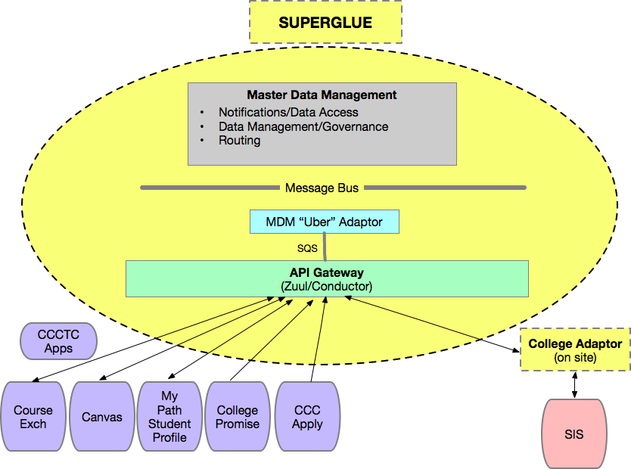
What is the CCC Technology Platform?
Technology Platform
eTrans- cript
CA

Slide 11
Transcript Capture
eTranscript CA to leverage the Technology Platform being deployed across initiatives
The Technology Platform integrates with the SIS
MDM provides colleges with control over data released
Transform transcript capture, eliminating the need to produce and upload ASCII file
The Technology Platform can connect with secondary systems hosting missing required data elements

Slide 12
Vendor Integration
The Technology Platform enables integration between eTranscript CA and the Colleges transcript vendor
Integration developed in conjunction with EdExchange
Provides consistent integration with transcript vendors
Validates transcript data to schema
Supports colleges vendor choice while fully participating in eTranscript California

Slide 13
What is EdExchange?
V e n d o r s
C
C
C
‘s
CCC Technology Platform
EdExchange

Slide 14
What is EdExchange?
The Problem
No simple exchange between institutions
Service provider networks siloed
Available exchanges built on legacy technology
The EdExchange Solution
Community based solution
Real-time data exchange
Payload agnostic
Secure peer-to-peer architecture provides a direct connection

Slide 15
What is EdExchange?
Directory Server
Secure repository of validated network endpoints servicing listed destinations
Accept Delivery Options request
Return Delivery Options report
Java Server operated by PESC (Infiniti/AWS)
AWS Web Hosting
Backup
Directory
Server
EDEXCHANGE
Directory
Server
Network Server
Serve as an endpoint in the secure EdExchange network
Lookup
Send
Receive
Java Server local to Vetted Institutions & Service Providers
College/Service Provider A
College/Service Provider B
Network Server
Network Server

Slide 16
Real-Time Data Exchange
eTranscript CA primarily focused on transcripts exchanged from CCC’s to UC & CSU systems
The Technology Platform enables greater focus on exchange between CCC’s
Transcripts moved as data from senders SIS to receivers SIS, with PDF available
Same technology supporting OEI, moving transcript from College of Instruction to Home College

Slide 17
End-to-End Automation
Developing RFP to bring student ordering to eTranscript CA
Integrate within MyPath Guided Pathways Platform
Support for fee collection, order tracking
The Technology Platform will integrate transcript request to Colleges SIS (or their Transcript Service Provider)
Provides an end-to-end solution, from request through data delivery

Slide 18
MyPath Guided Pathways Platform
Transcript ordered as student enters Community College
Transcript ordered as student leaves to continue their education

Slide 19
Support for CCC Initiatives
HS transcript data to be available to Multiple Measures
The Technology Platform will move transcript data to populate Ed Planner
Provide integration between MyPath/CCCApply and transcript requests
Integrating C-ID numbering in support of articulation
Real‐time transcript exchange between CCC’s, and to UC/CSU in support of student success and guided pathways

Slide 20
Q & A
mcohen@ccctechcenter.org

