Slide 1


Education Planning Initiative &
Starfish
CCC Apply Workshop
March 28, 2018

Slide 2
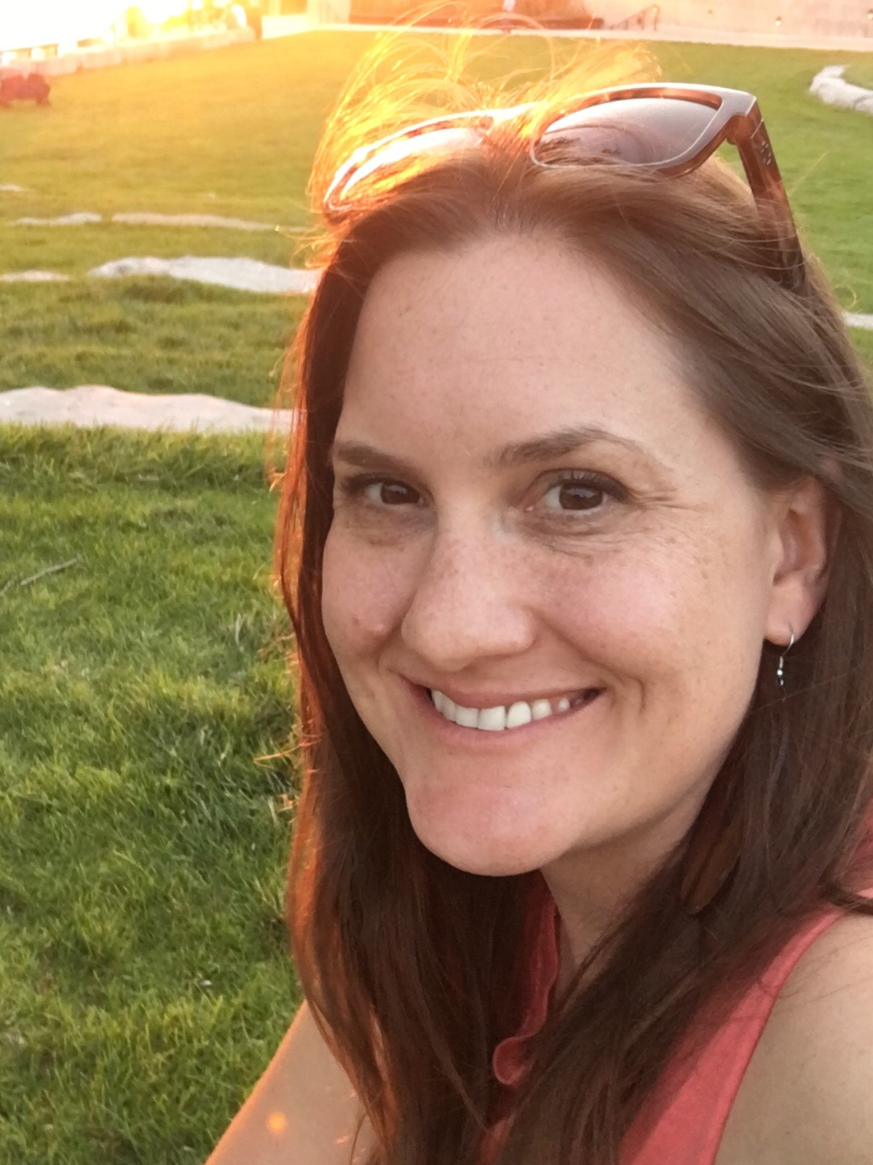
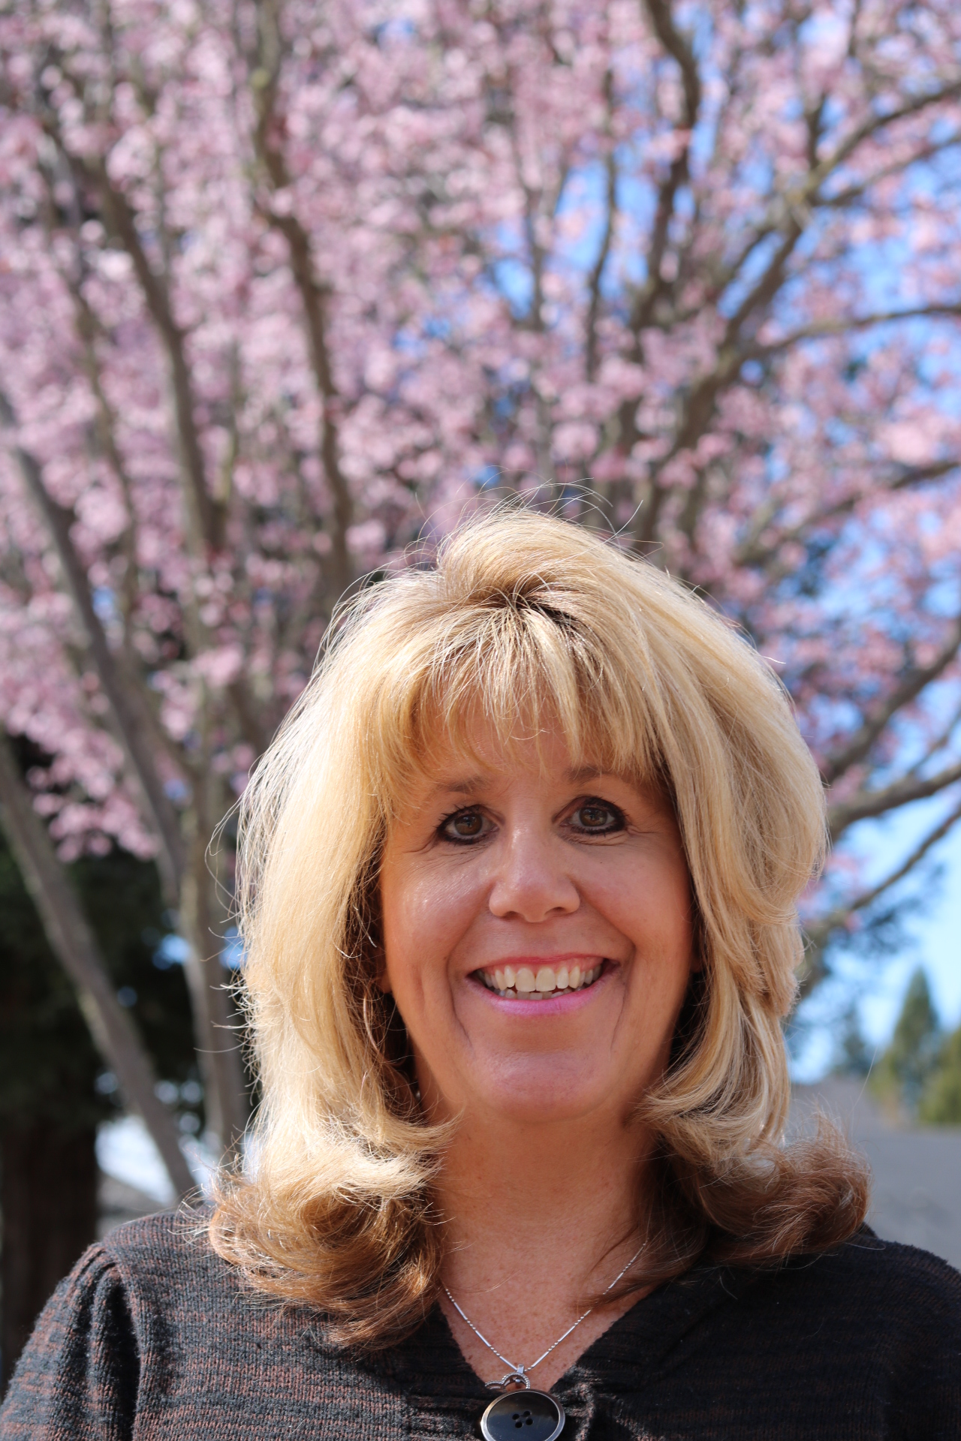

Kelly C. Kilby
Starfish
CA Strategic Account Executive
Kayla Mannon
Counselor
Fresno City College, SCCCD

Slide 3



CCC Starfish User Community Update
Starfish Demos:
*Degree Planner, *Early Alert, *Calendaring/Scheduling, *Reports & *Case Management Tools
Today’s Conversation
Introductions
Your Questions

Slide 4
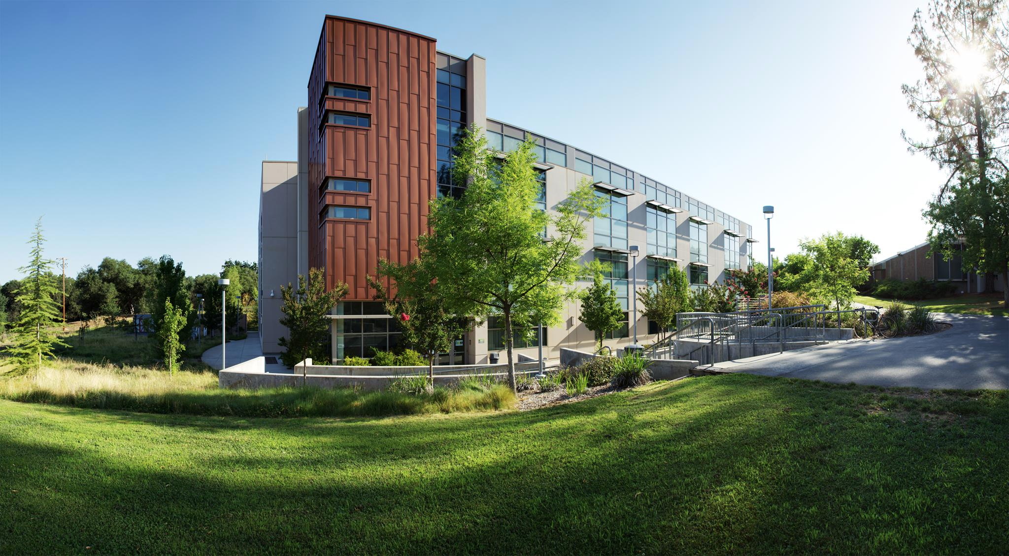


Foster a Network of Student Support
Success Stories & CCC User Community (37)
EPI Pilot Colleges & 2018 CCC Users
Phase II Colleges:
Ohlone College
Modesto Jr. College
Columbia College
Butte College
Shasta College
Foothill College
DeAnza College
Long Beach City College
Palomar College
Pasadena City College
Barstow College
Bakersfield College
Rio Hondo College
Coastline Community College
Berkeley City College/Peralta CCD
College of Alameda/Peralta CCD
Laney College/Peralta CCD
Merritt College/Peralta CCD
Hartnell College
Allan Hancock College
+3 Ventura CCD (March 2018!)
Legacy Colleges:
  Imperial Valley College
  Sierra College
“Our students are most successful when they have multiple resources – a rich support system to which they can easily turn to for help.
Starfish is the high-tech solution that creates a high-touch network for our students.”
Beth Ervin, Student Success
Coordinator, Sierra College
Sierra College catalyzed conversations
about communication culture and practices
Notes:
PROBLEMS TO SOLVE:
“We really wanted to look at our students from a holistic perspective. We wanted to avoid a deficit model and look instead at how our system could adapt to meet the needs of our students.”
Difficult to share information appropriately
-- Commuter Campus
-- Very high student to counselor ratio 1000-1.
-- Decentralized academic support
-- Needed to leverage existing funding structures (no new $)
Only 3% of students complete 30 units by the end of their first year. 50% of students don’t persist from fall to fall.
Grade policies and most communications are written at post-doctoral level!! This has helped change the culture.
In first year:
Faculty feedback was really important
Use attributes based on counselor feedback
Success Network – start small and build
Communication loop between all students’ educational partners
68% of faculty created profiles in Year 1
85% of faculty who opened the survey completed it
- We learned we had to require comments! It wasn’t helpful without them. But we trained them and gave them templates. Everyone needs a scoreboard.
14,422 total items
Students responded so positively to both kudos and even “in danger of failing” flags, which can be devastating.
An attribute is “HOW SURE ARE YOU OF YOUR GOAL?” An opportunity for counselors to talk to “somewhat sures” about majors, careers, options.
Athletic coaches are AMAZING partners in this program

Slide 5
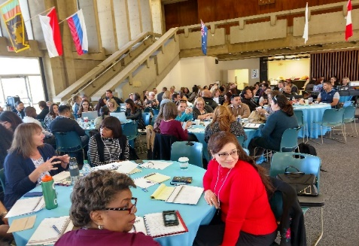
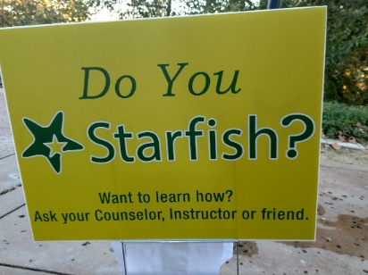
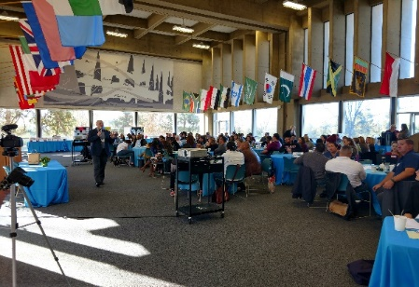
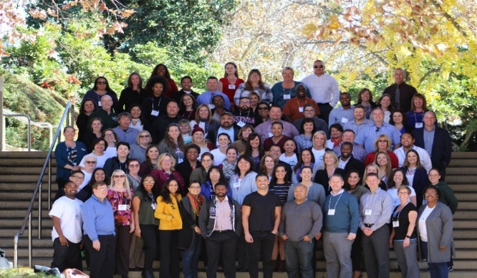

Starfish CCC User Group Summit (December 11-12, 2017)
37 Colleges Strong – December 2017

Slide 6



AACC Guided
Pathways Colleges
“Having Starfish on board is essential for us to initiate Guided Pathways, said Michelle Stricker,” Matriculation/SSSP Coordinator at Reedley College and Co-Chair of the CCC EPI Steering Committee.
Starfish is the Solution for:
Holistically looking at our students, systems, and processes all the way from the
individual to the institution. (All the Things!)

Slide 7
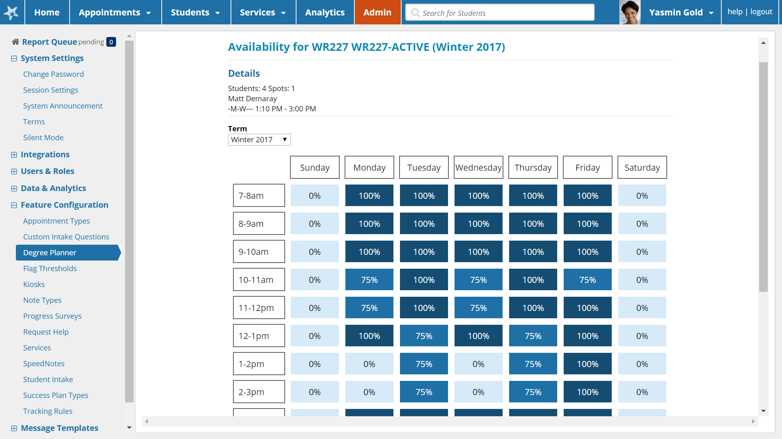
Course Demand Forecasting

Slide 8


Thank you | Questions

Slide 9
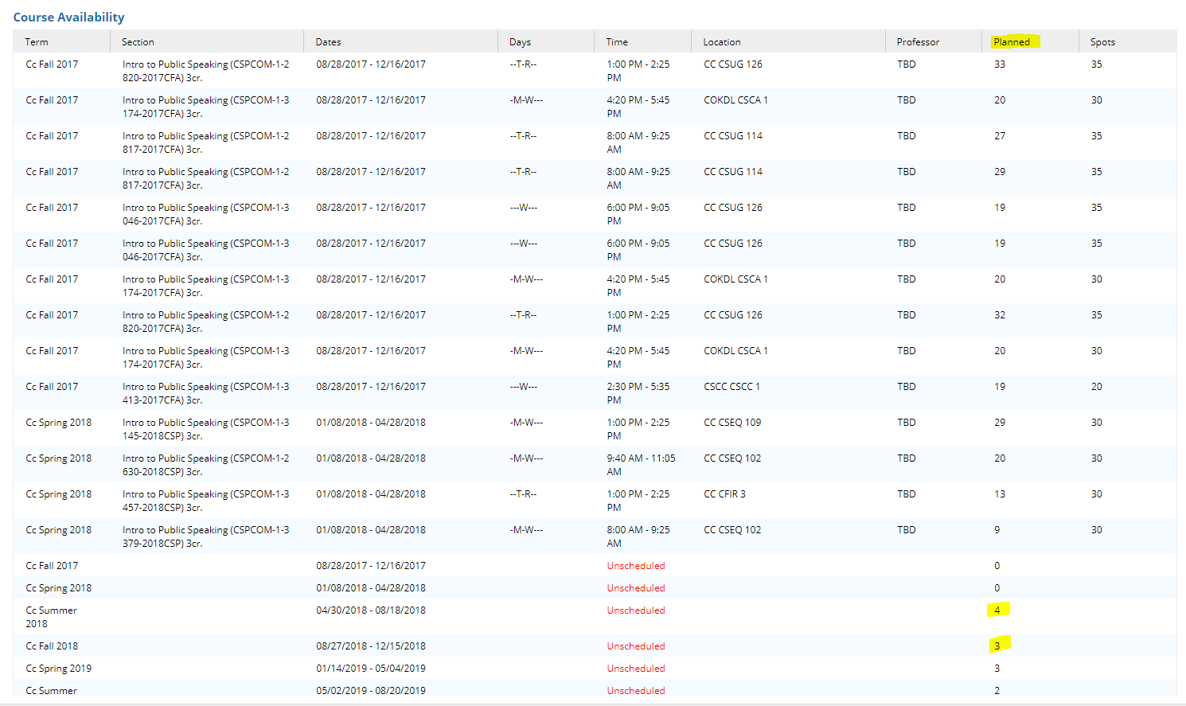
How many students have this on their ed plan??? (THANK YOU TO Melissa Raby, Columbia college for these!)
If you want to look up an individual class and find numbers planned…
And for which semesters…
Future terms →

Slide 10
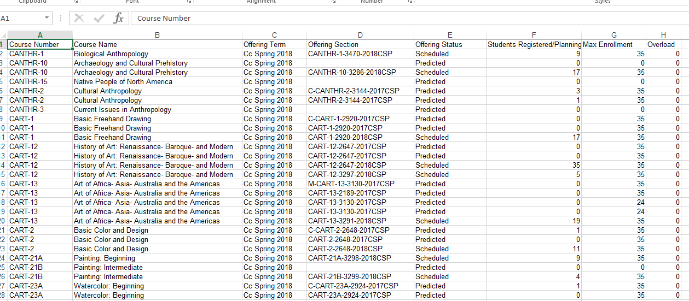
We can use this information!
We can download a full list of classes to Excel, to see # of students registered &/or planned for a future semester

