Slide 1
About Metamajors
CCCApply Conference
Costa Mesa, CA
March 28, 2018
Craig Hayward, PhD

Slide 2
What are metamajors?
Metamajors are collections of degrees and certificates that have related courses.
Metamajors help students choose a program of study based on their interests, knowledge, skills and abilities.
The intent is to guide students to timely graduation

Slide 3
How are metamajors structured?
While other states have had their metamajors legislated (e.g., Florida), in California metamajor design is a faculty-centric, iterative process.
My analysis of 22 colleges around the country that have implemented metamajors found that:
The minimum number of metamajors was 5, the maximum was 13
The median number of metamajors was 8
“Business” was in 21 of 22 colleges
Only six CCCs had public information about their metamajor structure

Slide 4
Common metamajors

Slide 5
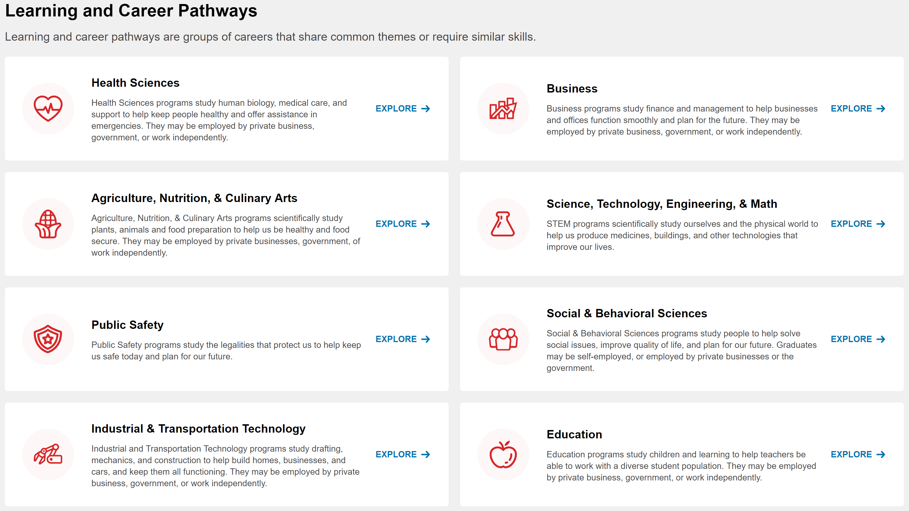
An example: Bakersfield College
Notes:
Not pictured: Arts, Humanities, & Communication

Slide 6
What can you do?
Curate your list of programs that are available in CCCApply
1
BC cut the number of programs in half, mostly by eliminating confusing references to GE pattern variants
Tag your students so that you know their program of study – “major” is not specific enough for guided pathways work!
2
Associate each program with just one metamajor
3

Slide 7
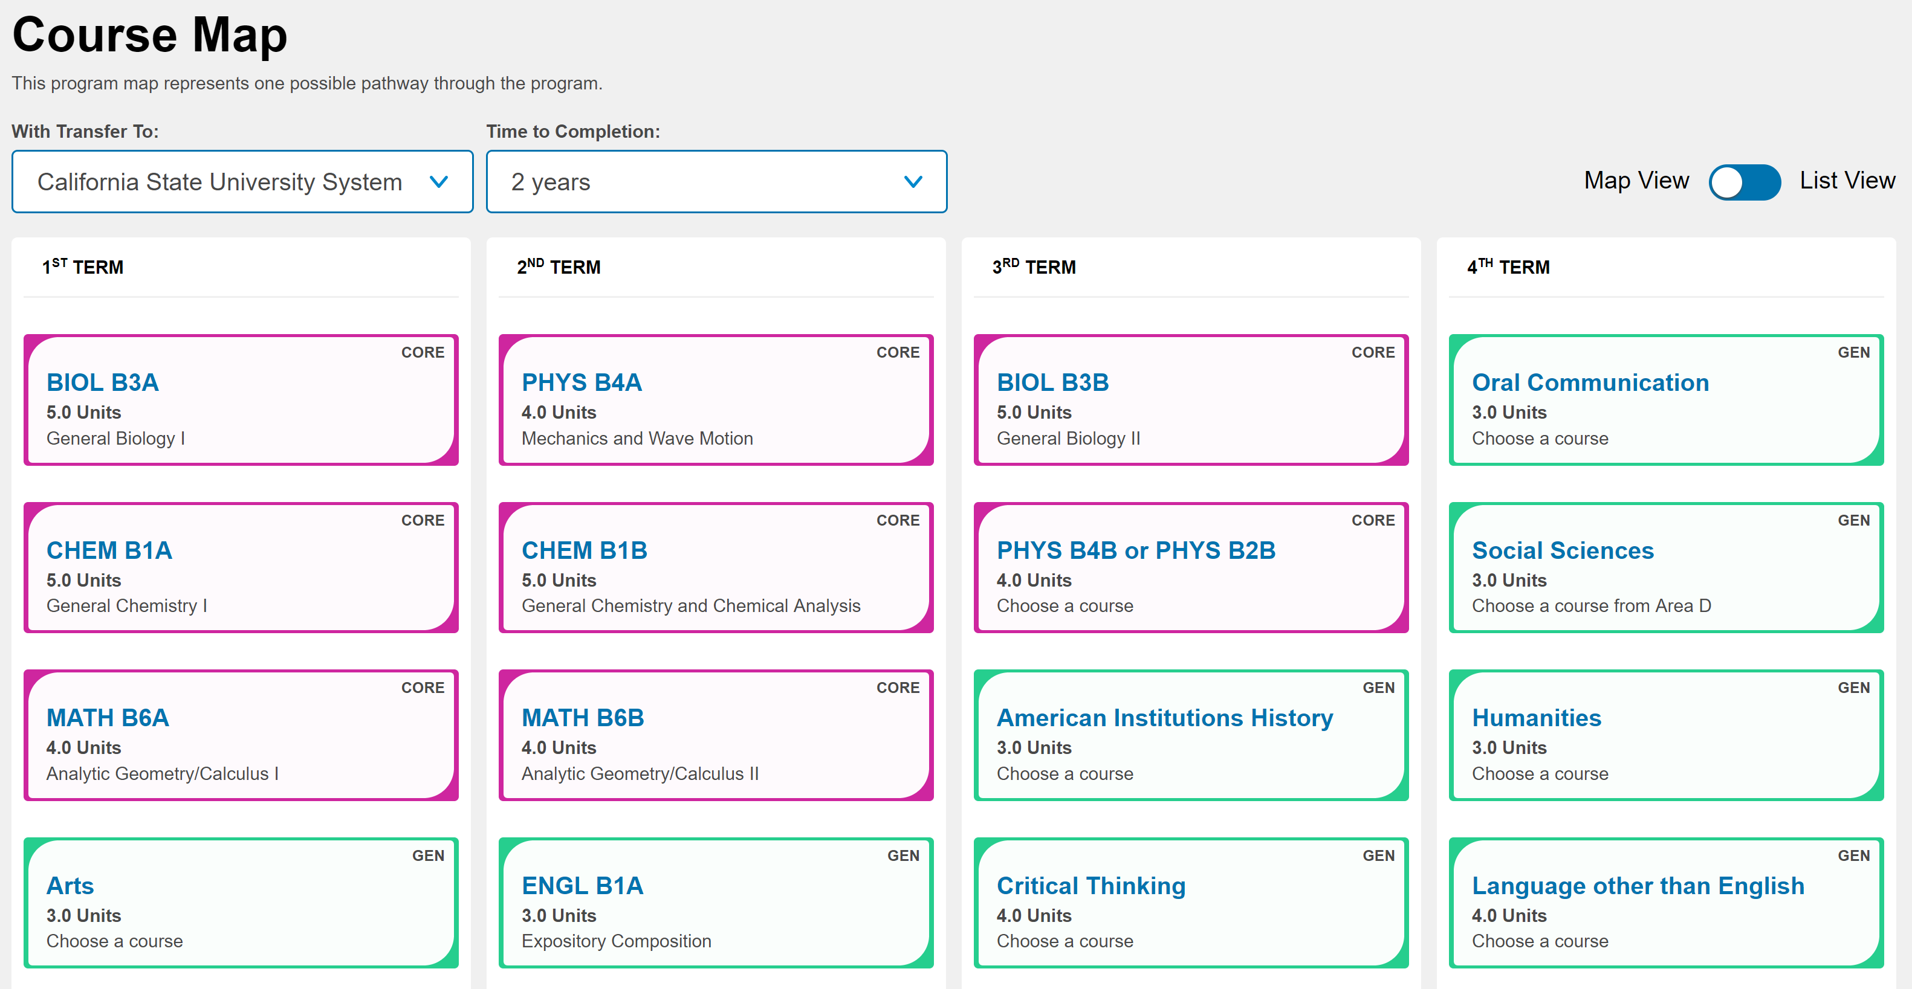
Demo of the Program Pathways Mapper
https://bakersfieldcollege.content.programmapper.ws/academics

