Slide 1
Student Success Suite User Group Meeting
January 12, 2023, 1:30 PM - 3:00 PM
Please note: This meeting is being recorded for the purpose of transcription.

Slide 2
SSS User Group
Welcome & Introductions
Please add your name, title, and college
to the chat window for our attendance sheet. Thanks!

Slide 3
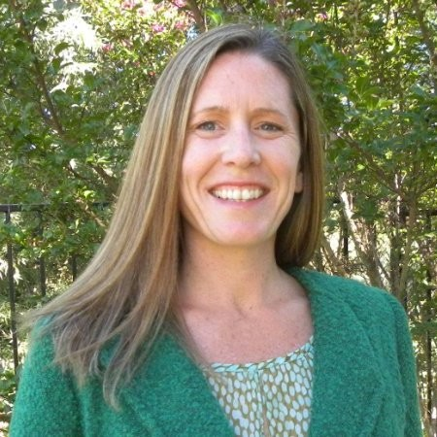
Please join us
in welcoming
Julia Arreguy
Our new CCCTC
Chief Technology Officer
Notes:
Jennifer does this.

Slide 4
Student Success Suite Meeting Agenda
Time | Topic | Facilitator
1:30 - 1:35 | Welcome and chat sign in | Rick Snodgrass, Jennifer Coleman
1:35 - 1:40 | Intro to New CCCTC CTO Julia Arreguy | Jennifer Coleman
1:40 - 1:50 | Recent Release Roundup for all SSS Products | Jane Linder
1:50- 1:55 | Student Support Statistics | Jane Linder
1:55 - 2:15 | SSS Next Gen Application System Architecture Overview Faster development and release cadence Improved user experience | Jane Linder
2:15 - 2:25 | SSS Next Gen System Analytics | Jane Linder
2:25 - 2:40 | SSS Next Gen Student Testing | Jane Linder and Rick Snodgrass
2:40 - 2:50 | Wrap up & Housekeeping | Rick Snodgrass

Slide 5
Student Account System Update
Support statistics continue to guide improvements
Upcoming releases include minor changes to text
“Reset Password” replacing “Recover Account”
Tell students their PII (ie. DOB) will be used to reset their password
New Chatbot coming soon!!
FAQs on creating/access student account, also how students can get help from their college

Slide 6
Application System Update
Update to tribal affiliations list paused
CCCApply Standard Minor Release 6.12 (Jan/Feb)
AB305 CalVet Enhancement
New CA Promise Grant App for 2023-2024
Notes:
Rick to pause recording

Slide 7
CCCApply DL Client Phase-Out Update
Less than six months to DL Client Phase Out deadline!
Want SuperGlue? Contact: crms@ccctechcenter.org
Recent SuperGlue releases includes MANY student fields not available through the DL Client

Slide 8
MyPath Update
MyPath hotfix deployed this week into production
Pilot deploy December 19, 2022
Fixes Amazon Doc upload issues

Slide 9
Latest Student Support Call Drivers
Support call drivers
Students looking for Student Account Support = 63.40%
79.59% for the same period last year
Students looking for help with CCCApply Apps = 15.89%
6.69% of the same period last year
Students looking for college support services = 20.71%
13.71% for the same period this last year 9 (course registration, college id, and transcripts, questions that must be deferred to the student's home college)

Slide 10
Latest Student Support Statistics
Average wait time (Phone) - 2 minutes
Calls Answered within 60 seconds: 57.9%
Average first response time (Email) - 5 hours
Average resolution (Phone) - 8 minutes
Average resolution (Email) - 7 hours
First contact resolution (Phone) - 99%
First contact resolution (Email) - 47%
Customer satisfaction score - 97%

Slide 11
SSS Next Generation Architecture
Modern technology stack and microservices-based platform built with the following goals & benefits:
Modern Interface
Mobile first design for better display on mobile devices
Improved performance
Remove server-side rendering and blend transactional data with static content
Enhanced security (greatly narrowed “attack vector”)
Rapid development (text vs code)
code changes use code libraries (why reinvent the wheel?)
Streamlined Business Logic (decouple business services from the user interface)
Reduced risk of disruptions (eliminate “big bang” releases with phased deployments)
Flexibility via serverless hosting
Deploy new features to specific colleges for early user testing & feedback
Tailored workflows for students (retain existing business logic via server side calls and API calls)
Migrate Core Apply Logic to Apollo GraphQL
Migrate Residency Logic to Apollo GraphQL

Slide 12
SSS Next Generation Architecture
Enhanced data delivery mechanisms
Faster student onboarding
Ability to keep colleges in sync with changes to CCC student profile
Robust, transparent system operations (release management, logs, monitors, alerts)
Increased reliability and availability to users
Enhanced Analytics Platform with Robust Analytical Tools
Dashboards, scheduled reports, APIs, deep graphing and ad hoc analytics
Better information to support student’s conversion from application to enrollment
Alerts & reports on student progress
Visual data modeling

Slide 13
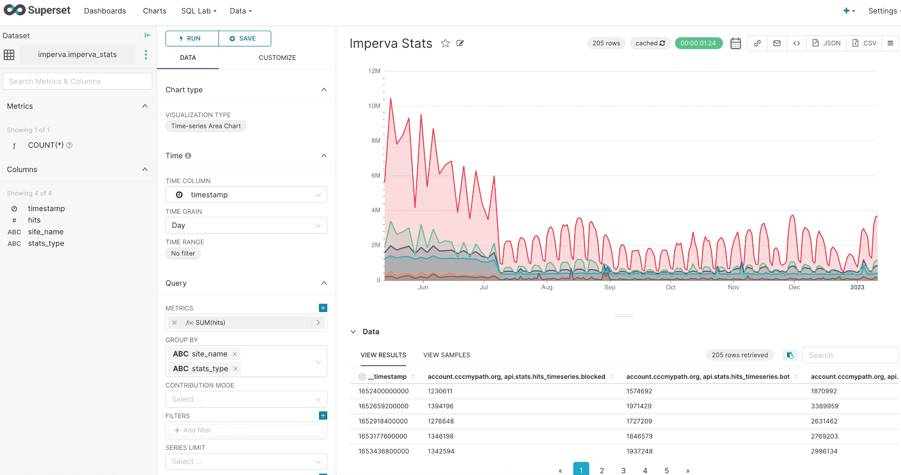
SSS Next Generation Analytics
SuperSet with AWS Backends

Slide 14
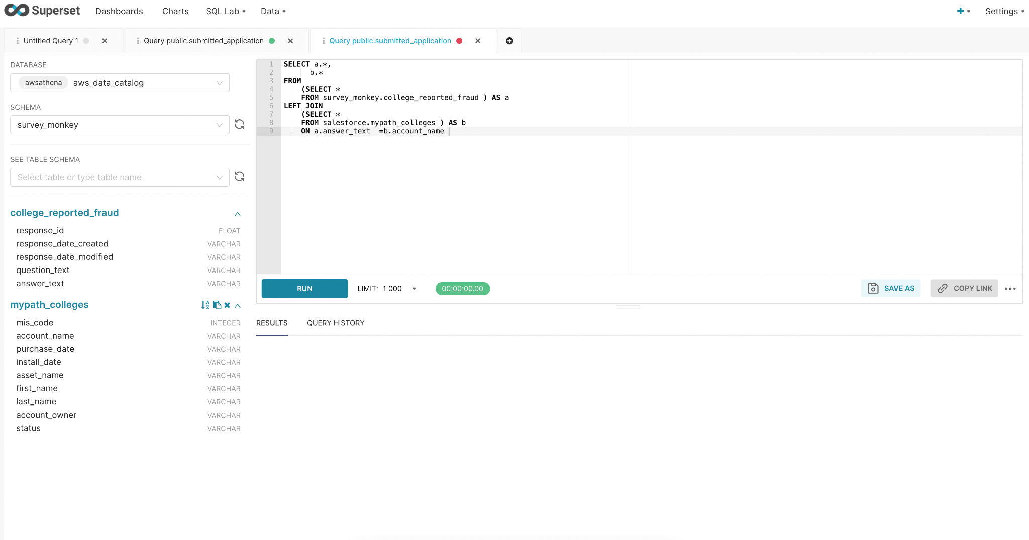
SSS Next Generation Analytics
Powerful SQL query capabilities

Slide 15
SSS Next Generation Progress
Delivered to Production:
New OpenCCC Student Account System (January 2022)
New identity management system with MFA & API support
New release management infrastructure for zero downtime deployments
GraphQL Solution (Apollo) (November 2022)
Supports bi-directional fraud reporting initiative
SuperGlue “delivered” flag
Delivered to Pilot
Enhanced Analytics
Initial UX Designs Completed and Reviewed by Students

Slide 16
User Interface Design Review: Dec 2022
Solicited student feedback on the CCCApply Next Gen user interface (UX) design approach
Conducted seven live zoom student feedback sessions with student participants.
Student tester breakdown:
Recruitment emails sent to 150 students
87 students volunteered to participate
58 students signed up for a live zoom feedback session
33 students attended a live zoom feedback session and submitted their feedback survey
Need to recruit student testers to represent as many colleges as possible!
Contact Rick to get a student tester recruitment flyer for your college

Slide 17
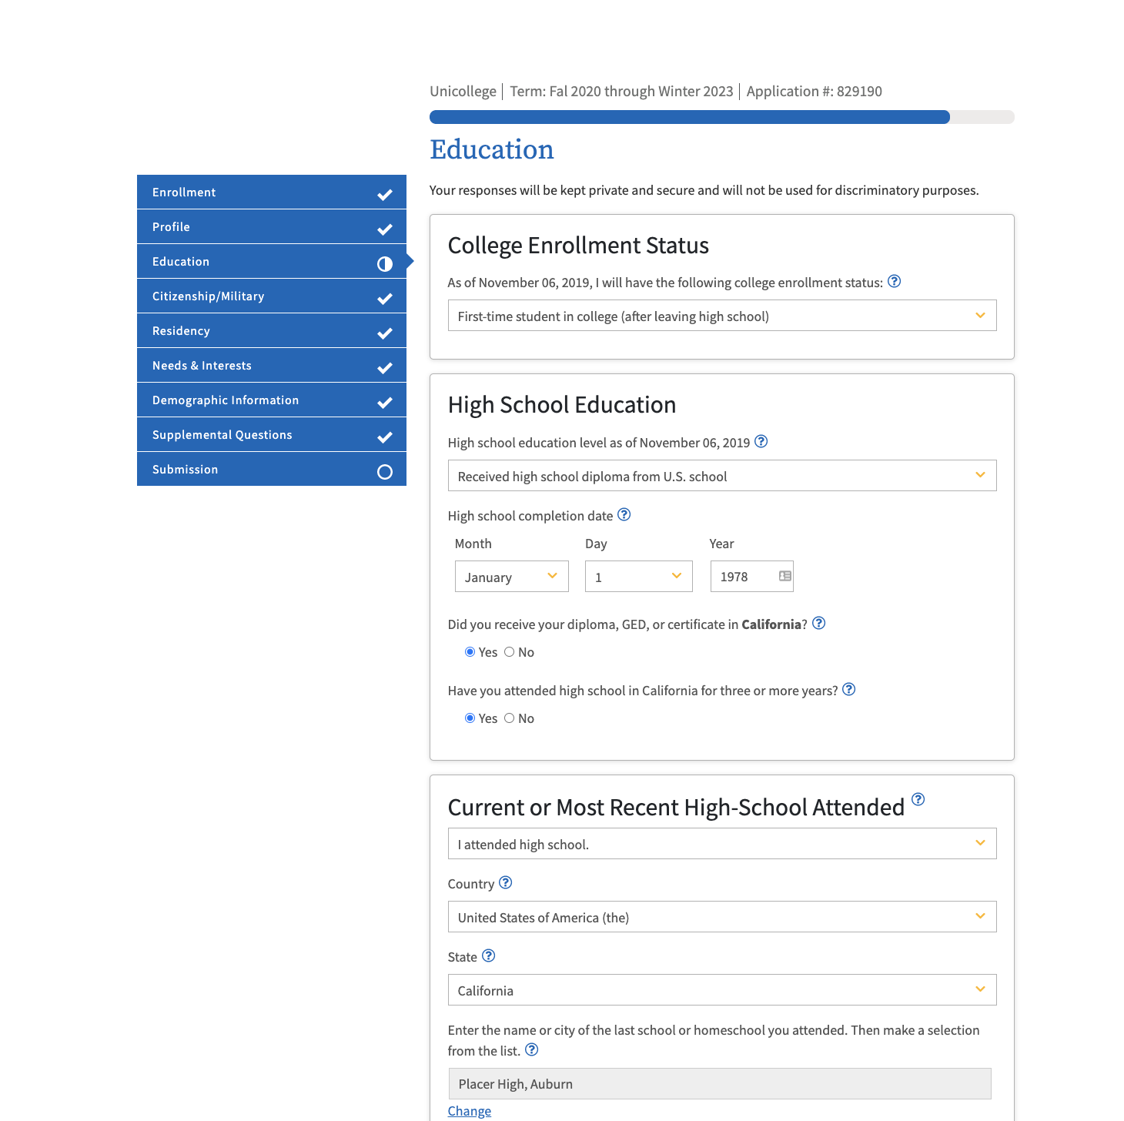
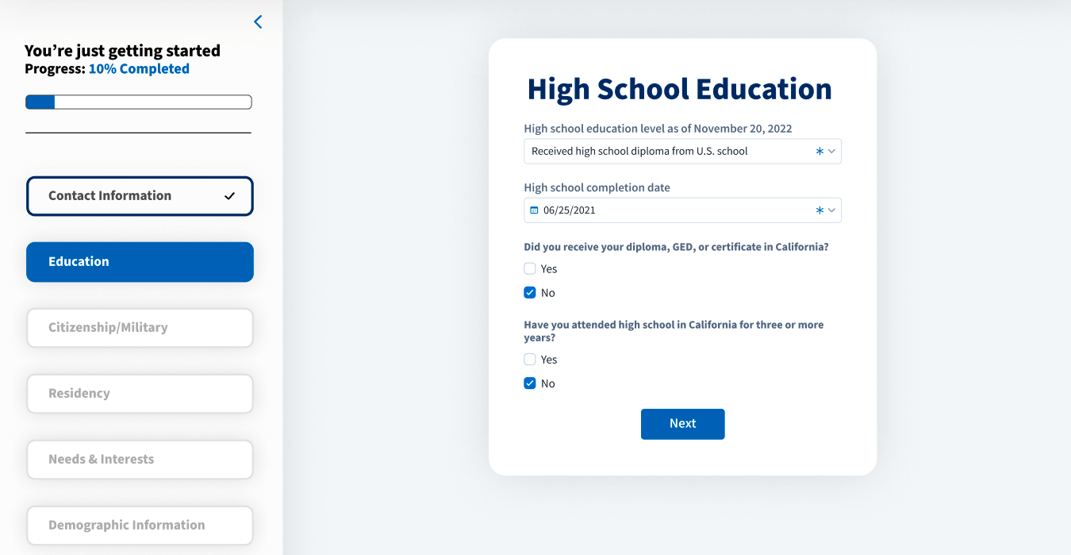
Question 2 - Short form vs long form
Option A
Option B

Slide 18
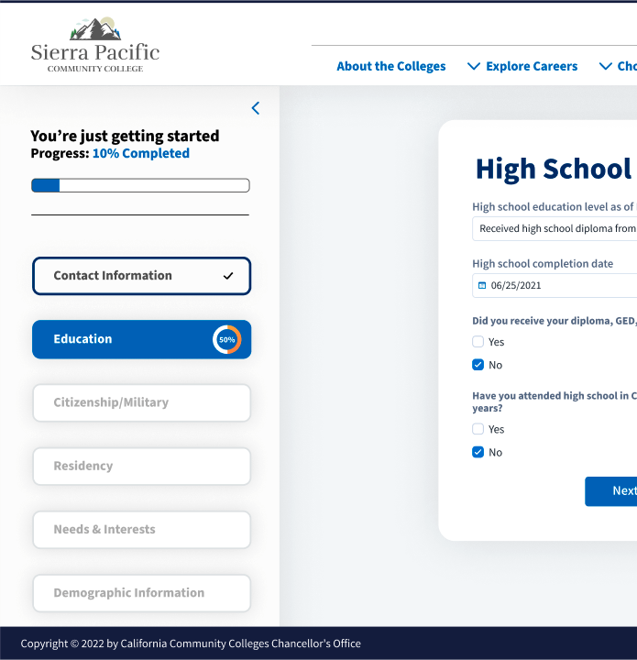
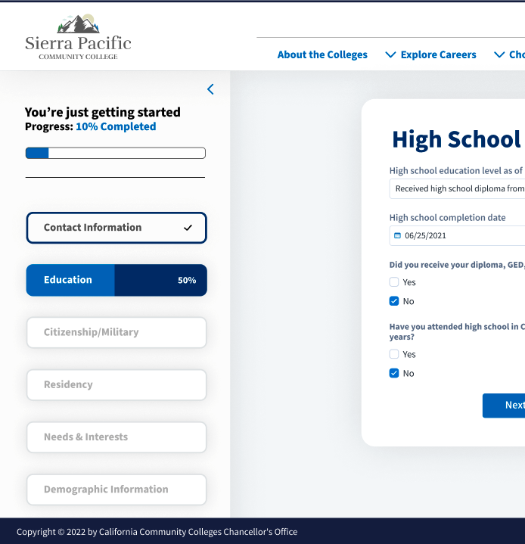
Question 4 - Progress Indicator Styles
Option A
Option B

Slide 19
SSS Next Generation Next Steps
Proof of concept dual-enrollment “branching” workflow demo (FY 22-23)
Showcase new tools & technologies and how they work with a known use case
Workgroups and Student Feedback Sessions
Provide continuous guidance during development
Interested in joining a workgroup?? Contact Jane & Rick!
Tailored workflows, reports & analytics, user interface and plain language
Port core CCCApply logic to new infrastructure for standard workflow (FY 23 -24)

Slide 20
Here to Help!
Issues with SSS Products?
Open a staff Help Desk ticket via email: staffsupportccctc@openccc.zendesk.com
Enabling Services CRMs: crms@ccctechcenter.org
SuperGlue implementations
MyPath demos
Noncredit and International online application implementations
CCCID for all students by Fall 2023

Slide 21
Want to Know What’s Up?
Register for an account on CCCTechnology.info and set your Profile Notifications to follow the CCCTC System Alerts category posts, today!
Release updates
Planned Maintenance
Have a general question? Start a discussion!
Private Spam Discussion group

Slide 22
Q&A
Student Success Suite Contacts:
Jane Linder, SSS Interim Product Director
jlinder@ccctechcenter.org
Mike Caruso, SSS Product Owner
mcaruso@ccctechcenter.org
Rick Snodgrass
rsnodgrass@ccctechcenter.org

Slide 23
Student Success Suite User Group Info
We have updated our Student Success Suite User Group meeting information! The current fiscal year meeting information can be found here.
**Please check the Student Success Suite User Group Roster for your names and information.
**If you are not receiving listserv emails, send corrections to:
Rick Snodgrass - rsnodgrass@ccctechcenter.org

Slide 24
Next meeting:
April 13, 2023 - 2 PM - 3:30 PM
Thank you all for joining us - we appreciate your time and your input!
Closing Comments from Jennifer

