Slide 1
Systemwide Architecture Committee
Bi-Monthly Meeting
August 24, 2023

Slide 2

The Vision + Digital Equity
Anyone in California seeking a postsecondary education, regardless of what they look like, where they live, time since high school, and their preferred education modality should have on-demand access.

Slide 3

Agenda
Welcome
Roadmap Prioritization
CCCID Update
Bi-directional SuperGlue
ID Verification / Demo
Common ERP
IT Tech Working Environment
Change Management
Future Agendas
Wrap up

Slide 4
Roadmap Prioritization
Notes:
Jason speaker

Slide 5
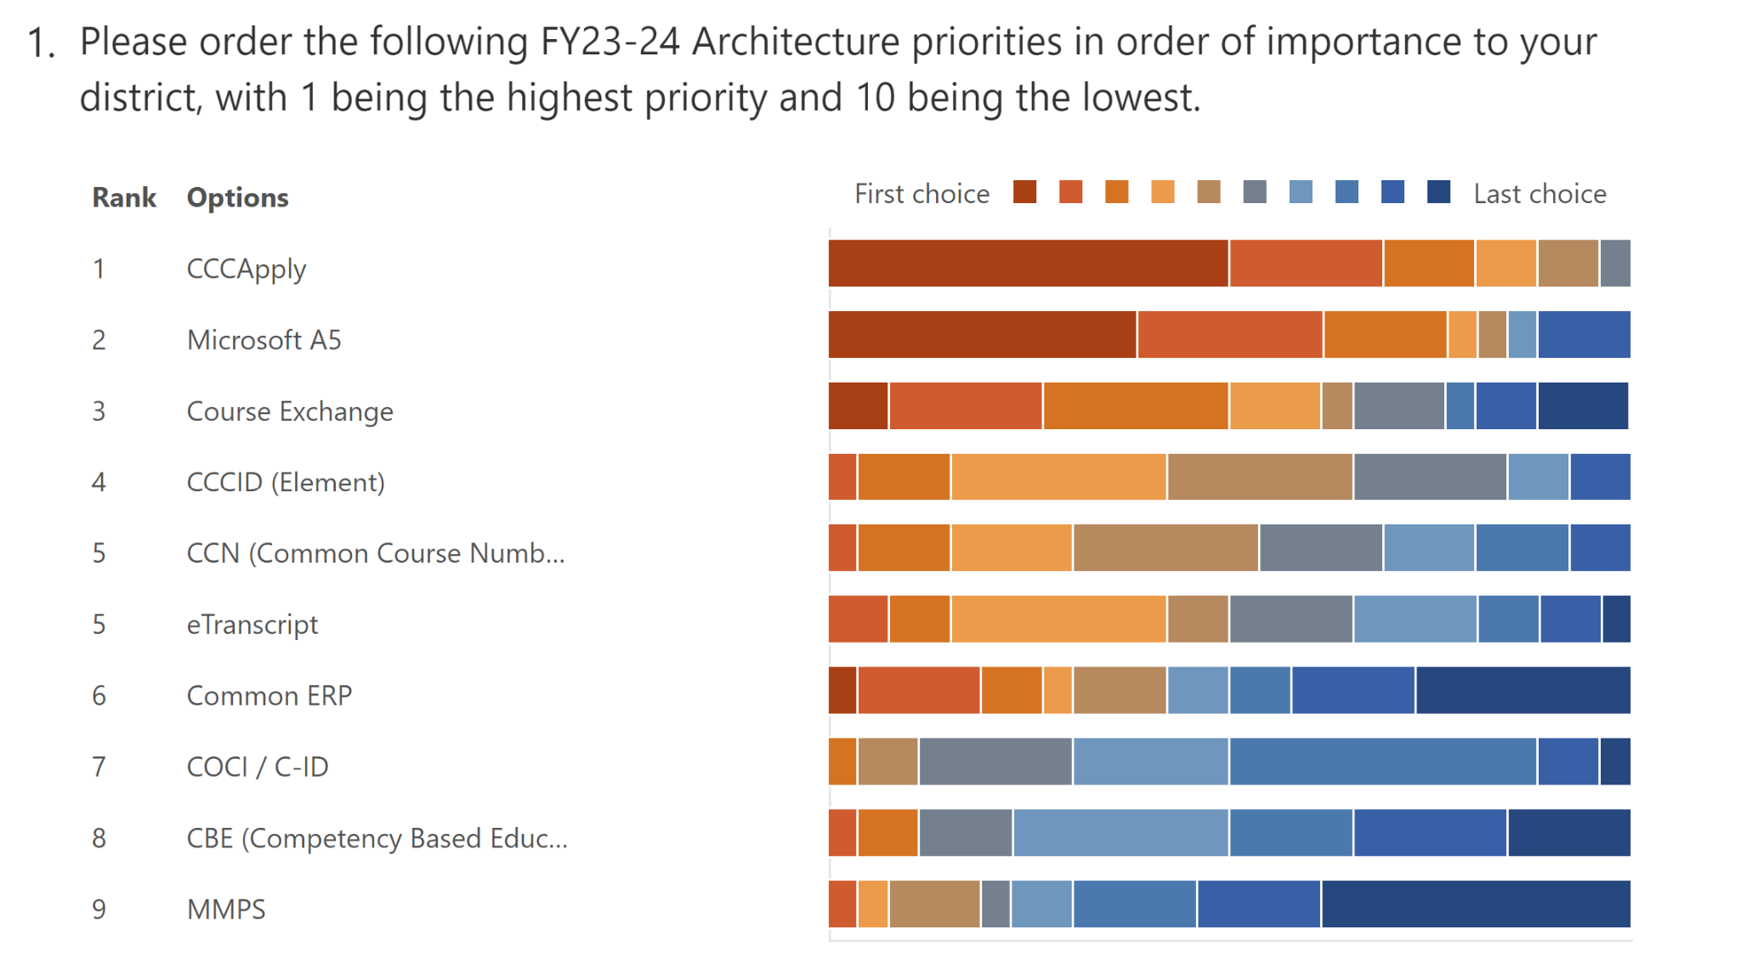
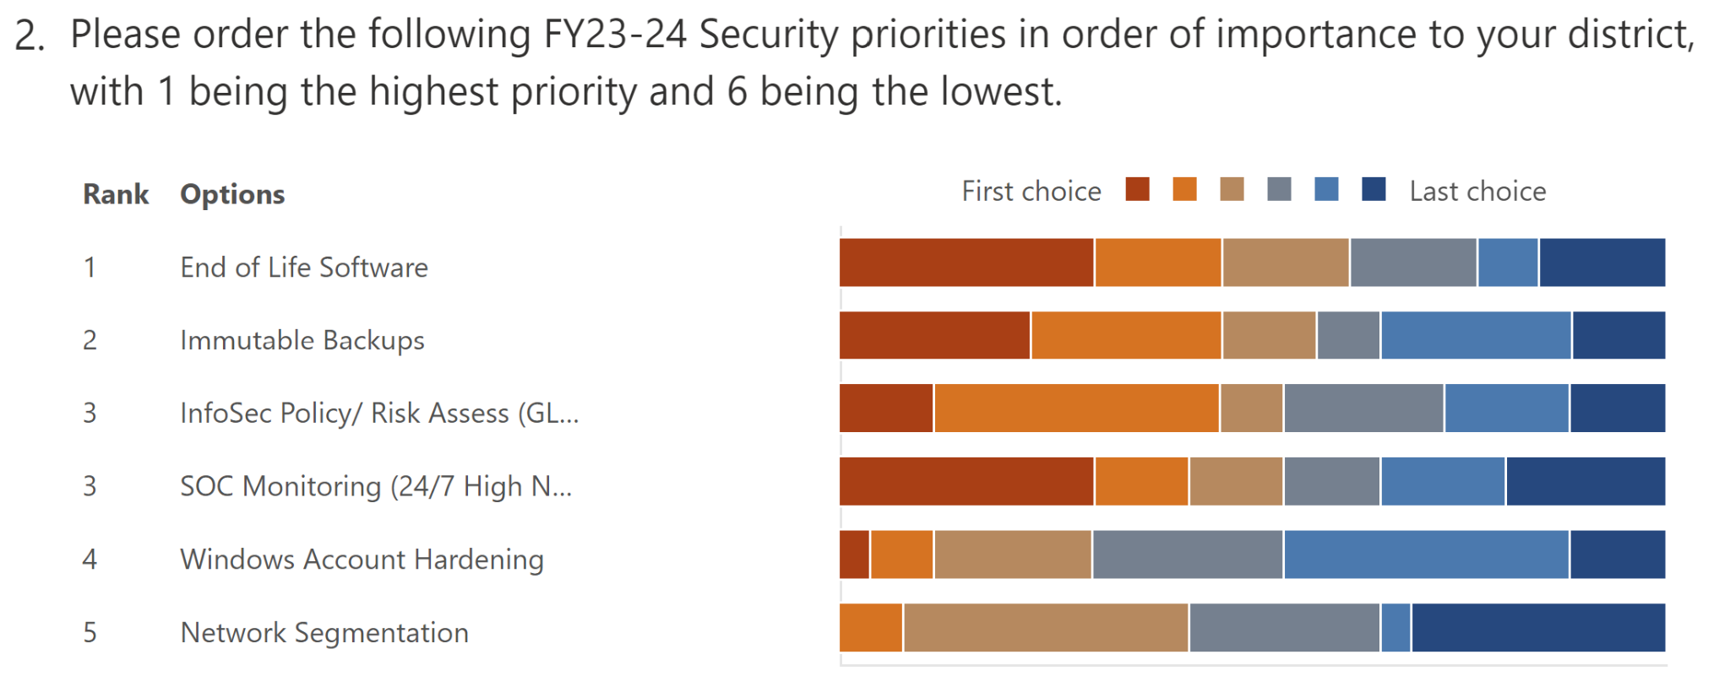
College / District / CISOA Input

Slide 6
Chancellor’s Office - Systemwide Tech Roadmap
CO focus areas
FY23/24 (7/1/23 - 6/30/24)
Eleven specific applications
Phases designated by color
One of many roadmaps
Each grant can have many Apps.

Slide 7
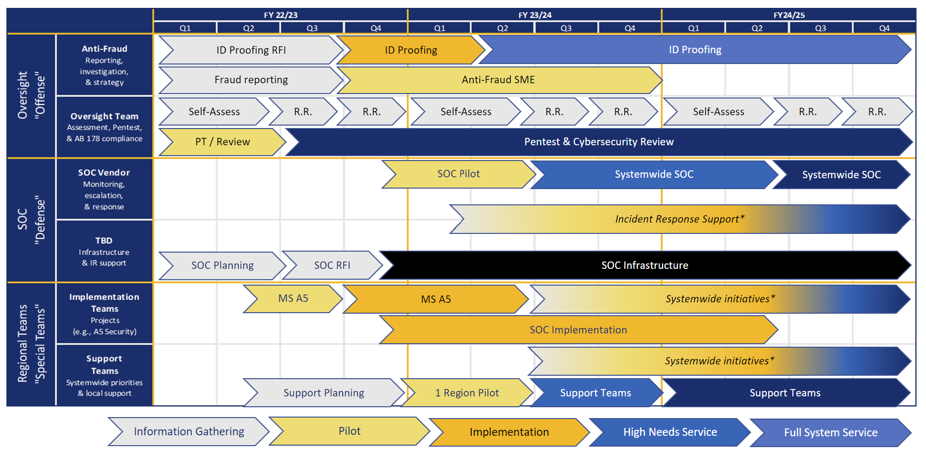
Chancellor’s Office - Systemwide Security Roadmap

Slide 8
CCCID Update
Notes:
Jennifer speaker

Slide 9
CCCIDs for All Students - Update
Process for generating CCCIDs for special populations
  Currently available for one at a time loading, enhancement underway
  Expected in production: spring 2024
  MIS Error Checking will inform future updates
    20% threshold
  Duplicate Handling
Memo with updates = pending approval / distribution
  Timeline Extended

Slide 10
Bi-directional SuperGlue
Notes:
Jennifer speaker

Slide 11
Bi-directional SuperGlue Fraud API
Current adoption stats
  Live: 8 colleges
  Implementation In-progress: 11 colleges
  Signed Up: 6 colleges
Implementation steps / functionality
  Work with the CCCTC Enabling Services team to obtain API account and credentials
  Integrate with the Fraud Data (GraphQL) API
    Install Postman tool and import event collections (optional, but recommended)
    Or set up standard templates in preferred API tool (Python, cURL, Powershell, Ruby, Java, etc.)
  Install the Fraud Report staging table and deploy latest version of College Adaptor to receive a live stream of fraud notifications; or use the GraphQL Fraud Report Query to receive a list of fraud notification
Concerns from the field?
Notes:
continue to have as standing update

Slide 12
ID Proofing / Verification
DEMO by ID.me
Notes:
Jason share/speak - in google drive (not formatted) https://docs.google.com/presentation/d/1Xnr6tLLkwLmmQurGYjGCGKm5ErZ8dlZE/edit#slide=id.p1

Slide 13
Common ERP
Notes:
Jennifer speaker

Slide 14
Common ERP
Task Force Representation - do you know who your representative is?
  CISOA
  Other stakeholder groups
  More information to come

Slide 15
IT / Technology Working Environment
Notes:
Jason speaker

Slide 16
IT / Technology Working Environment
Systemwide Architecture Committee Recommendations / Input
  Review the In Person / or Remote work situations at colleges
  Review thoughts or impacts for Tech leads and architecture
  Discuss flexibility on hiring at the college level
  Change Request Process Input and discussion
Notes:
impact from not having flexibility, accreditation, guidance from CO to identify remote support and services, sharing resources from CO

Slide 17
Change Management
Notes:
Jason speaker

Slide 18
Change Management
Systemwide Architecture Committee Recommendations / Input
  Current Change Management or User Request Process
  Current Approval / Governance process
Is the need met? What support is needed? Is there a SAC recommendation?
Notes:
feature request recommendation

Slide 19
Future Agenda Topics
Notes:
Jennifer speaker

Slide 20
Future Agenda Topics/Reports to Consider
Competency Based Education (CBE) - reports from CISOA rep going forward (Rupinder)?
  Interest / Needed? If so, preferred format - written, etc.?
Others?
  Common Course Numbering
  AI
Notes:
change management- per Jason,

Slide 21
Wrap Up

Slide 22
Closing Comments
Next meeting date: October 19, 2023
  Meeting schedule TBD based on TTAC scheduling
SAC website updated
  TTAC notes available via link from SAC page
Notes:
Jennifer speaker

