Slide 1
Creating Accessible Documents & Web Pages
2017 CCCApply & Electronic Transcript Workshop

Slide 2
What do these schools have in common?
Montana School for the Deaf and Blind
Reed College
Arizona State University
South Carolina Technical College System
University of Montana
Florida State University
Youngstown State University
Atlantic Cape Community College
edX
Harvard University
University of Colorado at Boulder
MIT
Louisiana Tech University
Princeton University
University of Phoenix
Case Western Reserve University
Miami University (Ohio)
College of the Siskiyous
Penn State University
University of California, Berkeley
University of Cincinnati

Slide 3
Significant Events
Americans with Disabilities Amendments Act (2008)
Focus shifted from the individual to how an entity complied with their non-discrimination obligations
Dear Colleague Letter & Updated FAQs (2010 & 2011)
Joint letter from US Dept of Education, Office for Civil Rights and Dept of Justice, Civil Rights Division

Slide 4
Dear Colleague Letter
“It is unacceptable for universities to use emerging technology without insisting that this technology be accessible to all students.”

Slide 5
Section 508 of the Rehabilitation Act
Applies to all Federal agencies when they develop, use, maintain, or procure ICT (ie., DUMP'ed)
Telecommunications products (e.g., telephones), Information kiosks and transaction machines, World Wide Web sites, multimedia, office equipment (e.g., copiers, fax machines), computers, mobile, etc.
California Government Code 7405 adopts the accessibility requirements of the Section 508 standards to state entities
Refreshed 508 Standards now map to WCAG 2.0, Level AA

Slide 6
WCAG 2.0, Level AA
Web Content Accessibility Guidelines 2.0
Defines how to make Web content accessible
Set of guidelines organized around four principles:
Perceivable
Operable
Understandable
Robust

Slide 7
WCAG 2.0 in action
Principle 2: Operable
User interface components and navigation must be operable.
Guideline 2.4 Navigable
Provide ways to help users navigate, find content, and determine where they are.
Success Criteria 2.4.7 Focus Visible
Any keyboard operable user interface has a mode of operation where the keyboard focus indicator is visible. (Level AA)

Slide 8
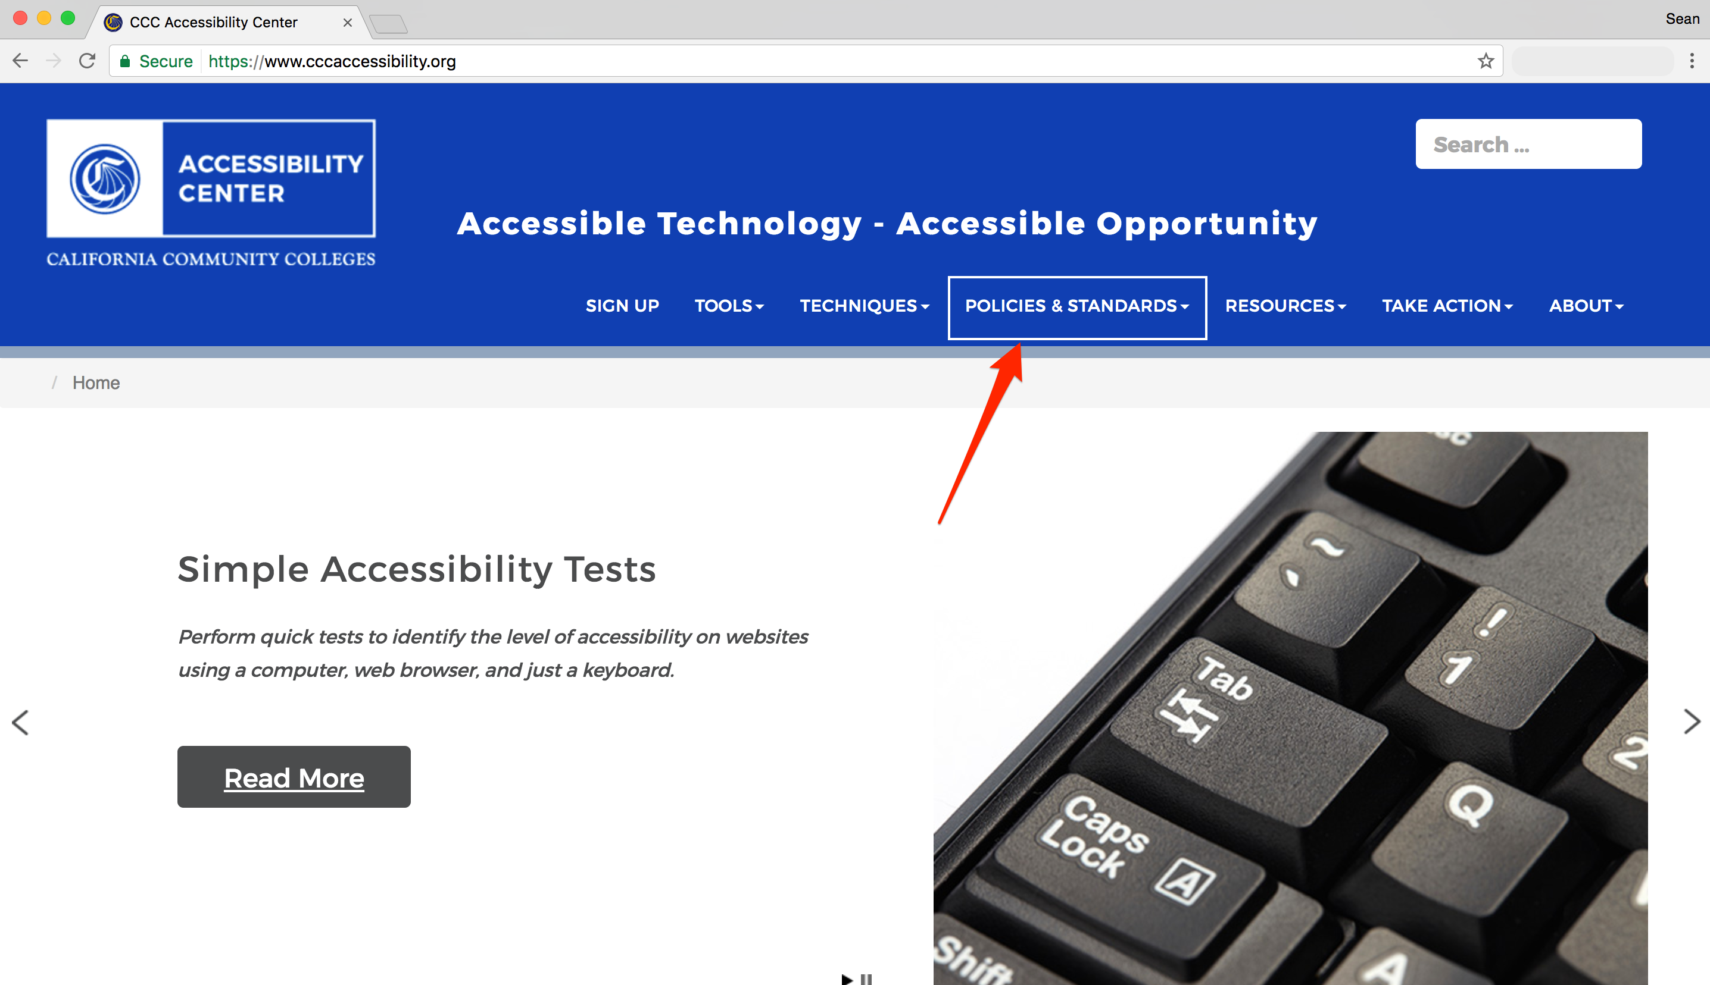

Slide 9
Web Page Accessibility
Teach Access
https://teachaccess.github.io/tutorial/
Provides hands-on sandbox for testing best practices for making web content accessible
Lynda.com
https://prolearningnetwork.cccco.edu/learn/
Available via the Professional Learning Network

Slide 10
Automated Testing
Advantages
Quick assessment of major accessibility issues
Offer a baseline assessment as to what is problematic
Can identify if problems exist in template or content
Limitations
Automated tools identify technical issues, but not functional
Can identify approximately 30-40% of accessibility issues

Slide 11

< img src="…" >

Slide 12
< img src="…" alt="Jar Jar Binks, the most despised character in the Star Wars Universe." >

Slide 13
In-Browser Tools
WAVE
Chrome & Firefox extension
Runs within the browser – no external communication
Checks the rendered page
Provides a <code> view
http://wave.webaim.org/extension/

Slide 14
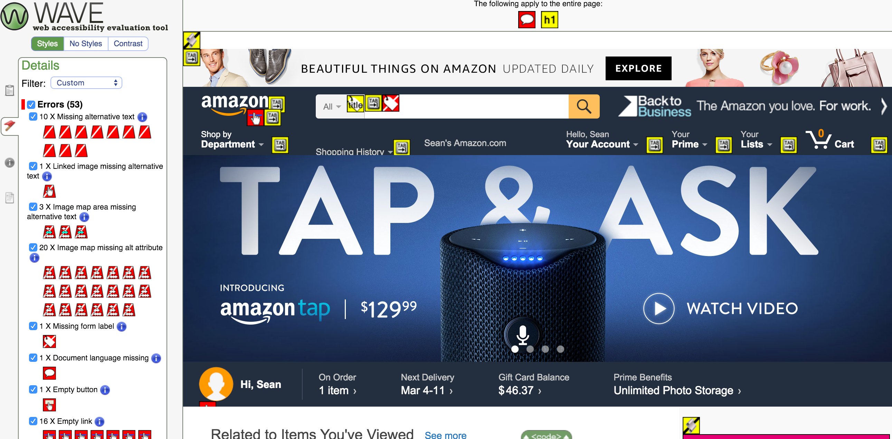

Slide 15
In-Browser Tools
aXe
Chrome & Firefox extension
Runs within the browser – no external communication
Leverages the Dev Tools interface in browser
Checks the rendered page
http://www.deque.com/products/axe/

Slide 16
In-Browser Tools
WCAG Contrast Checker
For Firefox
Evaluates color contrast for single page
Provides eye-dropper to select colors
https://addons.mozilla.org/EN-US/firefox/addon/wcag-contrast-checker/

Slide 17
Honorable Mentions
Colour Contrast Analyser
Free, desktop application for macOS/Win
Pass/Fail assessment against WCAG 2.0 SC
https://www.paciellogroup.com/resources/contrastanalyser/
a11y Tools Extension for Safari
Displays accessibility attributes & issues for macOS
http://pauljadam.com/extension.html

Slide 18
Don't rely on tools alone…
Manual accessibility checks are important
Keyboard navigation
Image descriptions
Flashing/Blinking content
Captions for videos (https://www.youtube.com/watch?v=23H8IdaS3tk)

Slide 19
Document Accessibility
Microsoft Word
https://www.cccaccessibility.org/techniques/
accessible-document-creation
Creating accessible MS Word documents starts with authoring techniques and will lead to more accessible PDFs, braille, etc.
Can run the "Check Accessibility" option to review the content

Slide 20
Document Accessibility
Best Practices for MS Word
Headings
Image Descriptions
Tables for Data
Readable Hyperlinks
Column & Layout Tools

Slide 21
PDF Remediation Tools
Adobe Acrobat
Accessibility Checker and Touch-Up Reading Order Tool
Equidox
Online application for fixing PDF documents for accessibility
Limited licenses coming (very!) soon

Slide 22
Google Docs
GrackleDocs
https://www.grackledocs.com/
Free add-in to Google Docs and Sheets that checks Google-based documents for accessibility issues
Allows for export to accessible PDF (not free, but cheap!)

Slide 23
IT ACCESS Mailing List www.cccaccessibility.org skeegan@ccctechcenter.org

