Slide 1
Information Security Is Everyone's Responsibility
Jeff Holden, CISSP
Information Security Officer
CCC Technology Center

Slide 2
CCC Breaches
Several CCC have had data breaches in the past few years
Riverside Community College District - 5/2014
College of the Desert – 6/2014
San Jose Evergreen District – 12/2016
Solano College – 5/2016
City College of San Francisco – 5/2016
Ohlone Community College District – 8/2016
Palomar College – 1/2017
Los Angeles Valley College – 1/2017

Slide 3
Higher Ed Breaches
The Worse Case
Maricopa Community College District
April 2013
2.4 Million users personal information stolen
Cost 26 Million dollars
Raised Student Tuition
Raised property taxes
Bulk of expense was for legal fees 9.3 million

Slide 4
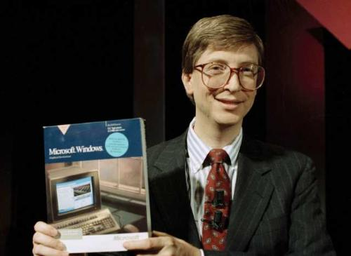
Who are the hackers?

Slide 5
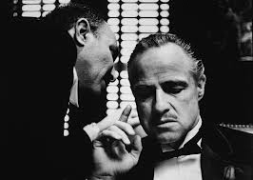
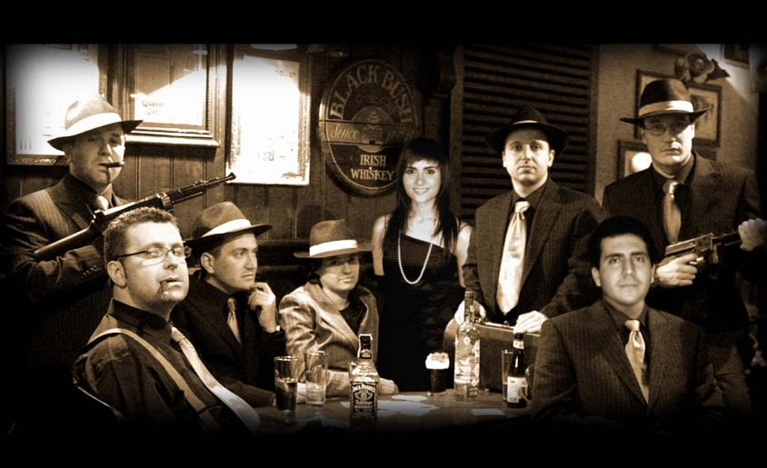
Who are the hackers?

Slide 6
Who are the hackers?

Slide 7
What is the motivation?

Slide 8
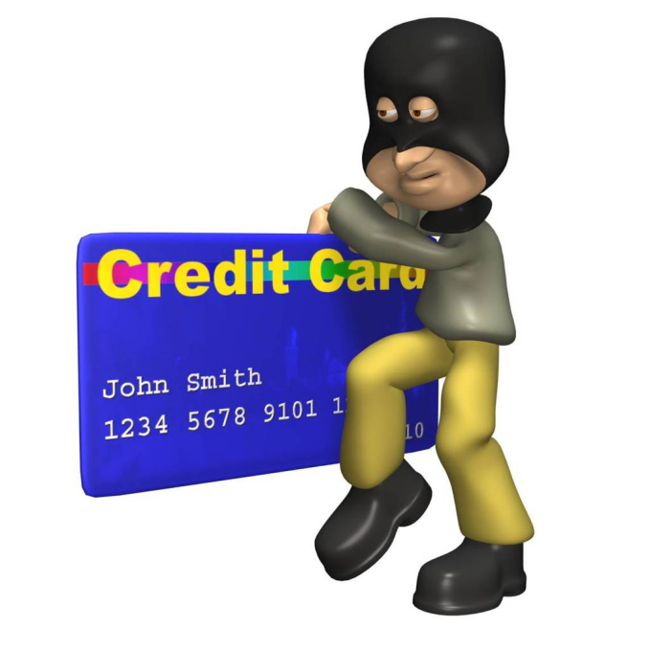
How do they make money?

Slide 9
Why is it easy?
Anti-virus mostly signature based

Slide 10
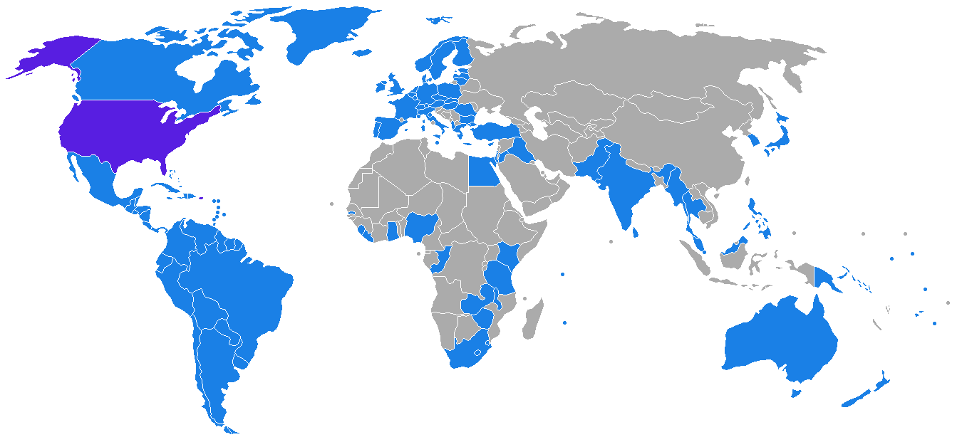
Why is the risk low?
US Extradition Treaties

Slide 11
What is IT doing?
Anti-virus
Firewall
Intrusion prevention systems
Patching
Equipment disposal
Cleaning up infections
Encryption

Slide 12
What can I do?
Illegal software – Don’t install it!!!

Slide 13
What can I do?
Social Engineering
Phishing

Slide 15
ACCOUNT ALERT
Dear Valued Member, According to our terms of services, you will have to confirm your e-mail by the following link, or your account will be suspended for security reasons. http://www.uc.edu/confirm.php?account=d.mich.mal@uc.edu After following the instructions in the sheet, your account will not be interrupted and will continue as normal. Thanks for your attention to this request. We apologize for any inconvenience. Sincerely, Uc Abuse Department
http://www.nbmd.cn/Confirmation_Sheet.pif
Notes:
This is a “Spear Fishing” email. A phishing attack specifically targeted to a limited audience, thus making it seem more legitimate.
If you HOVER your mouse over the link (DO NOT CLICK!), you will see the real URL show up as a floating box (in Outlook) or in the lower left-hand corner (in a web browser).
The link above goes to nbmd.com NOT uc.edu
A good general rule for email: If the shown URL and real URL do not match, be suspicious.

Slide 16
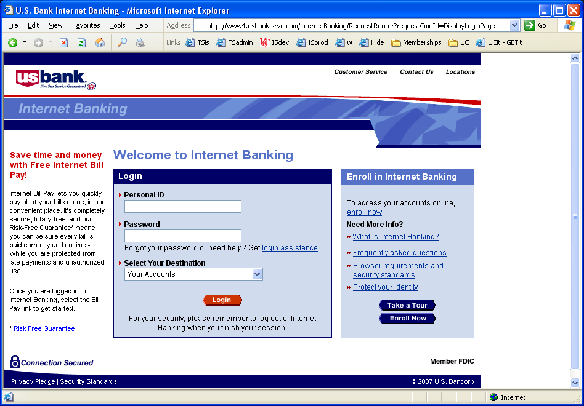
Good Site or Bad?
Notes:
This one is bad.
Note that the URL is actually owned by srvc.com NOT usbank.com
Note too that there is no padlock icon and the URL is not https. This means that this is not a secure connection. Never do financial business on an unsecure web site.

Slide 17
Good Site or Bad?
Notes:
This one is good. Note the padlock and that the URL is usbank.com

Slide 18
Best Practices
Don’t click on links in emails
Go directly to the page
Never send private information such as SSNs over email EVER!!!!
Don’t open attachments that you are not expecting
Don’t enable macros

Slide 19
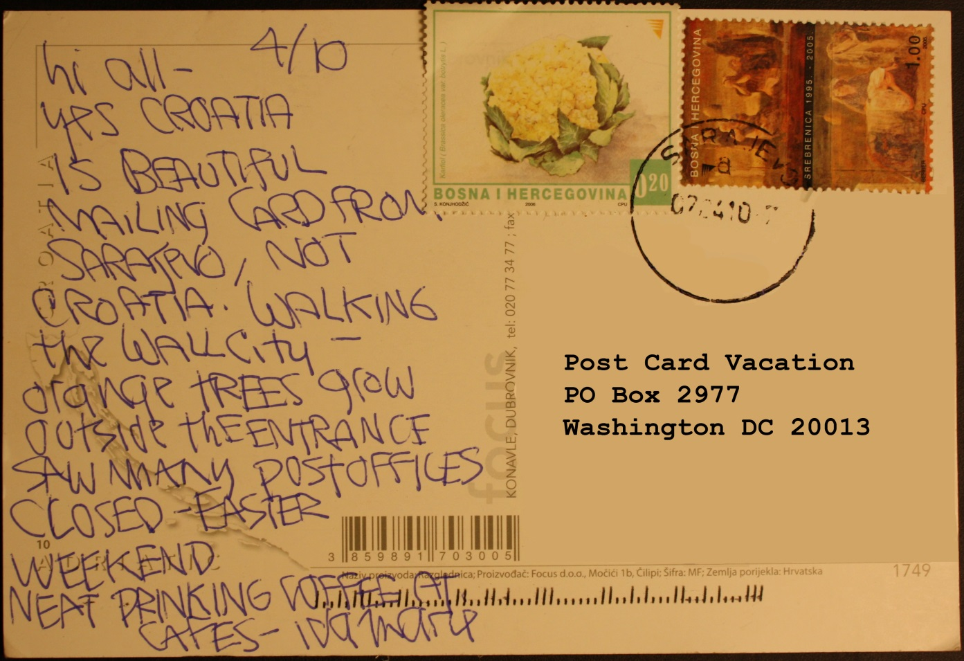
What can I do?
Email

Slide 20
What can I do?
Found media

Slide 21
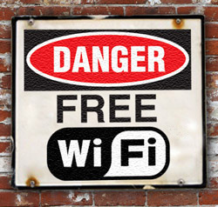
What can I do?
Free WiFi

Slide 22
Free WiFi
Open Wifi has no base encryption
Snooping
Man in the middle
DHCP poisoning
Use a VPN that tunnels all of your traffic

Slide 23
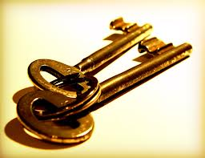
Other best practices?
Password management

Slide 24
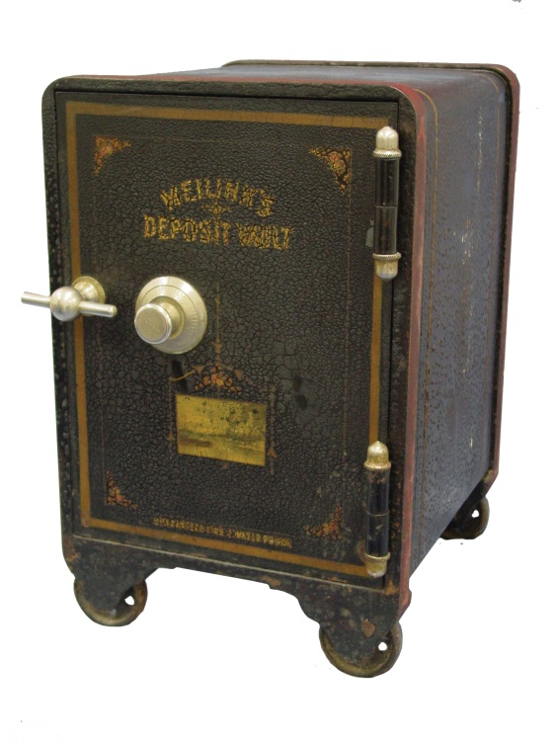
Other best practices?
Password management

Slide 25
Other best practices?
Don’t share accounts
Don’t store sensitive data on removable media
Lock your computer
Delete unneeded data
Lock up printouts with private information on it
Report strange behavior to IT

Slide 26
Traditional Information Security approach
Little to no Information Security Awareness
Firewalls
Logging
Staff
IDS
SSL
Antivirus
Authentication
Notes:
This slide is used to visualize the human risk to your organization. Most organizations provide multiple layers of defense in depth, usually technologies such as firewalls, anti-virus, authentication and IDS. Yet cyber attackers can easily bypass these defensive layers by targeting employees, using techniques such as phishing, drive-by downloads, social engineering phone calls, Trojaned apps or infected USB sticks.
The purpose of this slide is to demonstrate that no matter how much your organization invests in security technology, unless people are trained it will continue to be vulnerable to human based attacks

Slide 27
Take Security Awareness Training
Free training for all California Community College staff
https://www.cccsecuritycenter.org/services/awareness-training

Slide 28
Questions or Comments?
Jholden@ccctechcenter.org

