Slide 1
BOG Fee Waiver Application 2017-2018 Implementation & QA Session
CCCApply 2017 Annual Workshop
April 12, 2017 | Sacramento City College
Notes:
https://pilot.bog.opencccapply.net/gateway/bog?cccMisCode=ZZ3

Slide 2
Online BOG Fee Waiver Application
Board of Governor’s Fee Waiver Application
Owned by the CCC Chancellor’s Office
Governed by CCCApply Steering Committee
Developed by the CCC Technology Center

Slide 3
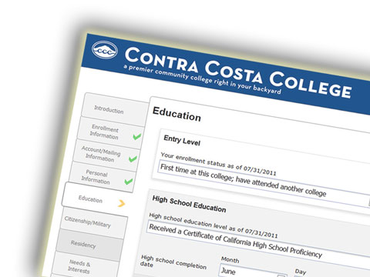
Applications
CCCApply Standard Application (Residency)
International Application (No residency)
BOG Fee Waiver Application (Financial Aid)

Slide 4
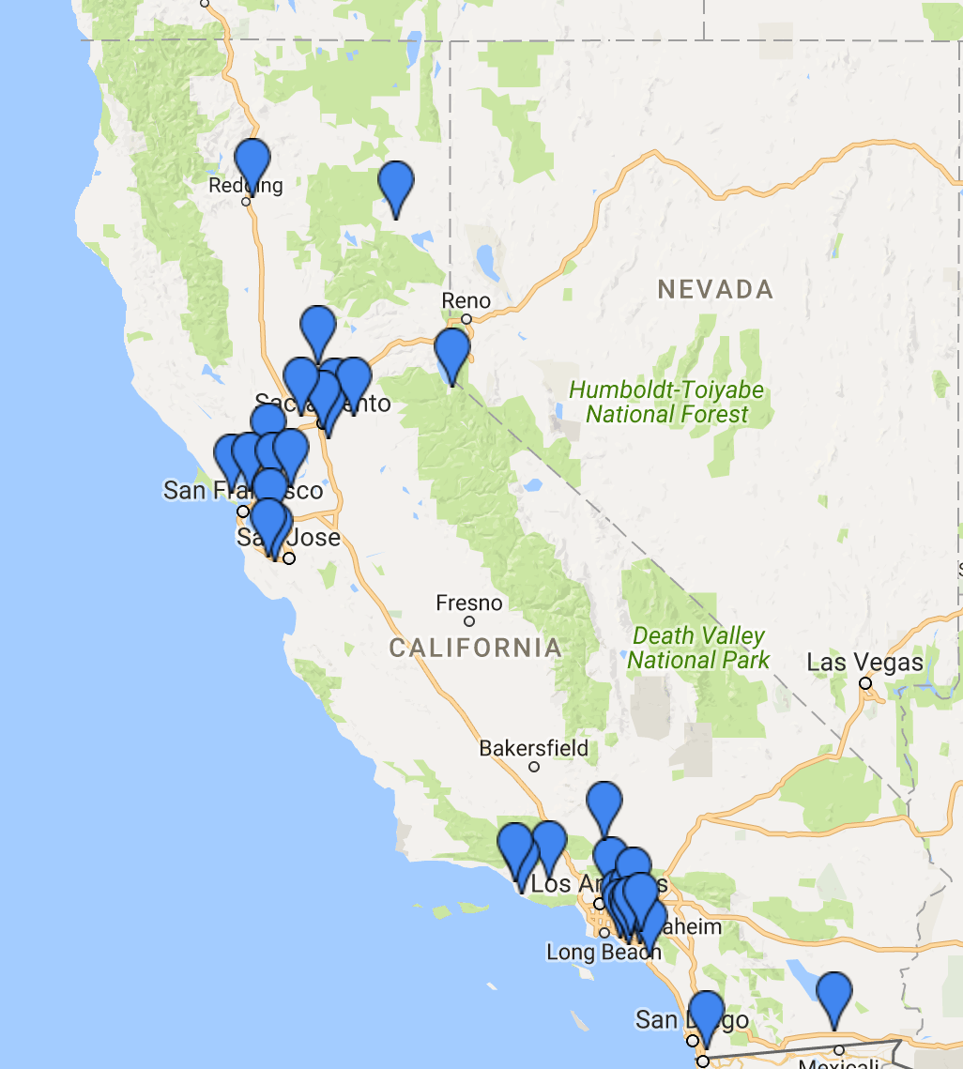
BOG Adoption
Launched BOG App in 2014
21 Colleges Live by 2015
34 Colleges Live as of Today
Adoption Growth Forecast
2017-2019 Objective for Legacy App: Grow adoption by 25%
2019-2021 Growth Objective for New BOG: Grow adoption by 75%

Slide 5
User Stats
Standard App: 5,337,155
International App: 492
BOG Application: 319,798
OpenCCC CCCIDs: 3,917,978

Slide 6
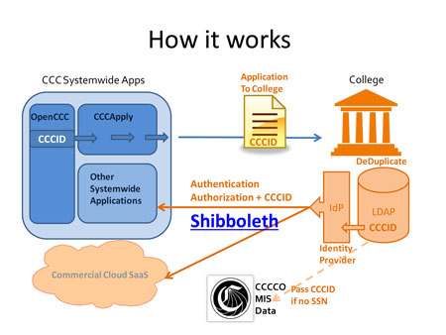
BOG Admin Tools
CCCApply Administrator SSO Authentication
CCC Report Center Jasper Reports
Downloads
Pilot Environment
BOG App
BOG

Slide 7
OpenCCC Account - CCCID
Statewide Federated Identity Initiative
Generates unique student identifier = CCCID
Sits in front of the BOG Fee Waiver
Catches duplicate accounts & applications
Future MIS Data Integration
Supports CCCCO research & student services
Private
Secure
Convenient
Easy to manage

Slide 8
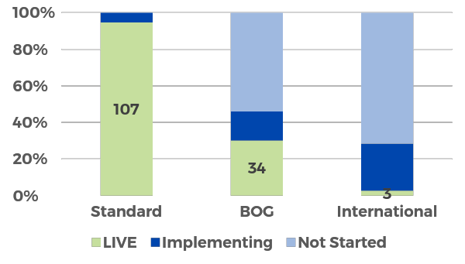
Implementation
Final 6 colleges working on Application
11 colleges working on BOG
International new and topic of discussion

Slide 9
CCCApply & BOG History: A New Beginning…
OpenCCCApply Goes Live 2012
Master contract with Xap Corporation expires, allowing CCCCO to develop new version of CCCApply & BOG.
2017
2016
CCC E-Application
2014
First electronic admissions app developed by the Xap Corporation
2012
The CCCID is launched
The OpenCCC federated identity initiative is released; sits in front of new version of the application to college: OpenCCCApply
2000

Slide 10
History: BOG Fee Waiver Application
Sept 2014
New BOG Fee Waiver Applications is released. 18 colleges go live in the first three months. Colleges migrated from Xap BOG App.
2017
2016
2014
2012
Chancellor’s Office BOG
The online BOG Fee Waiver application is based on the annually-approved paper application and the financial aid year cycle.
2000

Slide 11
Today: BOG Maintenance Mode
2017-2018 BOG Application
2017
2016
2014
2012
Tech Center goes to RFP to enhance New CCCApply & BOG Versions
Meanwhile, CCC Tech Center goes to RFP to enhance CCCApply with new mobile version for multiple languages.
2000

Slide 12
2017 Annual Update & 2017 - 2018 BOG Application Release
Production Release: March 31, 2017
Maintenance window 6:00PM – 11:00PM
Students are notified on www.cccapply.org
Colleges are notified on www.ccctechnology.info
CCC Help Desk monitoring calls and emails

Slide 13
2017 Annual Update 2017-2018 BOG Fee Waiver Application
Now Available! Preview in Pilot Environment
New questions, logic & downloadable data fields for Homeless Youth (AB 801)
New BOG Eligibility algorithm: Method D (based on Yes response to AB 801)
Standard annual updates to BOG Fee Waiver based on CCCCO approved paper app
Update to Method B Income Table (using 2015 Income for second year)
Dates fields updated; text updates
Notes:
Board of Governor’s enrollment fee waiver for all California Community Colleges

Slide 14
2017-2018 BOG Application New Fields for Homeless Youth – AB 801
Identifies homeless youth under 25 for enrollment fee waiver
New Questions, Logic & Downloadable Data Fields in All Applications
OpenCCC Account: New checkbox for “No Permanent Address”
All Applications: New checkbox for “No Current Mailing Address”
BOG Fee Waiver Application: New Y/N question “Pre-Determined Homeless”
All new AB 801 fields are downloadable

Slide 15
AB 801 in OpenCCC Account “No Permanent Address Homeless” Checkbox
New Questions, Logic & Downloadable Data Fields
Checkbox for “No Permanent Address – Homeless”
IF ”Yes” – removed validation
IF “Yes” – Defaults Yes on residency question

Slide 16
New Question on Application Year Page AB 801 in BOG Fee Waiver Application
Identified homeless youth under 25 for Financial Aid eligibility
New residency section question = “Determined Homeless”
Triggers skip logic to Consent & Submit
New BOG Method D eligibility logic
Downloadable field

Slide 17
New Question on Application Year Page AB 801 in BOG Fee Waiver Application
New question only appears if applicant is under 25 years of age
New residency section question = “Determined Homeless”
If “Yes” - Triggers skip logic to Consent & Submit

Slide 18
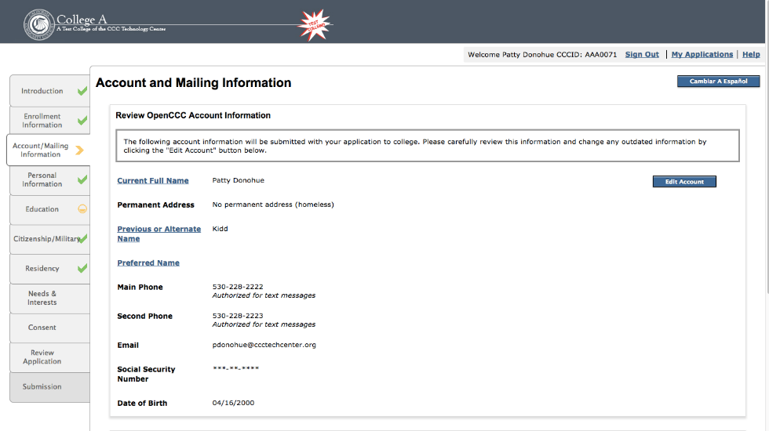
AB 801 in All Applications “No Current Mailing Address” Checkbox
Appears in Account & Mailing Information page summary
Appears on Review Application page & Submitted App PDF
New ”No Current Mailing Address” checkbox question & data field

Slide 19
BOG Implementation Project
No Supplemental Questions to set up
No Terms, No Majors,
No extra server restarts for branding
No new learning curve for setting up Rules
Uses same URLs to Report Center & Administrator
Takes less time & fewer resources than
setting up the Standard Application
Notes:
BOG Data Fields

Slide 20
BOG Implementation Project
Shibboleth IdP is already setup for authentication
Download Client is already installed
Portal branding image is already in place
Use the same URLs to Administrator & Report Center
Contract/MOU already completed
Applications can be exported from Report Center immediately
These tasks are already completed!

Slide 21
2017 – 2018
New Administrator 2.0
Roadmap
New CCC Administrator for all CCC Applications
Spring Boot / ReAct technology
Mobile-device friendly
Enhanced functionality for BOG applications (Toggle BOG Year on/off)
Centralized SSO Authentication
Release September 2017
Notes:
Research Projects
Future: CCC Report Center Upgrade
Research Projects

Slide 22
2018 – 2019
New BOG Application
Roadmap
Universal Form Builder
Multiple Languages
Mobile device friendly design
WCAG 2.0 AA accessible design
Integration with Project Glue
Universal Form Builder Technology
Skip logic for Method A – D
Phased integrated with MyPath
Start development on BOG 2018
Intuitive Skip Logic based on BOG eligibility algorithms
Integration with Project Glue
Universal Form Builder Technology
Skip logic for Method A – D
Phased integrated with MyPath

Slide 23
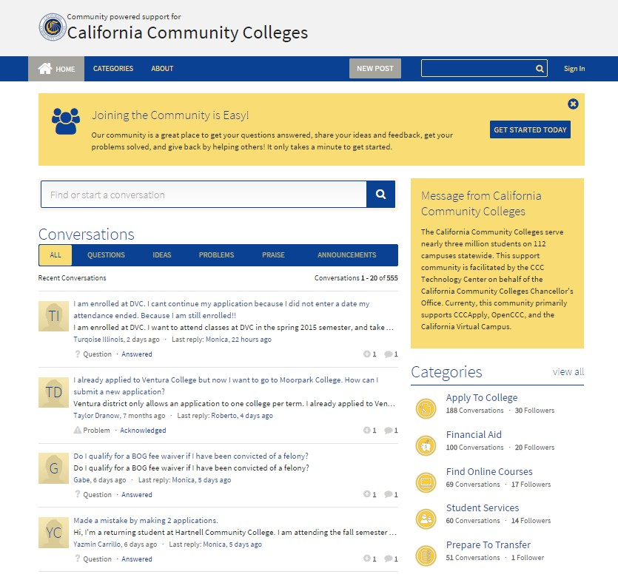
CCCHelp.info
•
•
•
•
Notes:
OpenCCC Helpdesk - Xerox Rep Mon- Sunday 7AM - Midnight
Online HELP - community-sourced help also manned by CCC Tech Center support team.

Slide 24
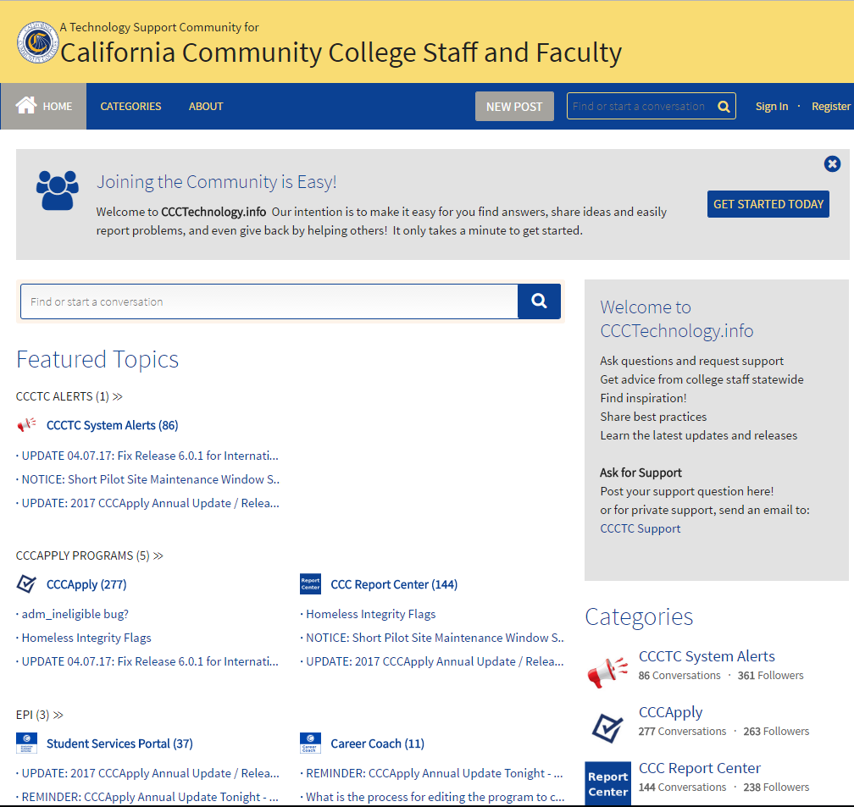
www.CCCTechnology.info
Ask questions and request support
Get advice from college staff statewide
Find inspiration!
Share best practices
Learn the latest updates and releases
for private support, send an email to: CCCTC Support

Slide 25
Thank you!
Contact:
Bryan Dickason
Specialist – Student Financial Aid
CCC Chancellor's Office
916-323-5952
bdickason@cccco.edu

