Slide 1
Meta-majors, Guided Pathways & CCCApply
Michelle Pena & Craig Hayward
CCCApply Steering Committee
Chancellor’s Office
Sacramento
8/30/17

Slide 2
When do we ask students to pick a major or program of study?
When students enter CCCApply, the second thing they are asked to do is to indicate their "Intended major or program of study”
How many programs do you think are in a typical drop-down list that students must choose from?
Notes:
How confident are students in their major choice?

Slide 3
Education goal
One in three students said that they wanted to change their Ed Goal
When students changed their education goal, they tend to “shift up”
21% changed from a non-transfer goal to a transfer goal while only 7% shifted from a transfer goal to a non-transfer goal.

Slide 4
First Screen of Majors

Slide 5
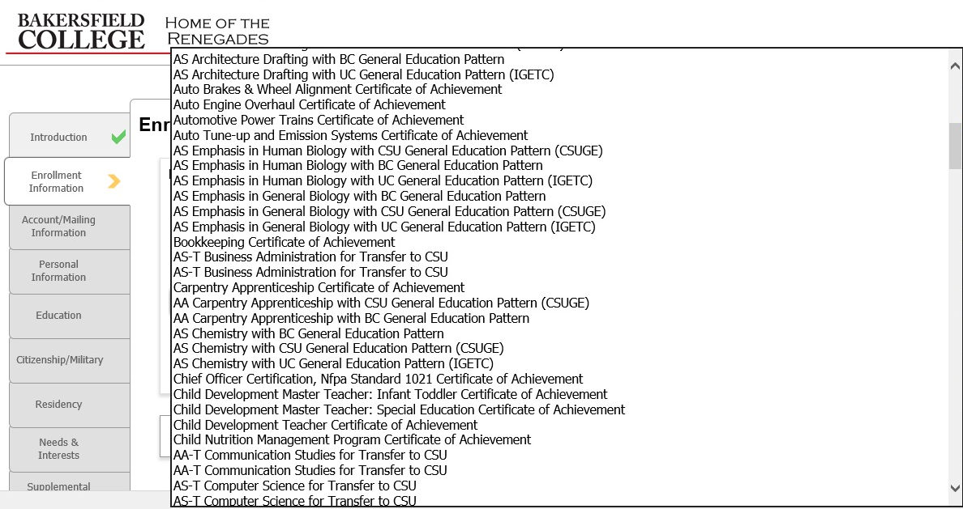
Second Screen of Majors

Slide 6
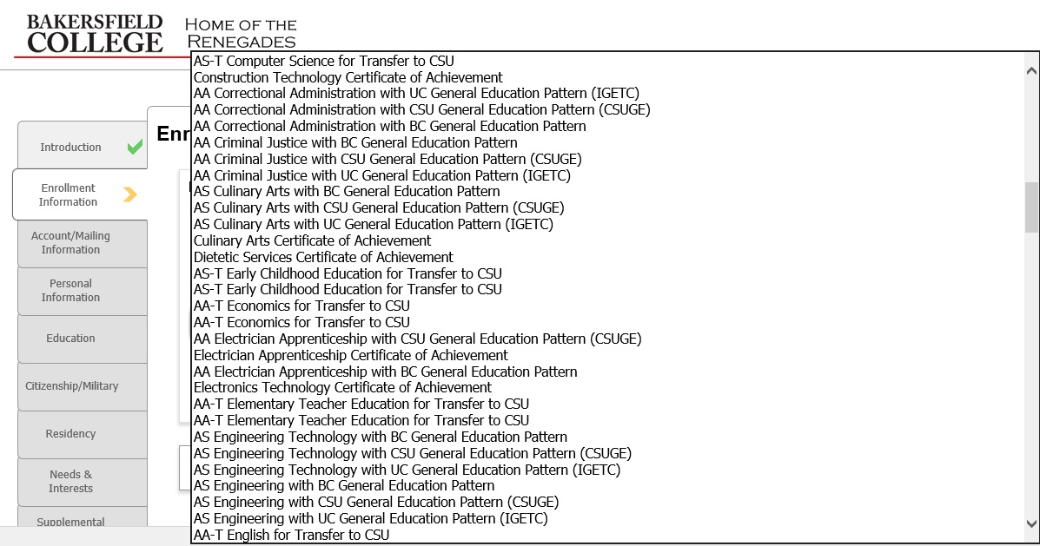
Third Screen of Majors

Slide 7
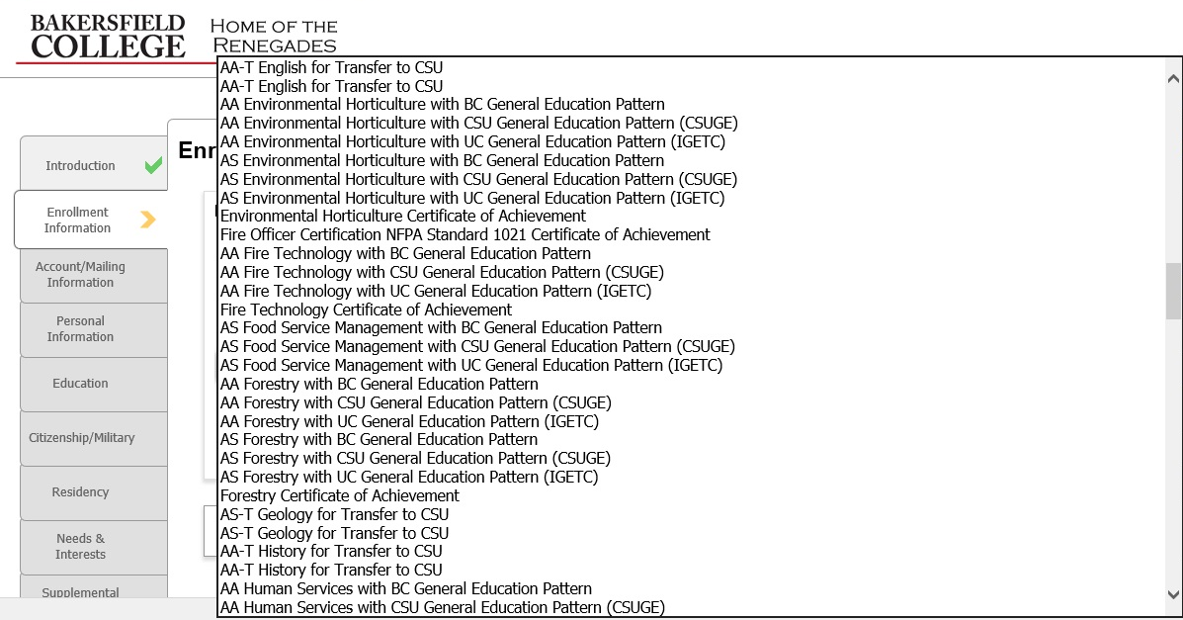
Fourth Screen of Majors

Slide 8
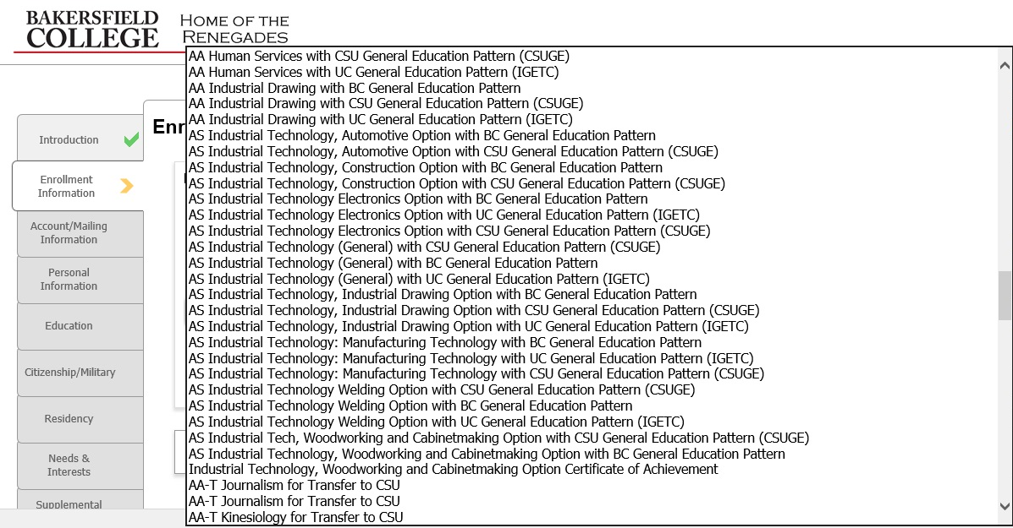
Fifth Screen of Majors

Slide 9
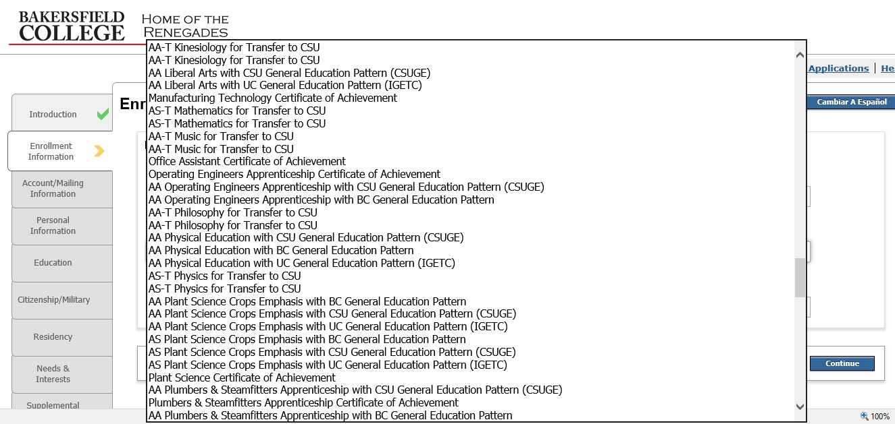
Sixth Screen of Majors

Slide 10
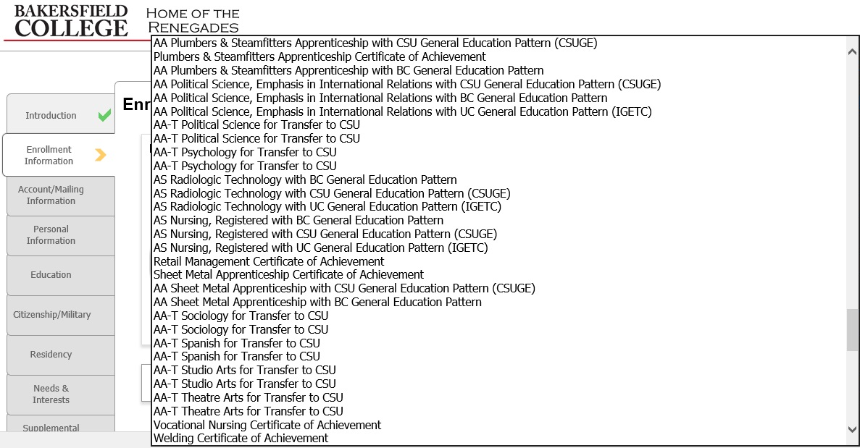
Seventh Screen of Majors

Slide 11
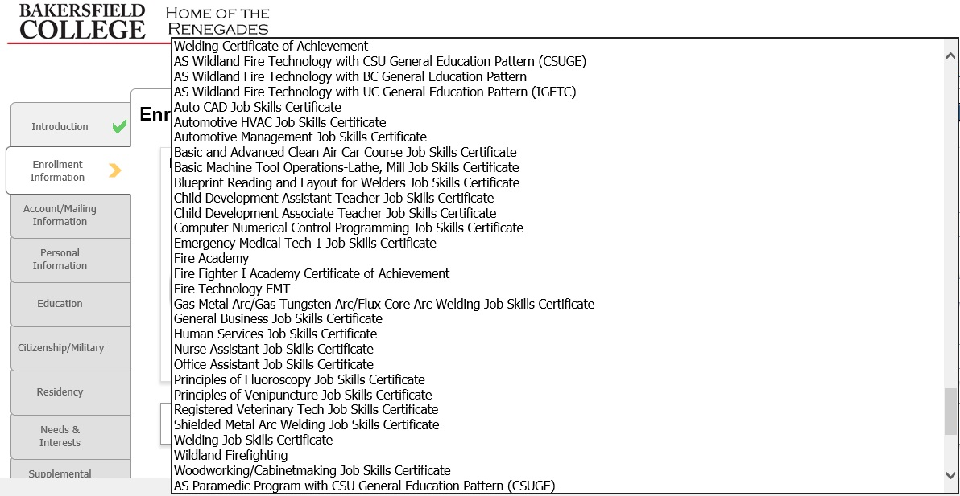
Eighth Screen of Majors

Slide 12
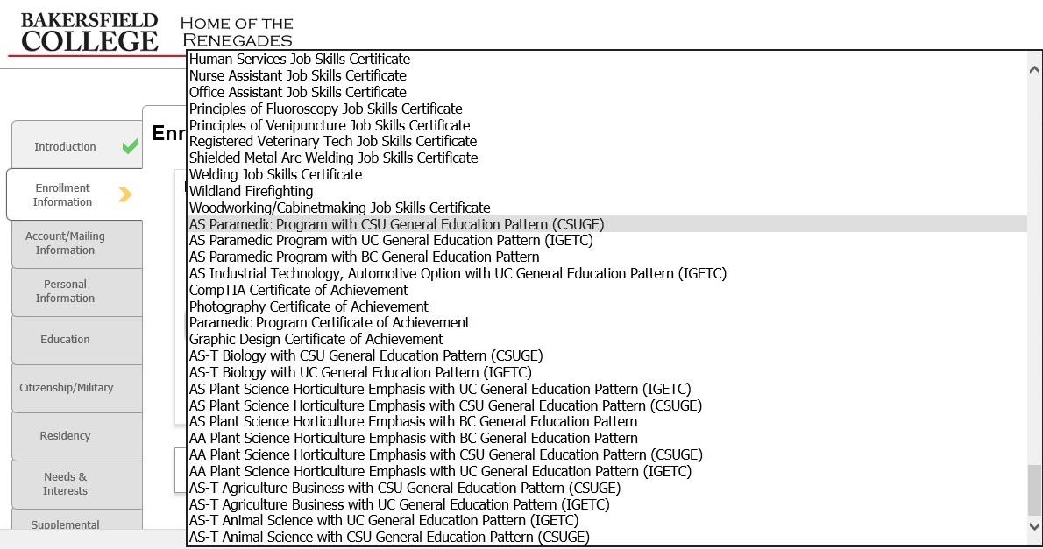
Ninth Screen of Majors

Slide 13
Answer: Lots and LOTS!
In this example there were 9 screens of majors and 251 major choices
Are students able to successfully navigate this interface?
Notes:
120 first-time students in Fall 2017 chose a discontinued major; 33 chose a major that only exists at PC or CC

Slide 14
2017 Major Confidence Survey
Survey of students enrolled in Summer 2017
Faculty administered survey to 701 students across 31 class sections
Students represent a cross-section of all students (not just first-time students)
Students were asked “How confident are you in your major?”
One out of four students were not confident in their choice of major
40% of students said that they wanted to change their major
Notes:
40% of students wanted to change their major (424/710). 43% of Summer Bridge students indicated that they needed to change their major.

Slide 15
Pathways to the rescue!
Agriculture, Nutrition and Culinary Arts
Business
Arts & Humanities
Education
Health Sciences
Industrial and Transportation Tech
Public Safety
Behavioral and Social Sciences
Science, Technology, Engineering, and Math
Personal and Career Exploration
Notes:
Just ten pathways to choose from

Slide 16
What is a meta-major?
A meta-major is a broad category of study comprising a cluster of related programs that have similar courses and themes and that lead to related careers.
The purpose is help students make an initial selection of an area of interest which will lead them into a program of study. With the most institutions offering more than 100 programs, students may be overwhelmed by the options.

Slide 17
Mock-up of a Meta-Major Interface
Pathway Groups

Slide 18
http://www.bmoseley.com/cccapply/

